Slide 1
Inquiry Project
What is Inquiry?

Slide 2
Inquiry Projects vs Traditional Research Projects
Inquiry Projects
Typically, teachers provide an overarching theme but students decide on the direction of the project (flexible choice)
Students develop inquiry questions that lead to deeper investigation of the content
Typically, high level of personal connection for the students
Emphasis on the process
Reflection is part of the process
Share findings with teacher and classmates
Teachers provide the topics for students to select (limited choice)
Content driven
Students are to demonstrate their knowledge of the selected topic
Emphasis on the product
Typically, low level of personal connection for the students
Research Projects

Slide 3
Student-Centred Learning
Inquiry

Slide 4
Points of Inquiry

Slide 5
Brainstorming

Slide 6
Notes:
LAW 12 – Develop two questions –
**This takes time!
Research your idea…what information is out there for your topic?
Review, reflect, discuss…then start refining your ideas and develop your questions

Slide 7
Collecting Information
Researching
Notes:
locate, access, assess, understand, synthesize and evaluate information

Slide 8
Notes:
APA 6 citation for Law 12
APA for social science courses – emphasis on the date a work was created
In-text citation ex. (King, 2014)
References List (at the end the paper in alphabetical order by author
-author, date, title, publication & retrieval information

Slide 9
Sharing
Your
presentation

Slide 10
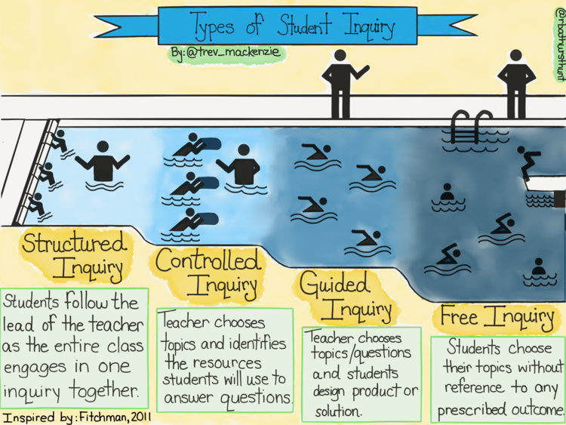

Slide 11
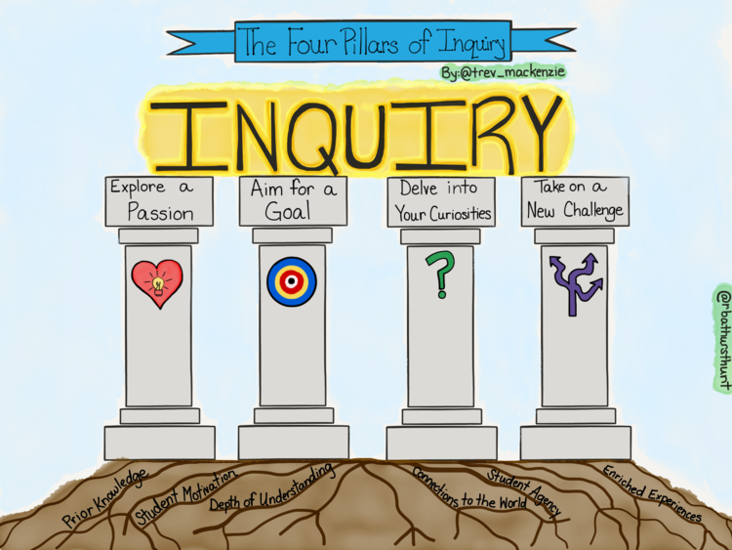
WHAT IS THE REASON BEHIND YOUR INQUIRY?

Slide 12
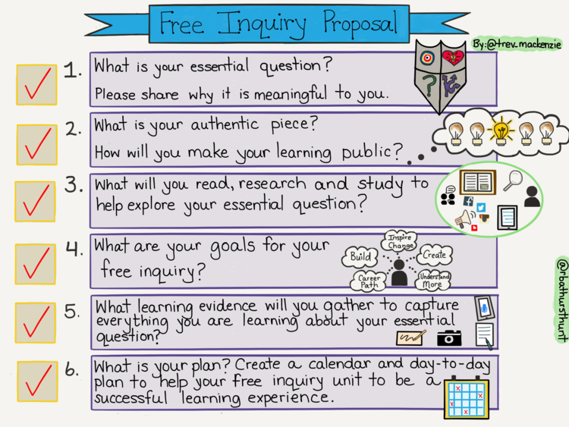
Sharing

Slide 13
