Slide 1
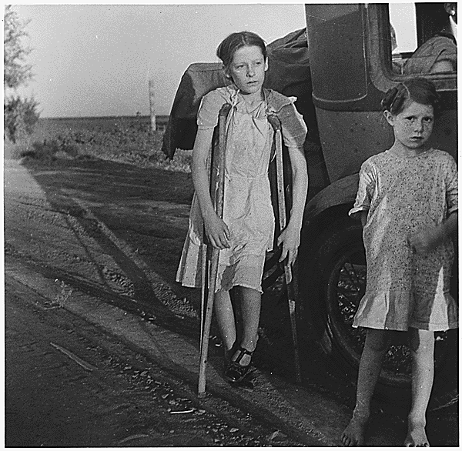
Children of Oklahoma drought refugees near Bakersfield, California. (Circa June 1935)

Slide 2
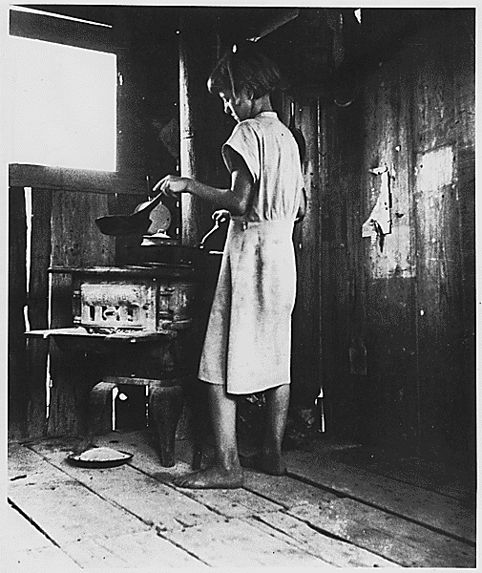
"Suppertime" for the westward migration. (Circa 1936)

Slide 3
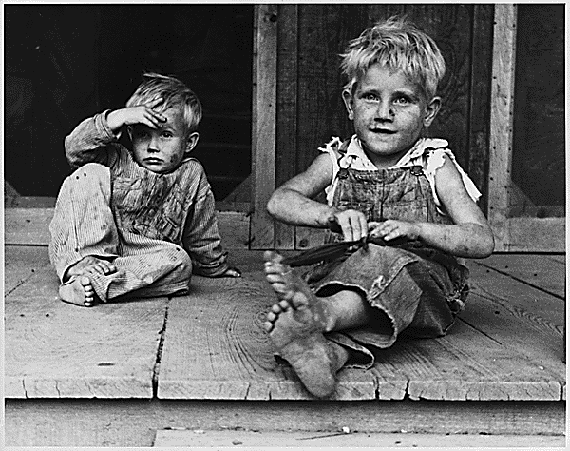
Children of rehabilitation clinic in Arkansas. (Circa 1935)

Slide 4
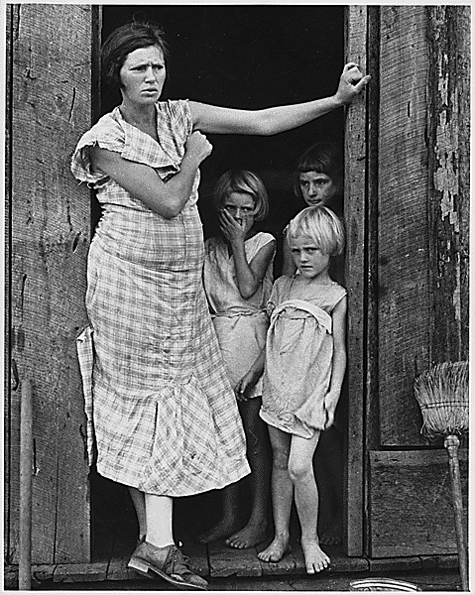
Wife and children of a sharecropper in Washington County, Arkansas. (Circa 1935)

Slide 5
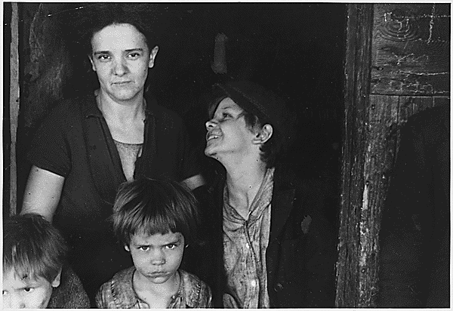
Family of coal miner in West Virginia. (Circa 1935)

Slide 6
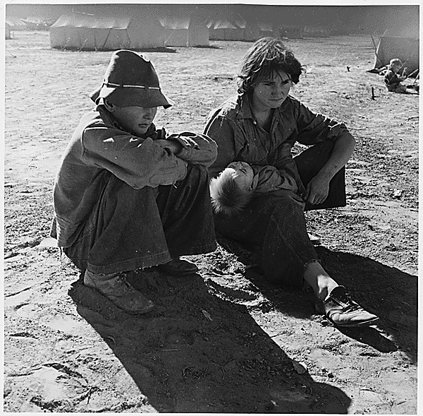
Young Oklahoma mother; age 18, penniless, stranded in Imperial Valley, California. (Circa March 1937)

Slide 7
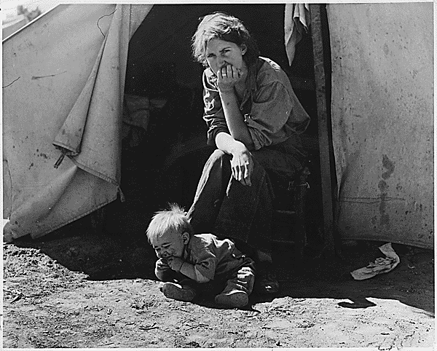
18-year old mother from Oklahoma now a California migrant. (Circa March 1937)

Slide 8
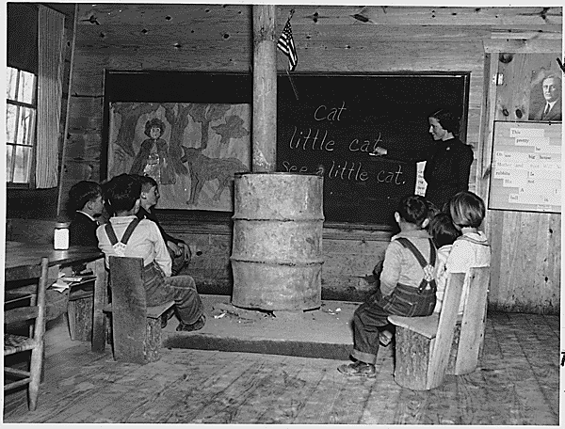
School in Alabama. (Circa 1935)

Slide 9
School in Alabama. (Circa 1935)

Slide 10
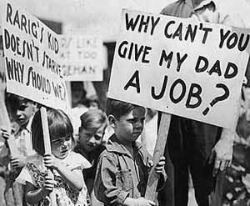
Kids protest in Alabama (circa 1935)

Slide 11
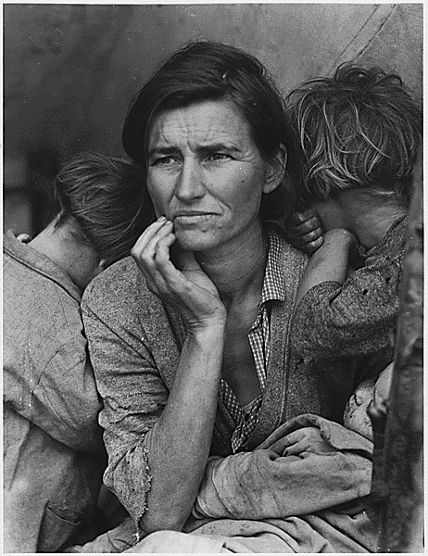
Destitute pea pickers in California. Mother of seven children. (Circa February 1936)
Notes:
Florence Owens Thompson was born Florence Leona Christie on Sept. 1, 1903, in Indian Territory, Oklahoma. Her father, Jackson Christie, had abandoned her mother, Mary Jane Cobb, before Florence was born, and her mother remarried Charles Akman (of Choctaw descent) in spring, 1905. The family lived on a small farm in Indian Territory outside of Tahlequah, Oklahoma.
17 year-old Florence married Cleo Owens (a 23 year-old farmer's son from Stone County, Mississippi) on February 14, 1921. They soon had their first daughter, Violet, followed by a second daughter, Viola, and a son, Leroy. The family migrated west with other Owens' relatives to Oroville, California where they worked in the saw mills and on the farms of the Sacramento Valley. By 1931, Florence was pregnant with her sixth child when her husband Cleo died of tuberculosis. Florence subsequently worked in the fields and in restaurants to support her six children. In 1933 Florence had another child, returned to Oklahoma for a time, and then was joined by her parents as they migrated to Shafter, California north of Bakersfield. There Florence met Jim Hill, with whom she had three more children. During the 1930s the family worked as migrant farm workers following the crops in California, and sometimes into Arizona. Florence would later recall times in which she would pick 400-500 pounds of cotton from first daylight until after it was too dark to work. She added, “I worked in hospitals. I tended bar. I cooked. I worked in the fields. I done a little bit of everything to make a living for my kids.”
The family settled in Modesto, California in 1945. Well after World War II, Florence met and married hospital administrator George Thompson, which, compared to the previous years of toil, brought more security
While Thompson's identity was not known for over forty years after the photos were taken, the images became famous. The sixth image especially, which later became known as Migrant Mother, "has achieved near mythical status, symbolizing, if not defining, an entire era in [United States] history."
Lange was funded by the federal government when she took the picture, so the image was in the public domain and Lange never directly received any royalties. However, the picture did ultimately make Lange a celebrity and earned her "respect from her colleagues".
In an interview with CNN, Thompson's daughter, Katherine McIntosh, recalled how her mother was a "very strong lady", and "the backbone of our family". She said that "We never had a lot, but she always made sure we had something. She didn't eat sometimes, but she made sure us children ate. That's one thing she did do."

Slide 12
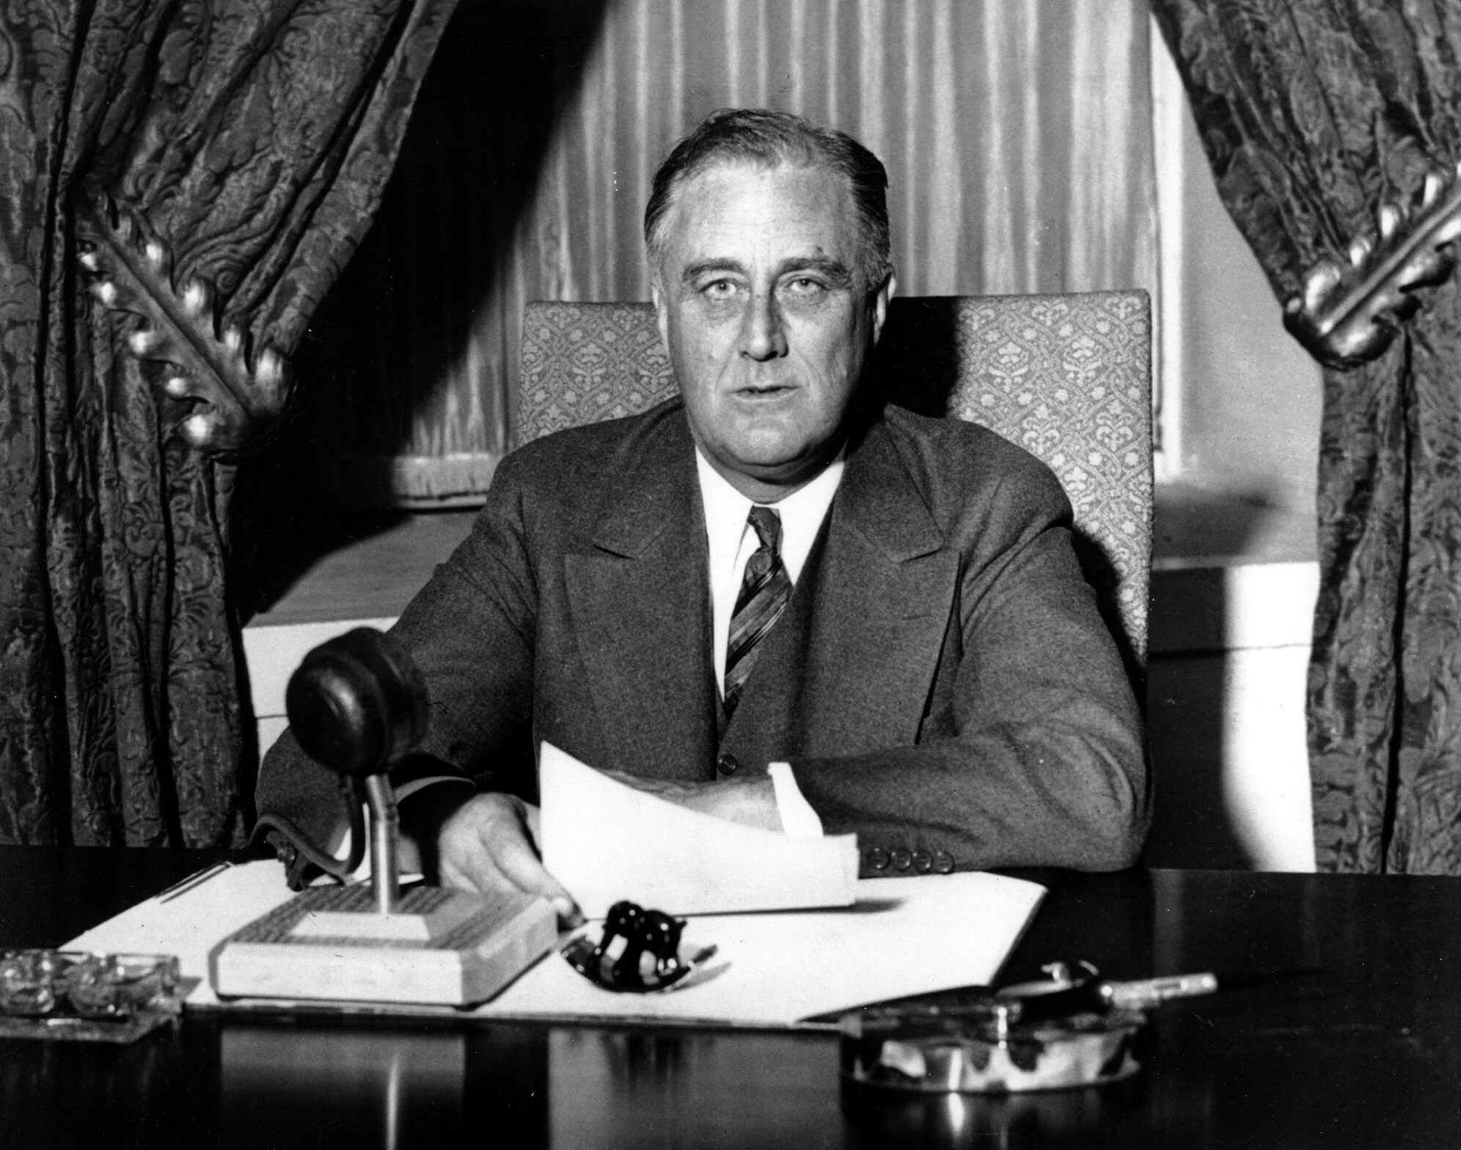

Slide 13
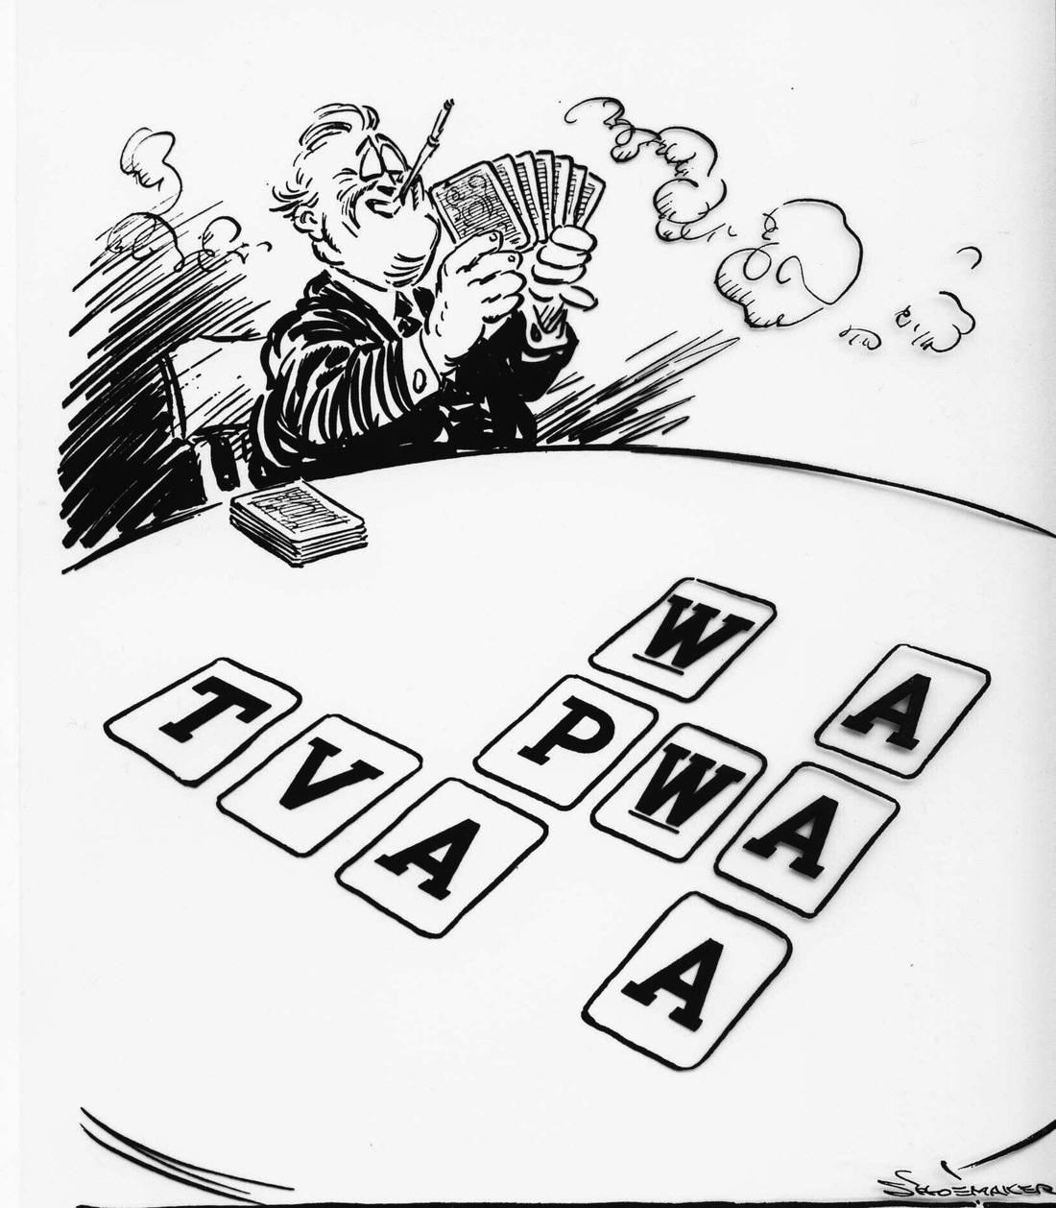

Slide 14
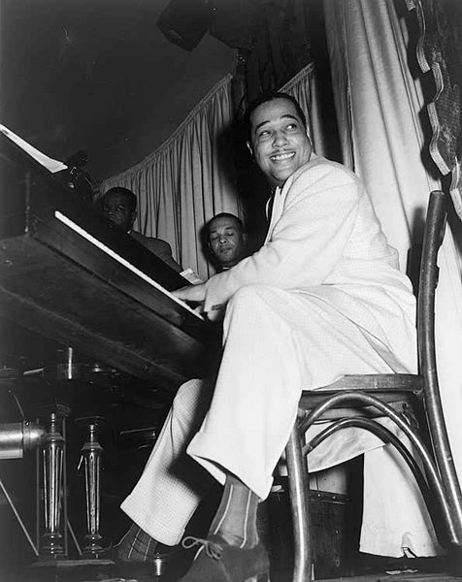
Notes:
Americans loved a variety of music genres in the 1930s. Big band and jazz music were increasingly popular. Duke Ellington and his big band played several types of music, from blues to gospel to jazz and more. One of his most successful songs was titled It Don't Mean a Thing (If It Ain't Got That Swing). From the decade of the 1920s, music continued to enjoy wild popularity as a form of entertainment. In the 1930s, it was important that it did not cost a lot, and that it diverted people's attention from their troubles.

Slide 15
Notes:
During that period, Walt Disney, the pioneer animator, produced films Americans loved to see. One of his most well-known animations was the tale of the Three Little Pigs, originally produced in 1933. Another of his became a part of American culture. Half a century later, his productions are still famous and frequently viewed by children and adults.

Slide 16
http://www.youtube.com/v/qXHfkWJyQDk

Slide 17
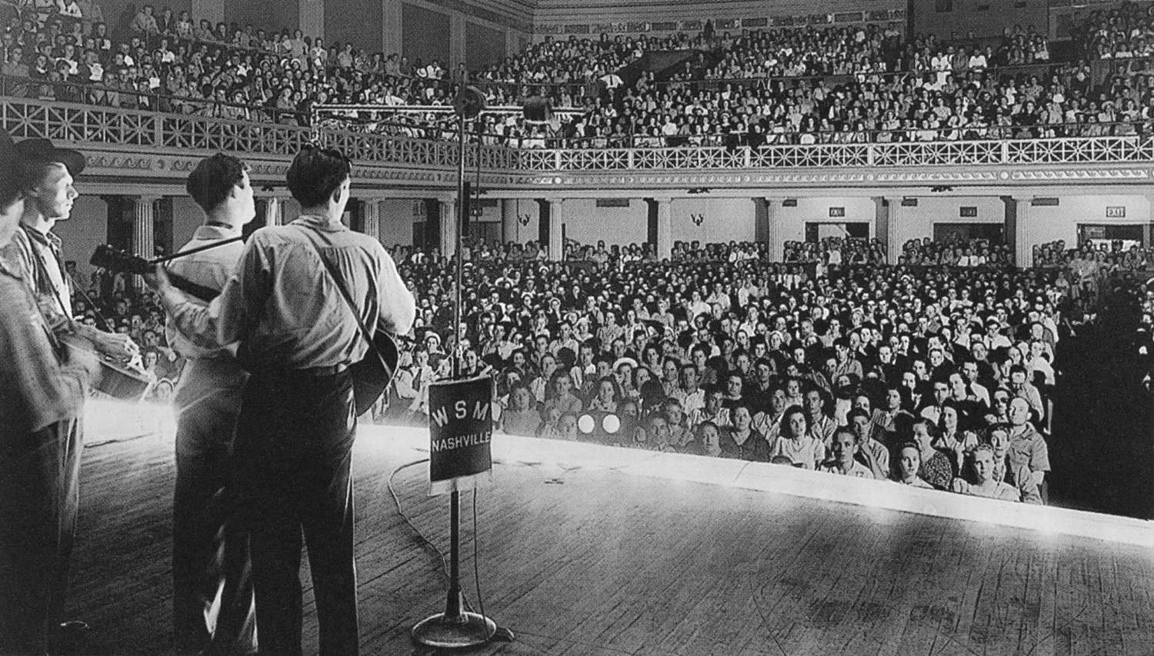
Notes:
Listening to radio broadcasting became a source of nearly free entertainment for millions of Americans. The radio stations had a little bit of everything for all ages, young and old. One of the most common radio shows for young children was Little Orphan Annie. The show is about an adventurous young girl who had an equally adventurous dog named Sandy. Together, Annie and Sandy would try to solve mysteries. The show was so loved by children that they soon began to purchase small items of merchandise such as pins of Annie. Adults listened to newscasts, radio theater, the Grand Ole Opry, soap operas, and sermons as well.

Slide 18
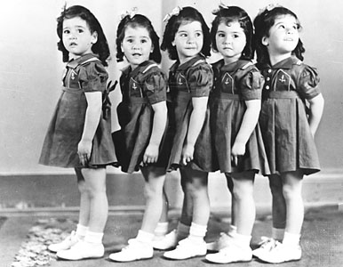

Slide 19
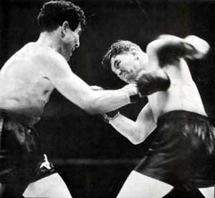
Notes:
James Walter "Cinderella Man" Braddock (June 7, 1905 – November 29, 1974) was an American boxer who was the world heavyweight champion from 1935–37.
Fighting under the name James J. Braddock (ostensibly to follow the pattern set by two prior world boxing champions, James J. Corbett and James J. Jeffries), he was known for his powerful right hand, granite chin and an amazing comeback from a floundering career. He had lost several bouts due to chronic hand injuries and was forced to work on the docks and collect social assistance to feed his family during the Great Depression. In 1935 he fought Max Baer for the Heavyweight title and won. For this unlikely feat he was given the nickname "Cinderella Man" by Damon Runyon. Braddock was managed by Joe Gould.

Slide 20
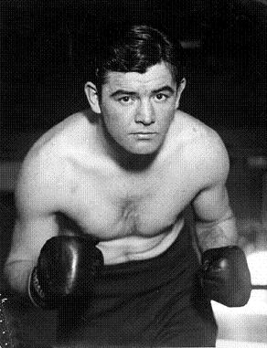
Notes:
Braddock was born in Hell's Kitchen in New York City on West 48th Street, within a couple of blocks of the Madison Square Garden venue, where he later became famous. He stated his life's early ambition was to play football for Knute Rockne at the University of Notre Dame, but he had "more brawn than brains."

Slide 21
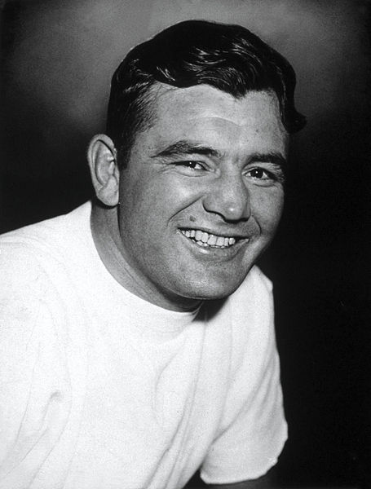
Notes:
Braddock pursued boxing, turning pro at the age of 21, fighting as a light heavyweight. After three years, Braddock's record was 44-2-2 with 21 knockouts In 1928, he pulled off a major upset by knocking out highly-regarded Tuffy Griffiths. The following year he earned a chance to fight for the title, but he narrowly lost to Tommy Loughran in a 15-round decision. Braddock was greatly depressed by the loss and badly fractured his right hand in several places in the process. His career suffered as a result, as did his disposition

Slide 22
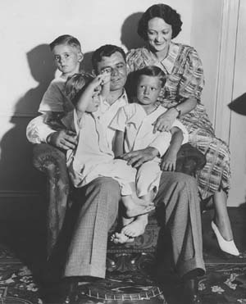
Notes:
His record for the next 33 fights fell to 11-20-2. With his family in poverty during the Great Depression, Braddock had to give up boxing for a little while and worked as a longshoreman. Due to frequent injuries to his right hand, Braddock compensated by using his left hand during his longshoreman work, and it gradually became stronger than his right. He always remembered the humiliation of having to accept government relief money, but was inspired by the Catholic Worker Movement, a Christian social justice organization founded by Dorothy Day and Peter Maurin in 1933 to help the homeless and hungry. After his boxing comeback, Braddock returned the welfare money he had received and made frequent donations to various Catholic Worker Houses, including feeding homeless guests with his family

Slide 23
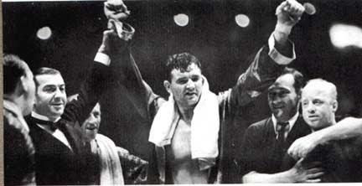
Notes:
In 1934, Braddock was given a fight with the highly touted John "Corn" Griffin. Although Braddock was intended simply as a stepping stone in Griffin's career, he knocked out the "Ozark Cyclone" in the third round. Braddock then fought John Henry Lewis, a future light heavyweight champion. He won in one of the most important fights of his career. After defeating another highly regarded heavyweight contender, Art Lasky, whose nose he broke during the bout on March 22, 1935, Braddock was given a title fight against the World Heavyweight Champion, Max Baer.

Slide 24
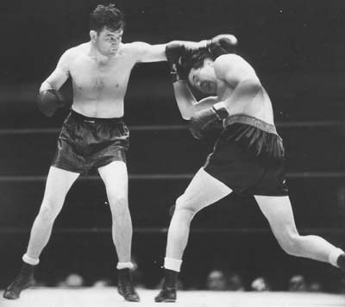
Notes:
Baer hardly trained for the bout. Braddock, on the other hand, was training hard. "I'm training for a fight. Not a boxing contest or a clownin' contest or a dance," he said. "Whether it goes 1 round or 3 rounds or 10 rounds, it will be a fight and a fight all the way. When you've been through what I've had to face in the last two years, a Max Baer or a Bengal tiger looks like a house pet. He might come at me with a cannon and a blackjack and he would still be a picnic compared to what I've had to face.“
Considered little more than a journeyman fighter, Braddock was hand-picked by Baer's handlers because he was seen as an easy payday for the champion. Instead, on June 13, 1935, at Madison Square Garden Bowl, Braddock won the Heavyweight Championship of the World as the 10-to-1 underdog in one of the most stunning upsets in boxing history. During the fight, a dogged Braddock took a few heavy hits from the powerful younger champion (30 years vs 26 years for Baer), but Braddock kept coming, wearing down Baer, who seemed perplexed by Braddock's ability to take a punch. In the end, the judges gave Braddock the title with a unanimous decision.

Slide 25
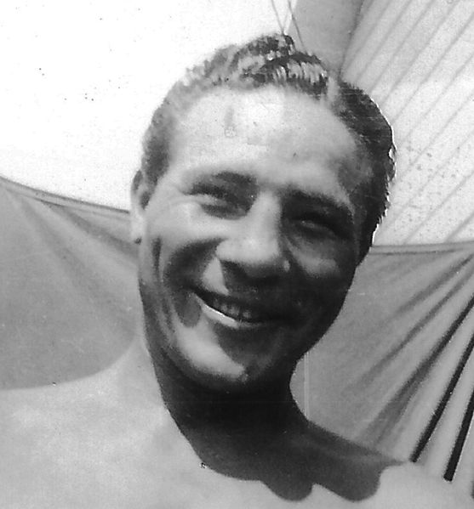
Notes:
Max Baer (February 11, 1909 – November 21, 1959) was an American boxer of the 1930s (one-time Heavyweight Champion of the World) as well as a referee, and had an occasional role on film or television
Baer turned professional in 1929, progressing steadily through the Pacific Coast ranks. A ring tragedy little more than a year later almost caused Baer to drop out of boxing for good.
Baer fought Frankie Campbell (real name Francesco Camilli in a ring built over home plate at San Francisco's Recreation Park to fight for the unofficial title of Pacific Coast champion. In the 2nd round of the fight, Campbell clipped Baer and Baer slipped to the canvas. Campbell went toward his corner and waved to the crowd. He thought Baer was getting the count. Baer got up and flew at Campbell, landing a cheap-shot right at Campbell's turned head which sent him to the canvas.
After the round, Campbell said to his trainer, "Something feels like it snapped in my head", but went on to handily win rounds 3 and 4. As Baer rose for the 5th round, Tillie "Kid" Herman, Baer's former friend and trainer, who had switched camps overnight and was now in Campbell's corner, savagely taunted and jeered Baer. In a rage and determined to end the bout with a knockout, Baer soon had Campbell against the ropes. As he hammered him with punch after punch, the ropes were the only thing to hold Campbell up. Herman, as Campbell's chief second, had the option of throwing in the towel, but did not. Referee Toby Irwin seemed indifferent to Baer's gratuitous attack, and by the time Irwin finally stopped the fight, Campbell collapsed to the canvas. Baer's own seconds reportedly ministered to Campbell, and Baer stayed by his side until an ambulance arrived 30 minutes later. Baer "visited the stricken fighter's bedside," where he offered Frankie's wife Ellie the hand that hit her husband. She took that hand and the two stood speechless for a moment. "It was unfortunate, I'm awfully sorry," said Baer. "It even might have been you, mightn't it?" she replied.
At noon the next day, with a lit candle laced between his crossed fingers, and his wife and mother beside him, Frankie Campbell was pronounced dead. Upon the surgeon's announcement of Campbell's death, Baer broke down and sobbed inconsolably. Brain specialist Dr. Tilton E. Tillman "declared death had been caused by a succession of blows on the jaw and not by any struck on the rear of the head," and that Campbell's brain had been "knocked completely loose from his skull" by Baer's blows

Slide 26
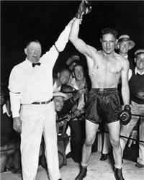
Notes:
The Campbell incident earned Max the reputation as a "killer" in the ring. This publicity was further sensationalized by Baer's return bout with Ernie Schaaf, who had bested Baer in a decision during Max's Eastern debut bout at Madison Square Garden on September 19, 1930.
An Associated Press article in the September 9, 1932 Sports section of the New York Times describes the end of the return bout as follows:
"Two seconds before the fight ended Schaaf was knocked flat on his face, completely knocked out. He was dragged to his corner and his seconds worked over for him for three minutes before restoring him to his senses... Baer smashed a heavy right to the jaw that shook Schaaf to his heels, to start the last round, then walked into the Boston fighter, throwing both hands to the head and body. Baer drove three hard rights to the jaw that staggered Schaaf. Baer beat Schaaf around the ring and into the ropes with a savage attack to the head and body. Just before the round ended Baer dropped Schaaf to the canvas, but the bell sounded as Schaaf hit the floor."[
Schaaf complained frequently of headaches after that bout. Five months after the Baer fight, on February 11, 1933, Schaaf died in the ring after taking a left jab from the Italian fighter Primo Carnera. The majority of sports editors noted, however, that an autopsy later revealed Schaaf had meningitis, a swelling of the brain, and was still recovering from a severe case of influenza when he touched gloves with Carnera. Schaaf's obituary stated that "just before his bout with Carnera, Schaaf went into reclusion in a religious retreat near Boston to recuperate from an attack of influenza" which produced the meningitis. The death of Campbell and accusations over Schaaf's demise profoundly affected Baer, even though he was ostensibly indestructible and remained a devastating force in the ring. According to his son, actor/director Max Baer Jr. (who was born seven years after the incident):
My father cried about what happened to Frankie Campbell. He had nightmares. In reality, my father was one of the kindest, gentlest men you would ever hope to meet. He treated boxing the way today's professional wrestlers do wrestling: part sport, mostly showmanship. He never deliberately hurt anyone.
In the case of Campbell, Baer was charged with manslaughter. Baer was eventually acquitted of all charges, but the California State Boxing Commission still banned him from any in-ring activity within the state for the next year. Baer gave purses from succeeding bouts to Campbell's family, but lost four of his next six fights.

