Slide 1
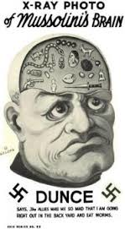
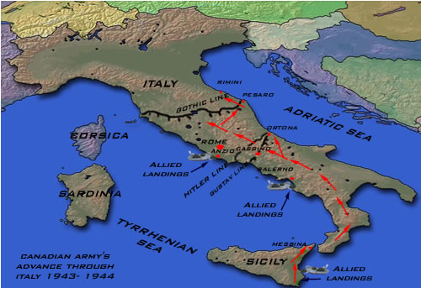
ITALIAN CAMPAIGN

Slide 2
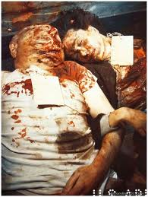
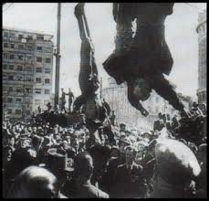
Blood ran to his head and enlarged it after being strung up. Hence the engorgement

Slide 3
ITALY: JULY 1943- MAY 1945
By the middle of 1943, the Germans had been defeated and removed from Africa.
In the East, the Germans were engaged in a ‘fighting retreat’ back towards Berlin. Each day, thousands of Germans and Russians were dying. Therefore, Stalin put pressure on the Western Allies to open up a 2nd front in Western Europe.
Western Allies response: USA not prepared until the spring of 1943, at the earliest.

Slide 4
The Invasion
Instead, USA, Britain and Canada decided to invade Sicily (July 9th 1943) and use it as a launching point to invade Italy. During the fighting on Sicily, Mussolini was overthrown, and on September 8th 1943, Italy announced its surrender.
For the remainder of the Italian campaign, Germany would fight on its own.
Allied forces invaded Italy on September 9th, 1943. The fight to oust the Germans from Italy would be some of the toughest fighting of the war.

Slide 5
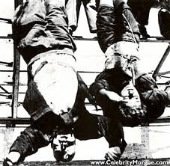
Fall of Rome
Rome fell on June 1944. The Germans were finally defeated in Italy by May 2nd, 1945.
Mussolini was displayed: his body was strung up.
https://www.youtube.com/watch?v=cm7fVZ2jnPU
Newsreel “Death of Mussolini”

Slide 6
Importance of the Italian campaign:
1. Fall of Sicily, Mussolini removed from power
2. It tied up German troops who might otherwise have been used at Normandy to defend against Operation Overlord

Slide 7
Strategic Bombing
Starting with the battle of Britain, the war on the western front was mainly a battle in the air.
Britain, USA, and Canada brought in the concept of strategic bombing.
Definition: Precision bombing of German cities.
Purposes:
1. To bomb civilian populations. Over 100,000 civilians were killed.
2. bomb factories
3. Hit any military targets: airfields

Slide 8
Blitzkrieg to the Bomb -- Italian Campaign (45:00- 47:45)
http://www.youtube.com/watch?v=EJelHXtRWSw

