Slide 1
Irony Defined
a. Verbal Irony = Contrast between what is said and what is meant
Verbal irony usually adds humour or emotional impact to a situation.
b. Dramatic Irony = Contrast between what the character thinks to be true and what we know is true.
Dramatic irony is used to create suspense and develop character (we see how the character acts in a situation)
c. Situational Irony = Contrast between what happens and what was expected to happen

Slide 2
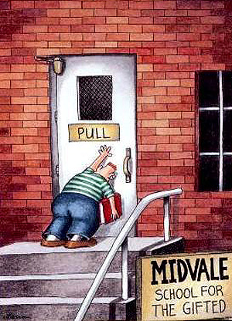

Slide 3
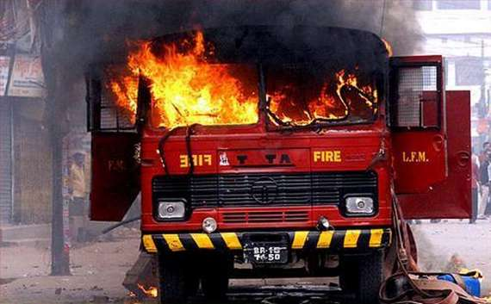

Slide 4
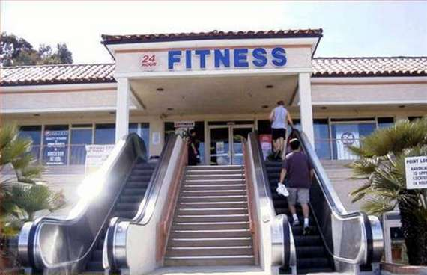

Slide 5
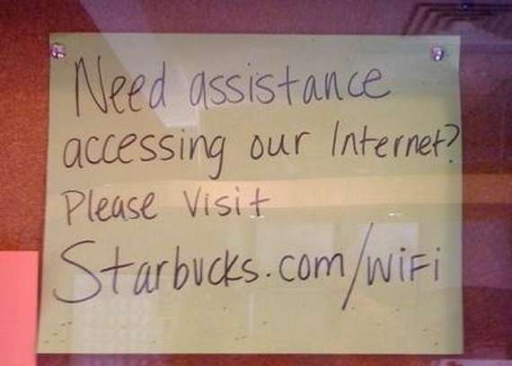

Slide 6
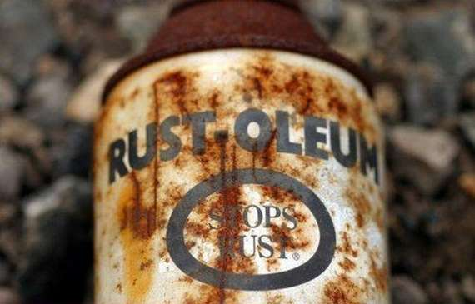

Slide 7
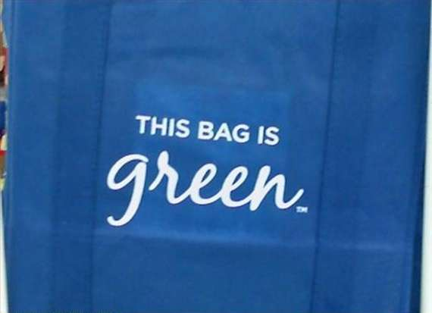

Slide 8
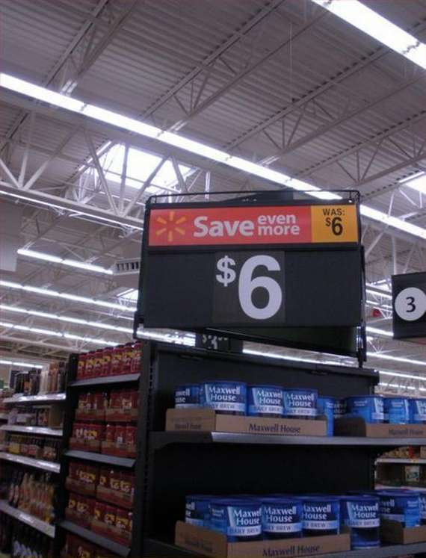

Slide 9
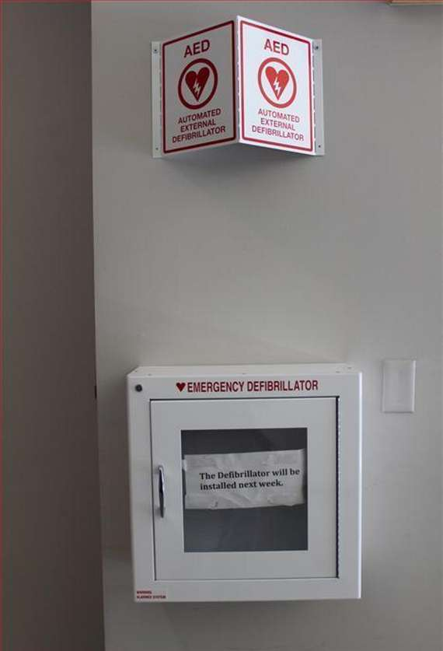

Slide 10
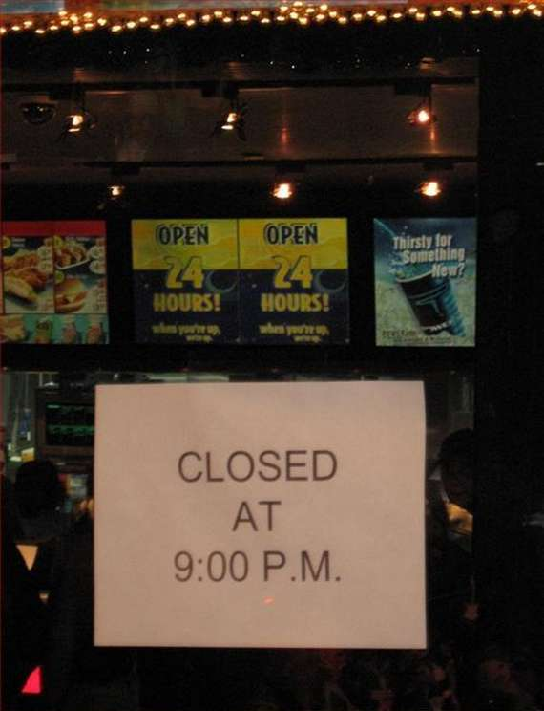

Slide 11
Video Clips
Verbal Irony
http://www.youtube.com/watch?v=dhRUe-gz690 (Black Night)
Dramatic Irony
“Is Anyone There?”
Situational Irony
Mr. Bean at the Beach
http://www.youtube.com/watch?v=6BFhN3n1S88
Monty python Flasher http://www.youtube.com/watch?v=bK7Bh1RMu5Y&playnext=1&list=PLEFA0404CB6F90D67&index=5
→Symbolism. Pick out in “Love the Way you Lie” video
http://www.youtube.com/watch?v=uelHwf8o7_U
Reminds us of the Quote “These violent delights have violent ends and in their triumph die like fire and powder which as they kiss consume‘”

