Slide 1
Iconic Photos of the 20th Century
Shaping Questions:
What is present?
What is missing?
What types of history are being presented (political, social, economic, military?)
How many can you detect?

Slide 2
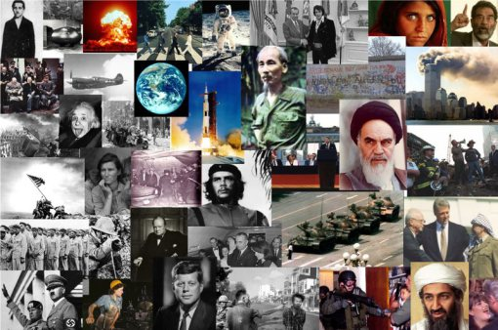

Slide 3
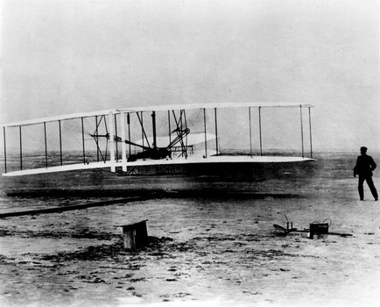

Slide 8
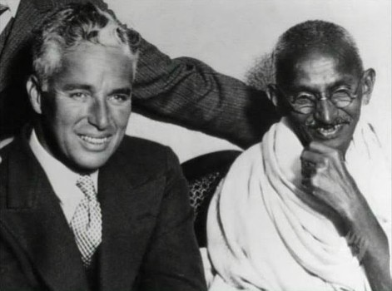

Slide 25
Iconic Photos of the 20th Century
Shaping Questions:
What is present?
What is missing?
What types of history are being presented (political, social, economic, military?)
How many can you detect?

