Slide 1
Existentialism!
(What is the meaning of life?

Slide 2
Existentialism
Philosophical movement that views human existence as having a set of underlying themes and characteristics (i.e. anxiety, dread, freedom, awareness of death

Slide 3
Existentialism
Being conscious of existing in the world, and questioning that existence
A perspective that pursues the question of the meaning of life or the meaning of existence

Slide 4
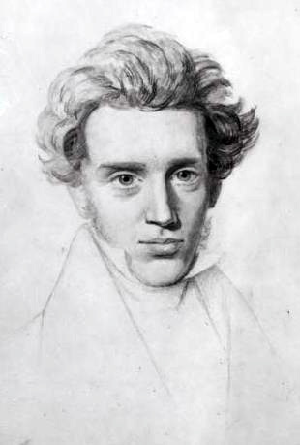
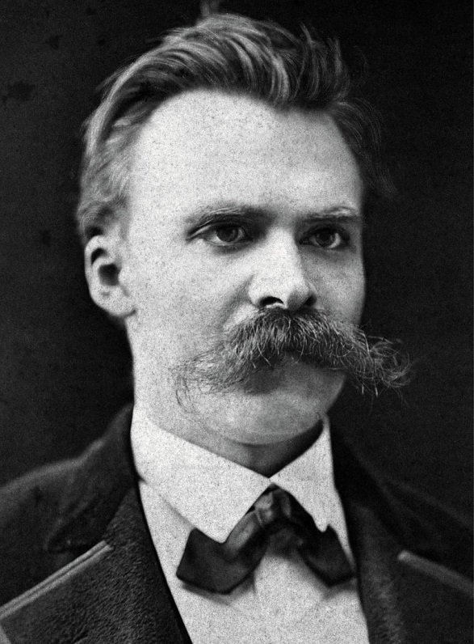
Existentialism
Soren Kierkegaard (1813-1855)
Freidrich Nietzche (1844-1900)

Slide 5
Existentialism
Movement became popular after WWI when people confronted with death and destruction feel that there is no meaning to life
Tremendous disillusionment within the populace

Slide 6
Existentialism
Movement that rejects the rationalism of the 19th century
Rationalism claimed that everything has inherent order

Slide 7
Existentialism
Thinkers asked:
“Is there a God?”
“How could he let this happen?”
(i.e. the destruction of cities, the landscape, the weapons of destruction – tanks, machine guns, poisonous gas)

Slide 8
Existentialism
Thinkers concluded – life has no meaning, we must deal with that every day
“To live, is to be authentic”

Slide 9
Existentialism
People will face “boundary situations” – an extreme situation that forces you to reflect on the meaning of life
To be “authentic,” is to face these situations, to be “inauthentic” is to be blind, and follow authority

Slide 10
Existentialism – Three Interpretations
1. Life has no meaning, no order in the world, might as well commit suicide
2. One must live and discover the morals for yourself
3. Focus on God

Slide 11
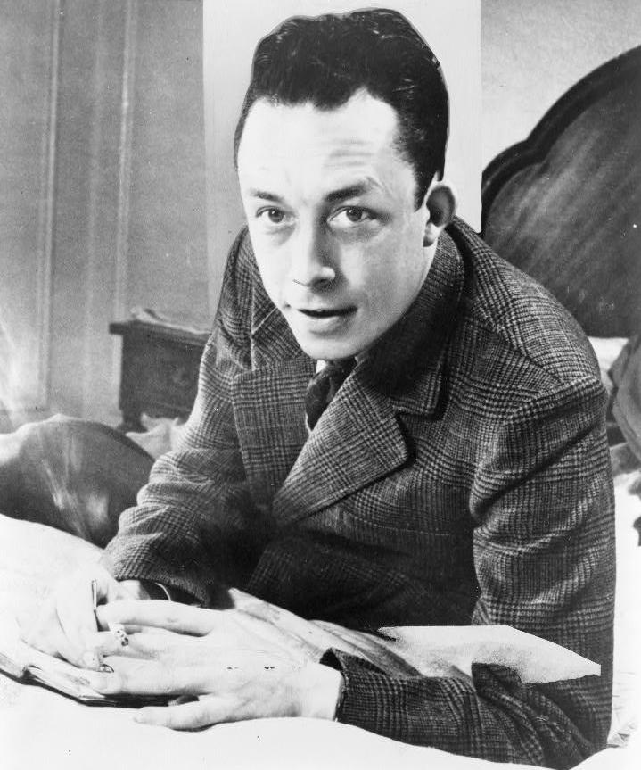
Existentialism – First Interpretation
Life has no meaning, no order in the world, might as well commit suicide
Once the decision is made on
how to live, then the “authentic
choice” is the choice to live in
this modern world, despite its
absurdity

Slide 12
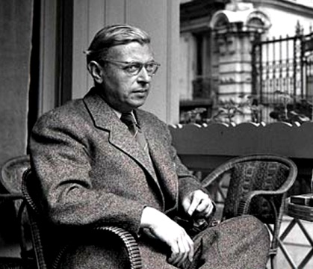
Existentialism – Second Interpretation
Jean Paul Sartre (1905-1980)
-saw the Nazis as the ultimate evil
-believed that the most authentic choice one can make is to resist Nazi occupation
-during war, moral guideposts disappear and people instinctively know whether or not they should resist

Slide 13
Existentialism – Second Interpretation
2. Thinkers believed that one must discover morals for yourself, a book or a teacher cannot teach morals
Sartre believed that the French had “never been freer than under the German occupation” because without rules and laws there was a chance to start fresh

Slide 14
Existentialism – Third Interpretation
3. Focus on God
Thinkers believed he is dead because he cannot be logically proven
Kierkegaard suggested that an authentic choice a person could make is to accept that God may not be logically possible, but to make a leap of faith and believe anyway

