Slide 1
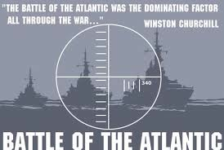
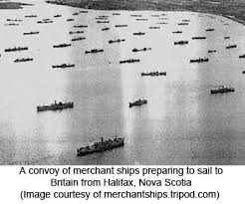
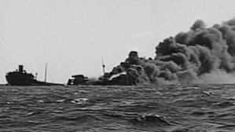
BATTLE OF THE ATLANTIC

Slide 2
U571 – Enigma Code Machine
https://www.youtube.com/watch?v=2imOf6-H3tI
(Trailer)
https://www.youtube.com/watch?v=eLyhRYJXf1U Sinking the Destroyer
(Video to show what would it be like to be in the Navy)
Highly Inaccurate: it was actually Britain (members on HMS Bulldog) who captured the Enigma machine from U-110 in the North Atlantic in May 1941.

Slide 3
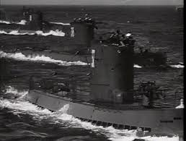
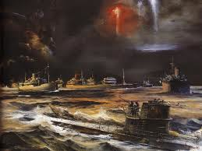
Battle of the Atlantic
Definition: The ongoing struggle of the allies to keep open her shipping lanes to Britain.
Most allied ships were sunk by U-Boats hunting in groups called “Wolf Packs”

Slide 4
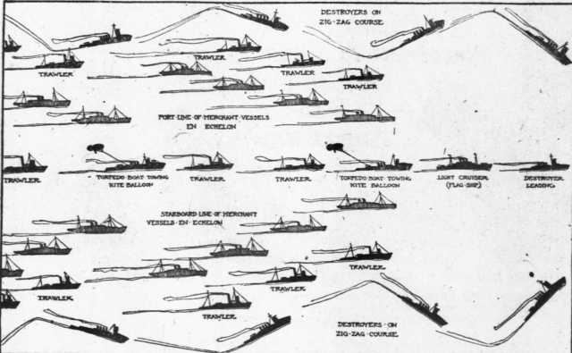
Draw a picture of Convoy in the open space on your page.
At this point, draw a picture of the convoy system on the whiteboard
Can any students do it?

Slide 5
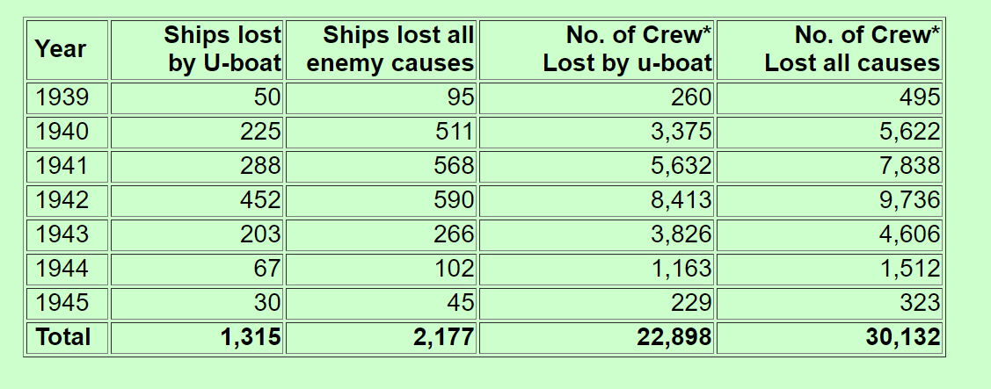
Chart Time
What do we notice about the data?

Slide 6
What do we notice about the data?

Slide 7
What changed in 1943 to ‘turn the tide’ against the U-Boats?
1. Long range aircraft cooperating with naval support groups using radar.
2. Allies were punching through the soft underbelly of Europe.
3. Indiscriminate bombing of German Cities
4. Raids on French Ports – U-Boats were deployed to these locations
5. American involvement in the war

Slide 8
Significance
It kept the supply lines open; the “umbilical cord” between North America and Britain.
Could not run the war without supplies.

