Slide 1
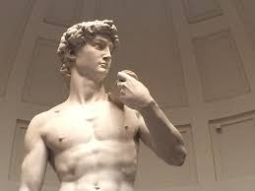
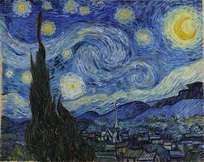
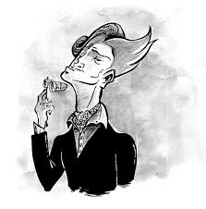
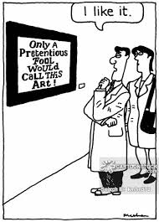
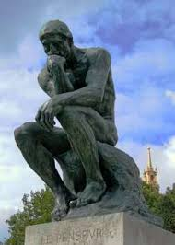
Creative Writing Art Critique

Slide 2
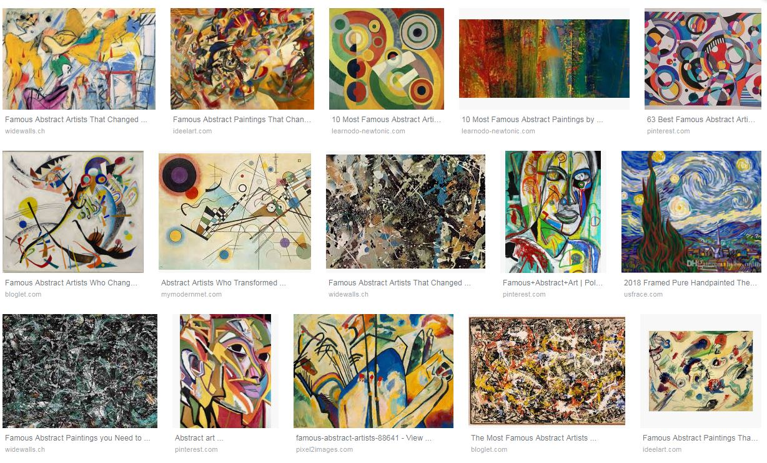
Famous Abstract Art

Slide 3
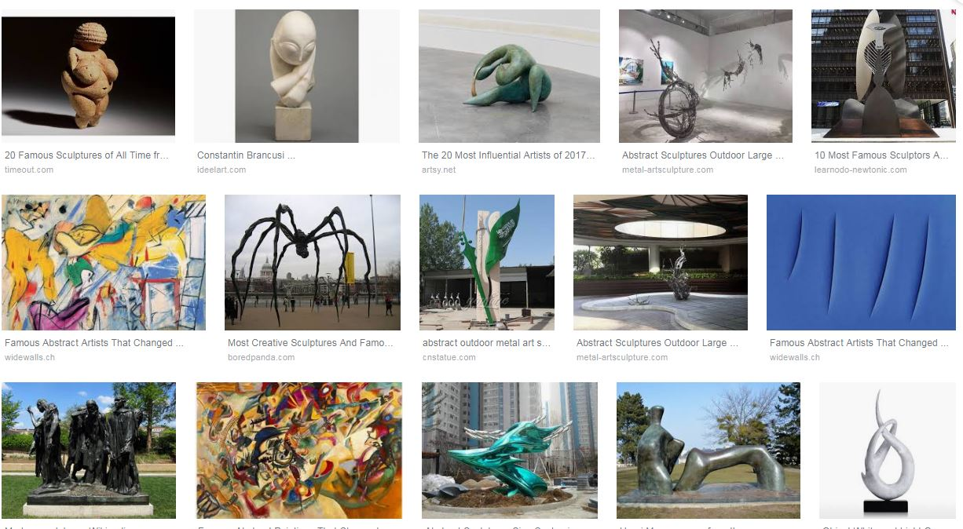
Famous Abstract Art (Sculpture)

Slide 4
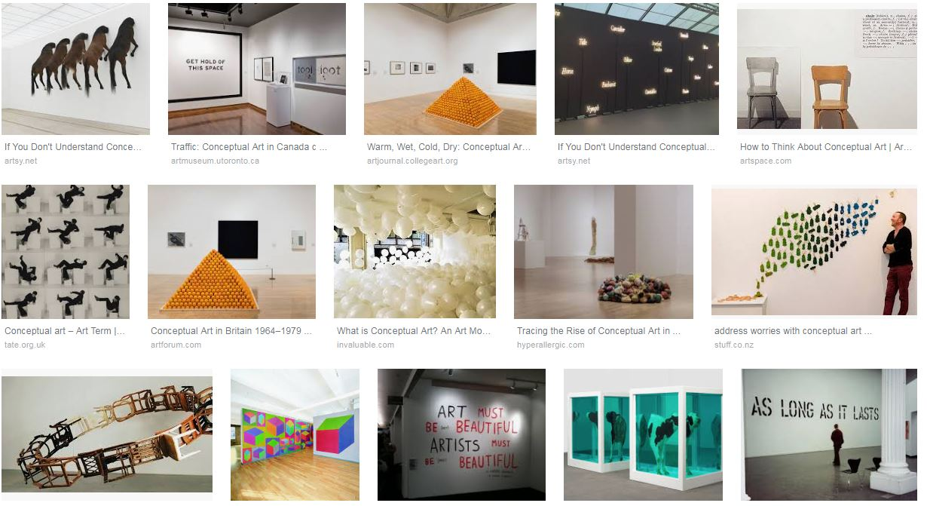
Conceptual Art

Slide 5
Conceptual Art

Slide 6
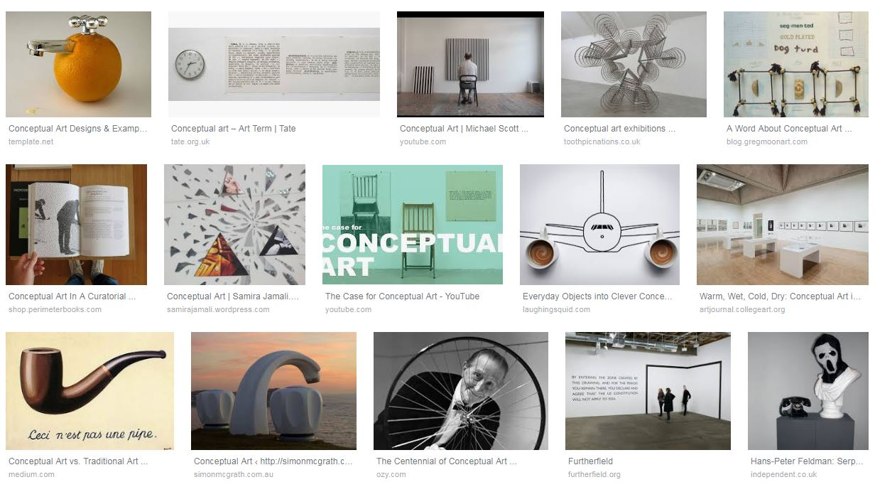
Conceptual Art

Slide 7
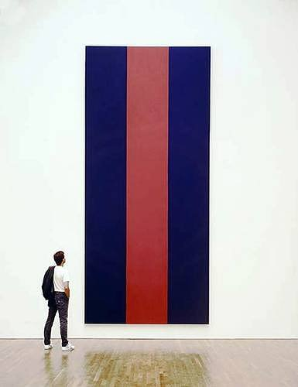
Barnett Newman “Voice of Fire” Acrylic on Canvas 1967
1990: Canadian National Gallery purchased it for $1.76 Million
Now worth approx $50 million
https://ottawacitizen.com/entertainment/local-arts/newmans-revenge-the-value-of-voice-of-fire-is-scorching-hot

Slide 8
Fooled by Ikea
https://www.youtube.com/watch?v=_2nO2abXXrk

Slide 9
Parody – Types of Art Critics
https://www.youtube.com/watch?v=qcHzNzB0fK8 Concept of Voice

Slide 10
“Riley”

Slide 11
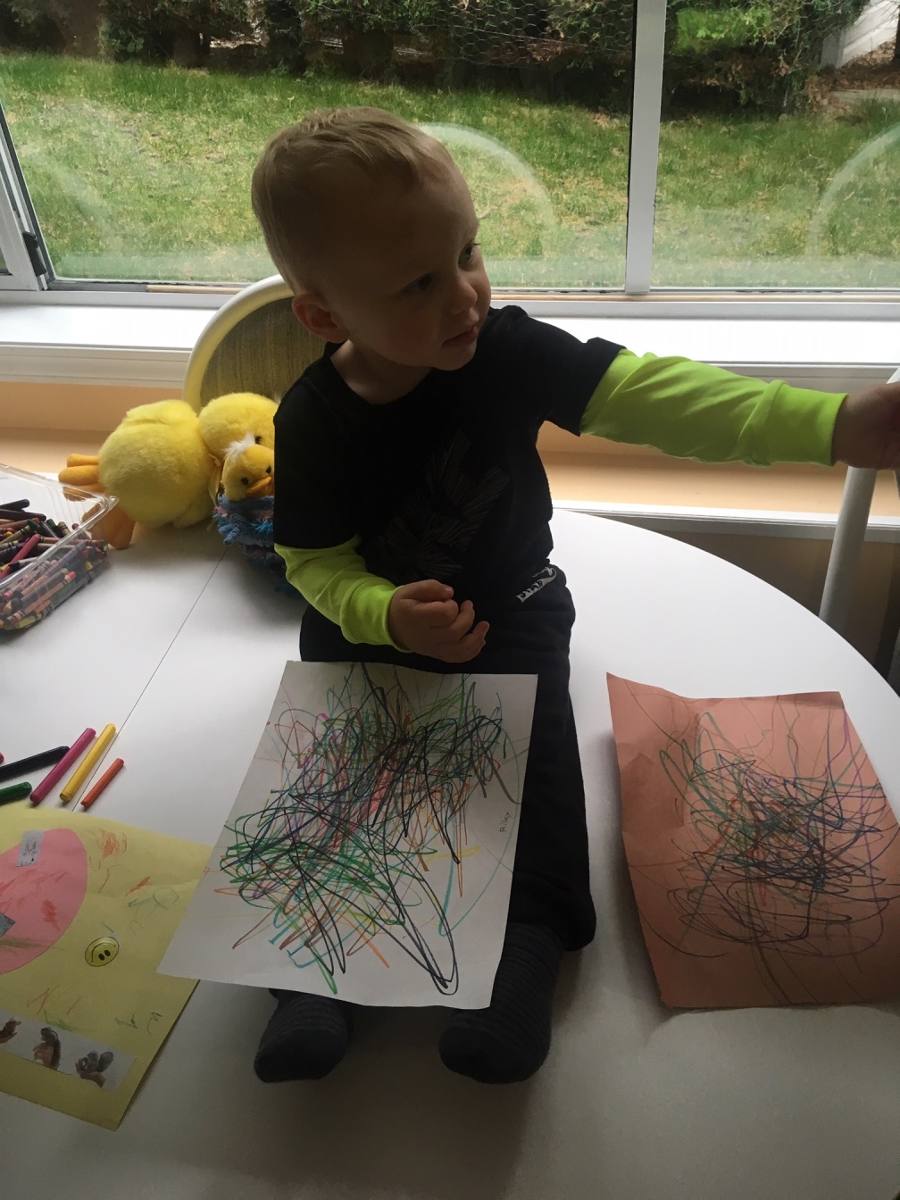
“Riley”

Slide 12
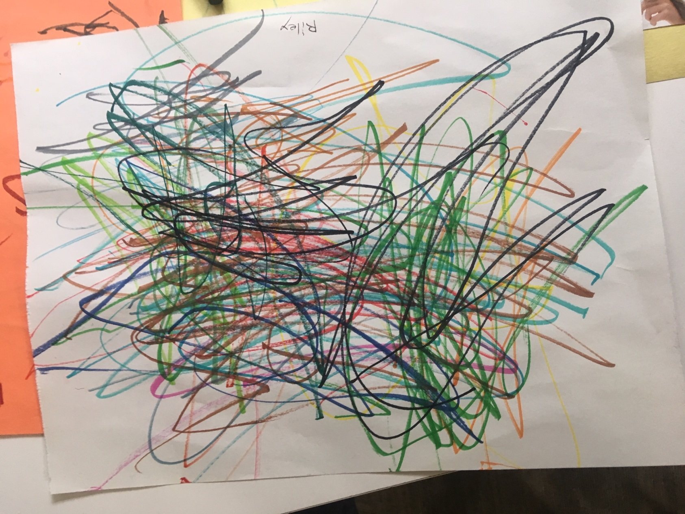

Slide 13
