Slide 1
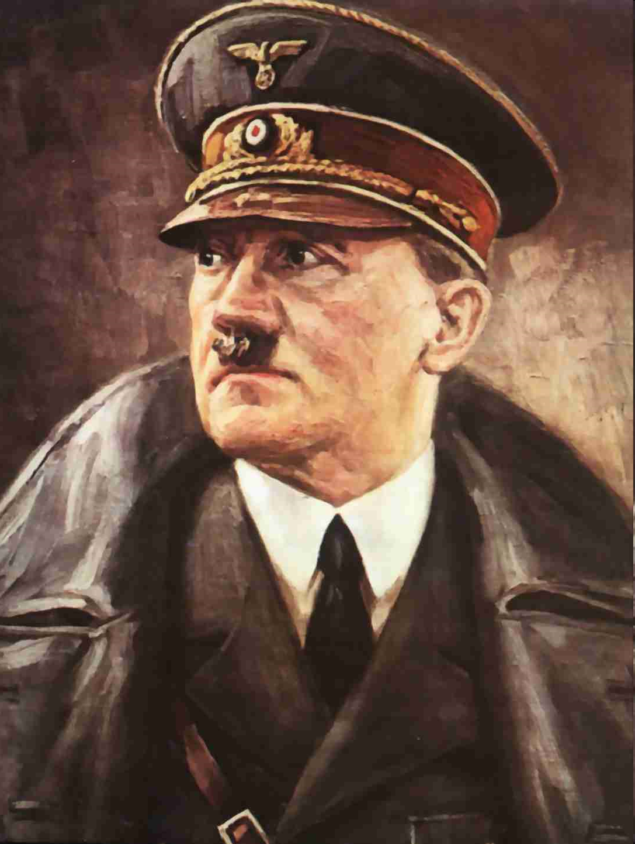
Propaganda
Prop⋅a⋅gan⋅da [prop-uh-gan-duh]
–noun
1.information, ideas, or rumors deliberately spread widely to help or harm a person, group, movement, institution, nation, etc.
2.the deliberate spreading of such information, rumors, etc.
In war, battles are fought on fields, but they are also fought with information, deception and lies. If one side in the civil war could convince the general public that the other side was evil, they could win support.
“Propaganda, Propaganda, Propaganda, all that matters is propaganda.”

Slide 2
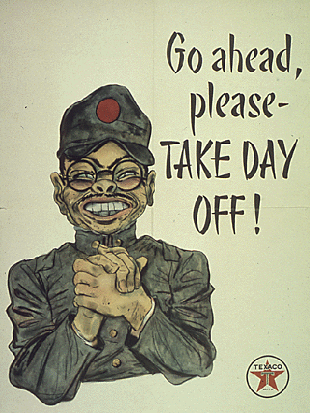

Slide 4
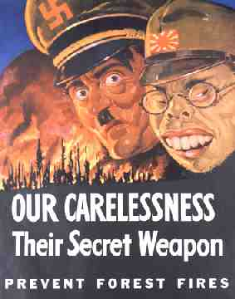

Slide 5
Disney Propaganda
http://www.youtube.com/watch?v=SG15bVweujE&feature=related
“Education for Death”

Slide 6
Your Propaganda
Answer the following questions about the picture on your overhead:
Who is the Propaganda’s intended audiences
What is the message/who are they making fun of
Is the Propaganda effective? How/why?

