Slide 1
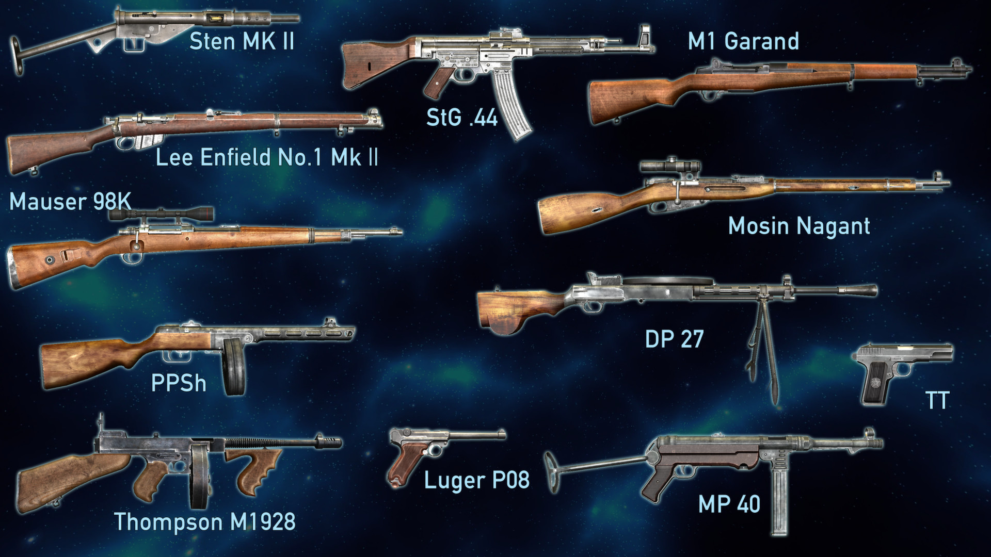
WW2 Arms Auction

Slide 2
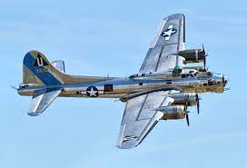
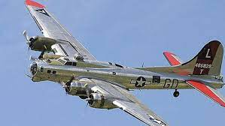
B-17 Flying Fortress

Slide 3
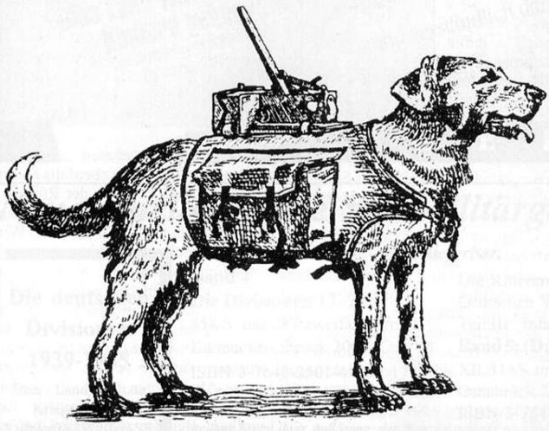
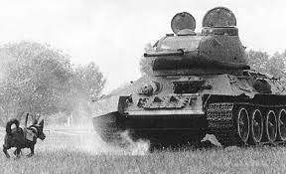
Dog Bombs

Slide 4
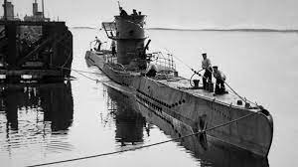
Submarine (U-Boat)

Slide 5
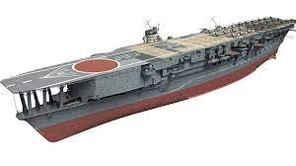
AirCraft Carrier

Slide 6
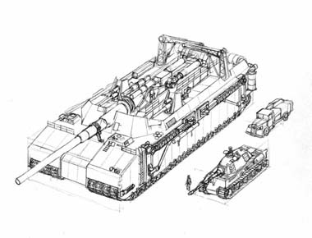
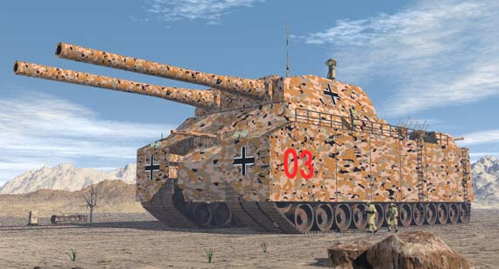
Landkreuzer p-1000 ratte
Notes:
The Landkreuzer P. 1000 Ratte, if it had been built, would have been 115 feet in length, 45 feet wide and towered 36 feet - almost four stories - into the sky. A true rolling fortress, it was to have armor 9 inches thick and be equipped with multiple heavy weapons and a crew of at least 20. The massive main turret design was to be borrowed from a naval heavy cruiser like the Gneisenau-class warships, but modified to carry only two guns instead of the usual three. Each of the guns would have had a bore 280mm (11 inches) in diameter and could throw a shell (which could weigh as much as 700 pounds) as far as 25 miles.
In addition, the Ratte was to carry at least one 128 mm anti-tank gun or possibly two 15 mm Mauser MG 151/15 autocannons. As the project was never finished, the location of these weapons on the vehicle are not clear, but researchers have speculated that they might be mounted forward and below the main turret or on a smaller turret or turrets at the rear. To guard against aircraft attacks, eight 20 mm Flak 38 anti-aircraft guns were also envisioned to be mounted on the machine.
Unlike smaller tanks, the Landkreuzer was large enough to have internal self-contained lavatories and various storage spaces. There were also plans for it to carry two BMW R12 motorcycles which might have been used for scouting purposes.
To spread out its tremendous weight, the Ratte would have needed six tracks, three on each side, rather than the usual two found on tanks. Even so, the monster tank's passage would have cracked the pavement and it could never have travelled over most bridges. However, with six feet of ground clearance and the use of a snorkel, the Ratte would have been able to ford most rivers with little difficulty.

Slide 7
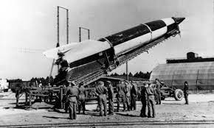
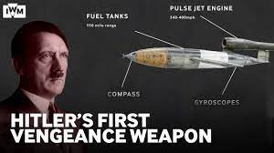
V1 and V2 Guided Missiles / Rockets
Notes:
The speed of the V1, while faster than most planes in service, is still susceptible to ground anti-aircraft fire and many were shot down. The V2, on the other hand, is a rocket-propelled self-guided ballistic missile which can deliver 1,000kg of payload at a speed of 5,760km/h in flight with a range of 320km.
The V-weapons inflicted immense suffering in Britain, causing over 30,000 civilian casualties and left hundreds of thousands homeless. The V-weapons' apparently random strikes were unnerving. They caused dismay among a British population that had hoped that enemy air attacks were now a thing of the past. Despite their psychological impact, the destruction wrought by the V-weapons was less than that endured during the Blitz of 1940-1941 MORE TERRIFYING THAN EFFECTIVE. NOT ENOUGH FUEL BY END OF WAR TO KEEP THEM GOING.

Slide 8
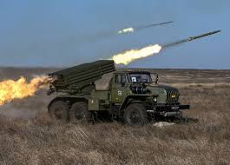
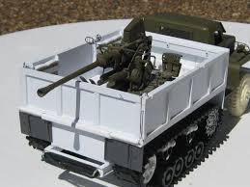
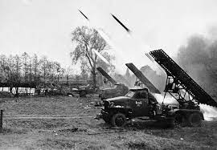
Studebaker Truck
Notes:
Sent to USSR to add to their artillery – allowed for mobile artillery and fast troop movements on the Eastern Front (see WW2 from space for more info)

Slide 9
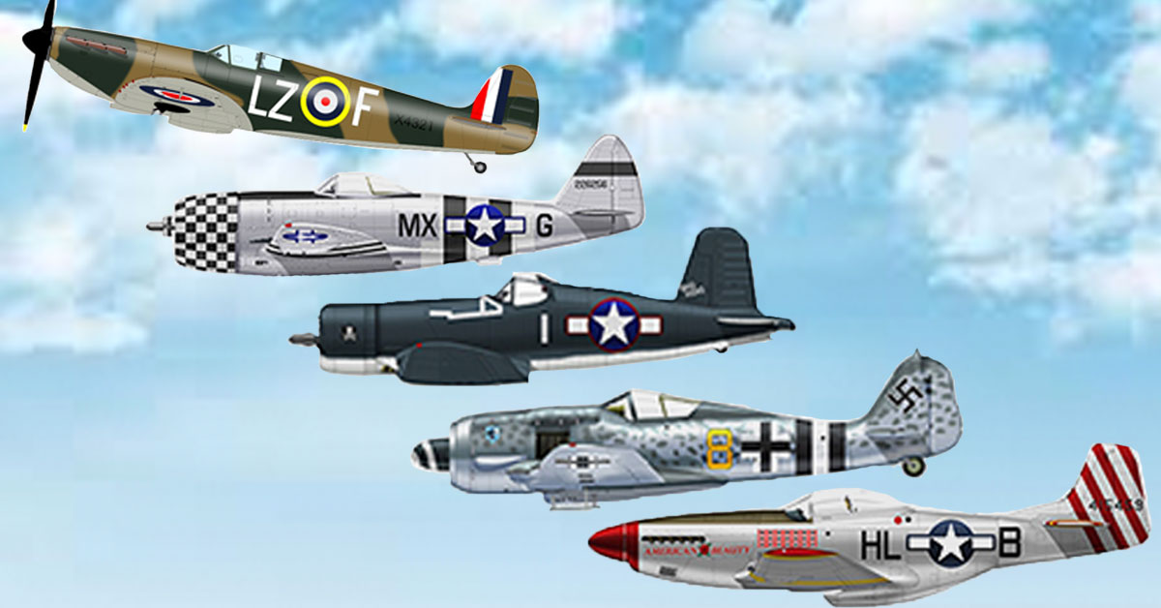
Fighter Planes
FIGHTER PLANES

Slide 10
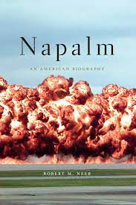
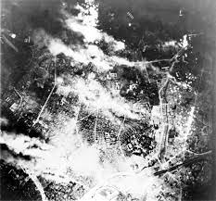
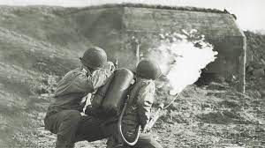
Napalm
Notes:
Invented and used in the firebombing of Tokyo…. Battle where all ethical lines are crossed.

Slide 11
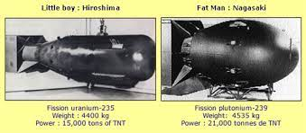
Atomic Bomb

Slide 12
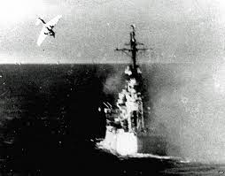
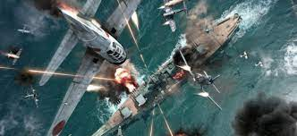
Kamikaze Strategy

Slide 13
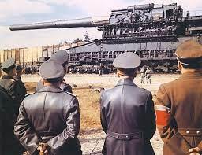
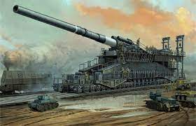
Schwerer Gustav Rail GuN
Notes:
The new weapon was a gun about 12 meters high, 47 meters long, weighing 1,350 tonnes and was firing 10 tonnes shells through a 30 meters long pipe. 22 people could sit aligned on the barrel of the gun. The impressive weapon became known as the “Great Gustav”.
Two guns of this type were ordered, the second one being named Dora. Dora was the second gun produced. and It was deployed briefly against Stalingrad, but the Germans had quickly withdrawn it when the Soviets threatened to encircle the weapon. Dora was broken apart before the war ended and was discovered in the west by American troops.
The Gustav cannon needed 2,000 people. The majority of these people were tasked with providing air cover for the gun and not were involved with the actual operation of the gun. The assembly of the five main parts that made up the cannon lasted four days. Also, the calibration of equipment needed in order to shoot one shell took several hours, which meant that the gun could only shoot 14 rounds per day.
Over a year after its first use, the Nazis gave up using the Gustav gun. The gun appears to have been destroyed to prevent its capture some time before 22 April 1945, but other sources state that the great weapon was captured and disassembled by the Russians.

Slide 14
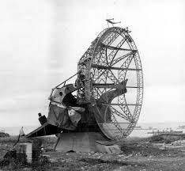
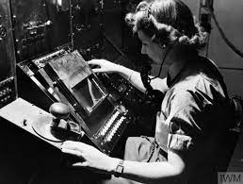
Radar

Slide 15
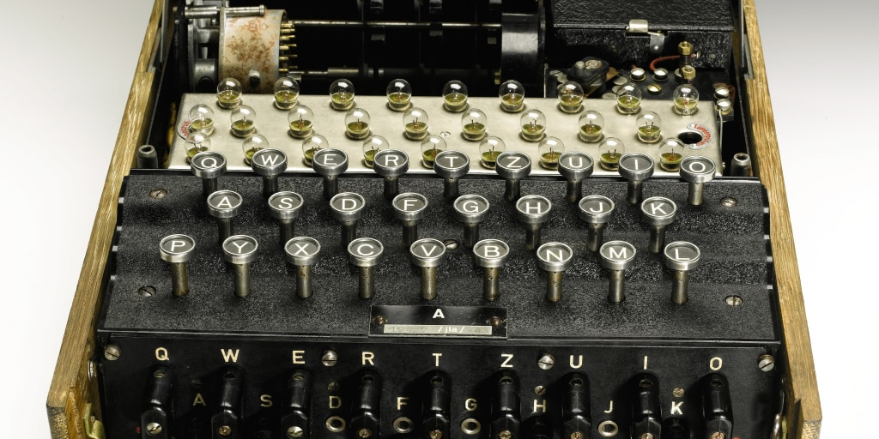
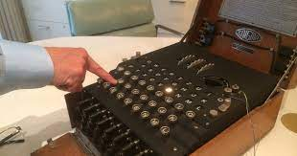
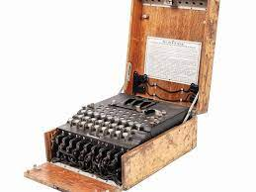
Enigma Code Machine

Slide 16
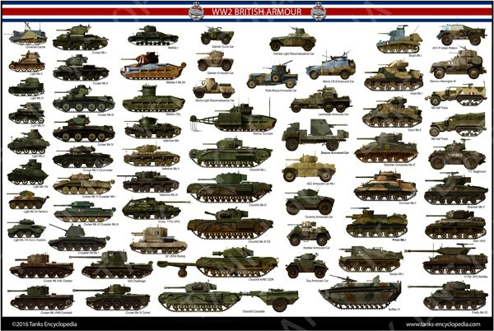
Tanks

Slide 17
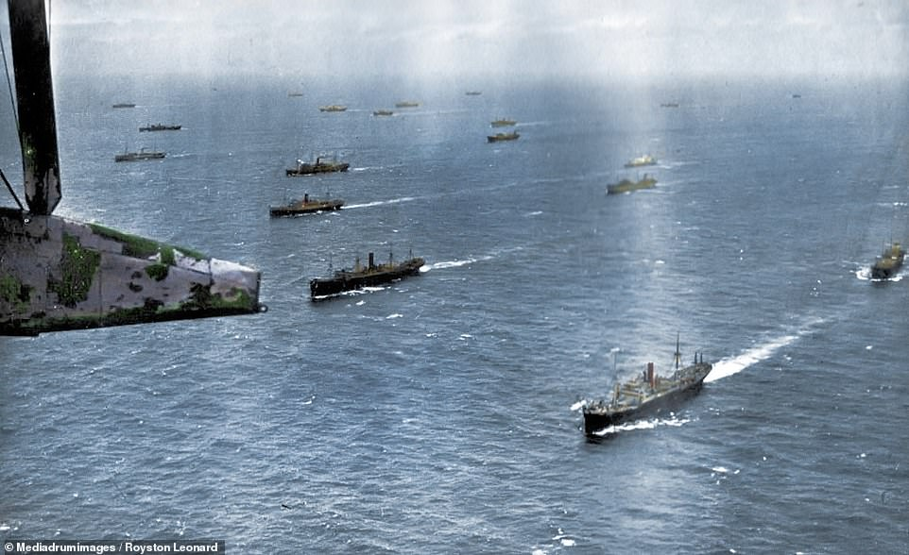
Convoy

Slide 18
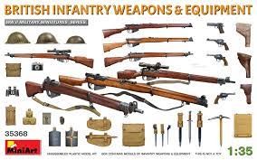
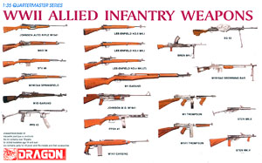
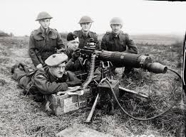
Infantry Weapons

Slide 19
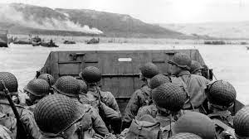
The Arms Auction is Over. Tally up those scores and let’s see who won the second world war

