Slide 1
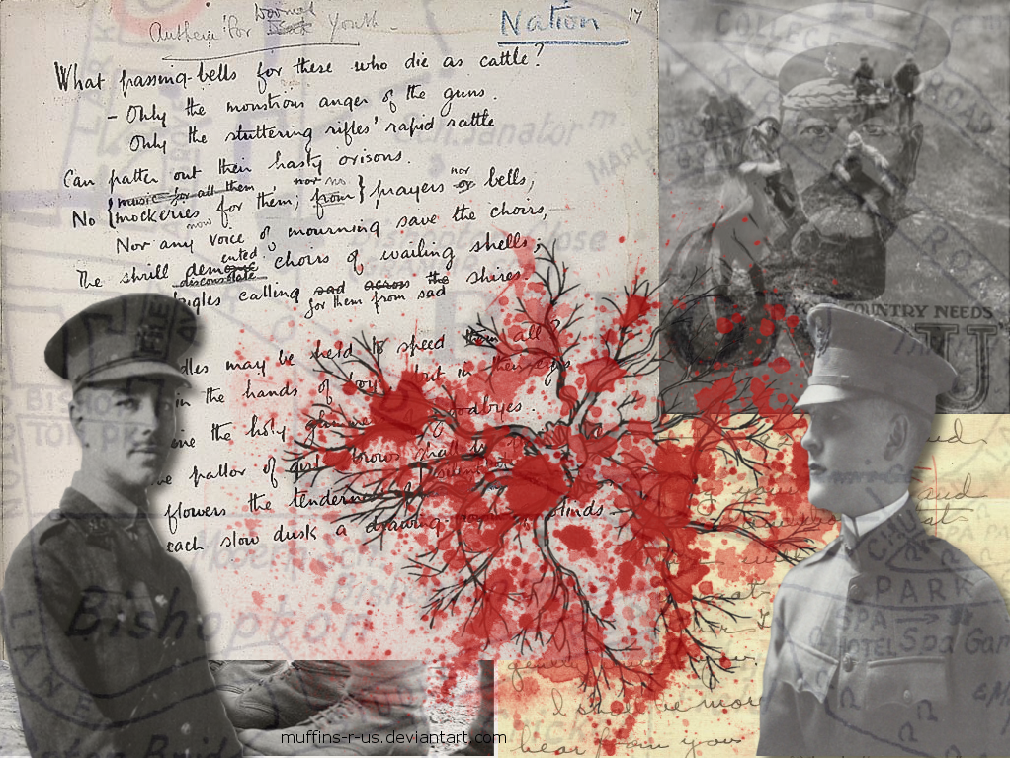
Partner up in A/B
A will look at photo and has one minute to describe in detail.
Then, B will turn and examine and pay partner one compliment
Switch for next photo

Slide 2
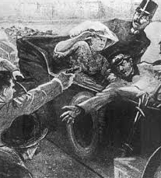

Slide 3
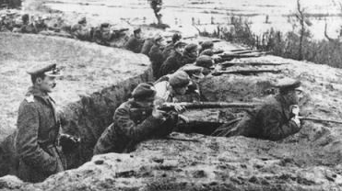

Slide 4
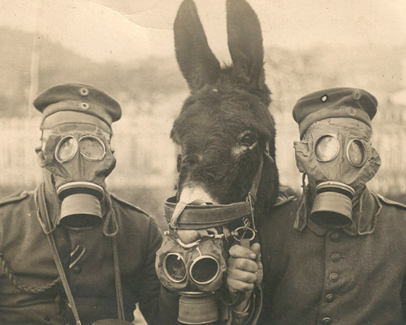

Slide 5
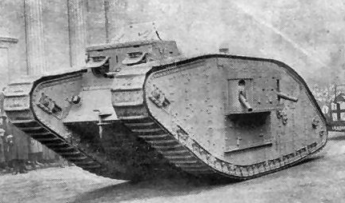

Slide 6
