Slide 1
Understanding Emotions & Developing Emotional Intelligence
Welcome to our applied psychology class! Today, we'll explore emotions, feelings, and their role in emotional intelligence. We'll provide tips and actionable strategies on how to effectively identify, process, and regulate our emotions.
M
by Mr. Fitton

Slide 2
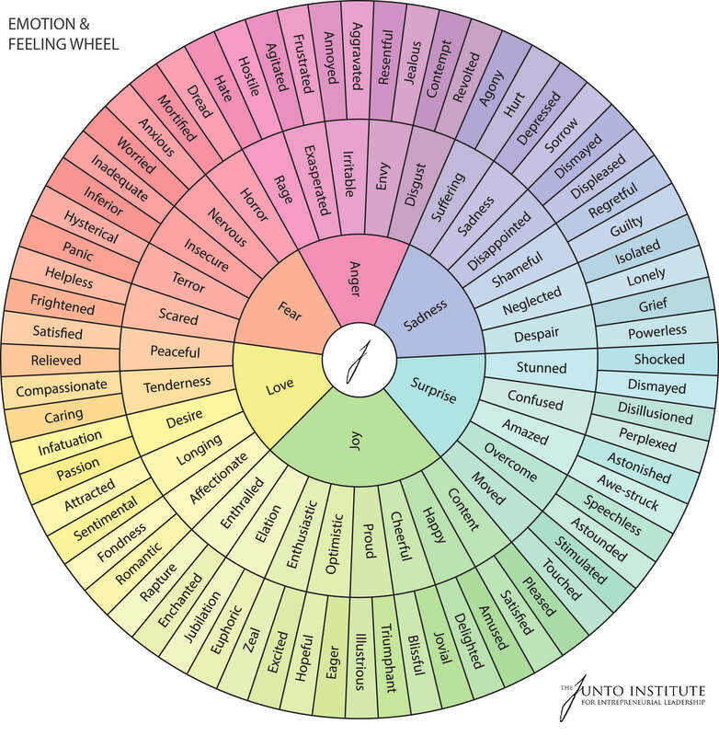
Recognizing Emotions
Anger
Surprise
Learn to recognize this powerful emotion and identify what triggers it.
Understand its nuances and how it relates to expectations and predictions.
Fear & Anxiety
Happiness
Differentiate between anxiety and fear and explore how they can motivate us or hold us back.
Examine the many facets of happiness, including joy, contentment, and gratitude.

Slide 3
Emotional Intelligence
1
What is Emotional Intelligence?
2
Benefits of Emotional Intelligence
An overview of EI, including the four components: self-awareness, self-regulation, social awareness, and relationship management.
How developing emotional intelligence can improve relationships, decision-making, and overall wellbeing.
3
Emotional Intelligence Assessment
4
Improving Emotional Intelligence
Discover resources to assess and identify your emotional intelligence level.
Effective strategies to improve all components of emotional intelligence.

Slide 4
Processing Emotions
Check Your Emotions
Determine the Root Cause
Write down your feelings and reflect on where they are coming from.
Ask yourself what triggered your emotional response. Is it something you can control?
Reframe Negative Thoughts
Breathing Techniques
Change negative self-talk into positive affirmations. Practice gratitude and acceptance.
Deep breathing exercises can help to reduce stress and anxiety.

Slide 5
Regulating Emotions
1
Recognize and Label
Identify the emotion you are feeling and label it. This helps to put a name to the feeling and can reduce its intensity.
Acceptance
2
Accept that all emotions are valid and that it's okay to feel them.
3
Social Support
Seek out friends, family, or a therapist to talk to about your emotions.

Slide 6
Actionable Steps for Building Emotional Intelligence
Develop Empathy
Practice Self-Awareness
Build Strong Relationships
Practice seeing situations from another person's perspective.
Be mindful of how you are feeling and how your emotions are influencing your behavior.
Effective communication is key to building trusting relationships.

Slide 7
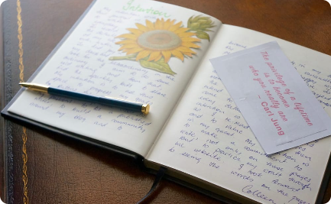
Tips for Feeling and Understanding Emotions
Practice Mindfulness
Reflect and Write
Get Outside
Regularly engage in mindfulness activities like meditation or yoga.
Write about your emotions in a journal to gain insight into your thoughts and feelings.
Enjoy the great outdoors and spend time in nature to boost your mood and reduce stress.

Slide 8
Review and Take Action
1
What did we learn?
2
What can we do?
3
Take Action!
Review the key concepts about emotions and emotional intelligence.
Pick three actionable steps to incorporate into your life to improve your emotional intelligence.
Commit to taking daily actions to maintain and improve your emotional intelligence.

