Slide 1
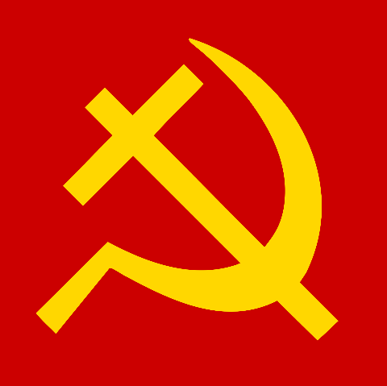
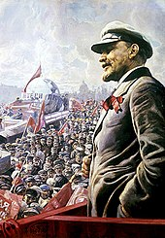
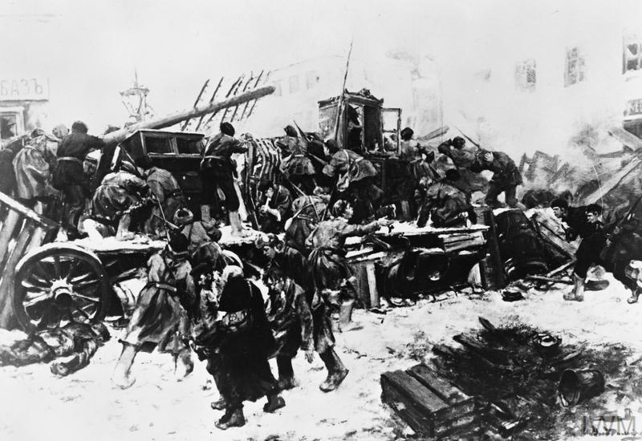
Timeline on the Russian Revolution 1894-1928
By Jonathon Lefebvre

Slide 2
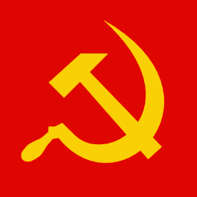
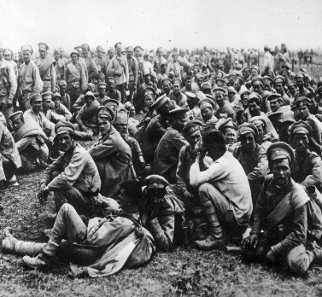
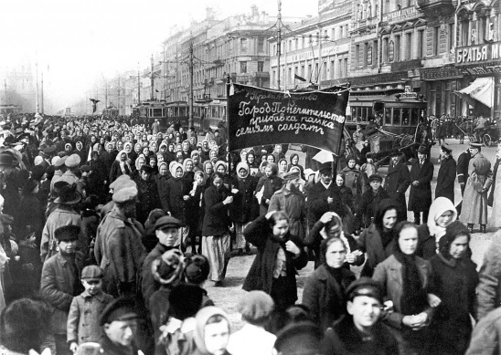
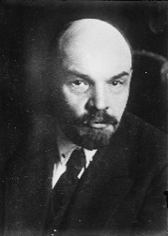
Bloody Sunday January 22, 195
Russia Enters WW1- August 1, 1914
Tsar Nicholas II assumes control over Russia - 1894
On January 22, 1905, angry steelworkers in St. Petersburg stage a peaceful protest. They were wanting reform in working conditions, the poor economy and the ongoing war with Japan. The protesters marched onto the Winter Palace to confront the Tsar to hand in a petition demanding change. Upon reaching the palace, panicked solders opened fire on the protesters causing the death of over 1000 people. This event was called “Bloody Sunday” and is largely believed to be the catalyst to the Russian revolution.
On August 1, 1914, Russia declares war on the central powers after they invade Russia’s ally, Serbia. Russian soldiers were underequipped and lacked military training. About 1/3 of the troops were not even issued rifles. Compounding the lack of equipment was the abysmal leadership of the Russian army and by the fall of 1915, 800 000 soldiers had died and no land had been won. The Russian people were discouraged and wanted nothing to do with the fight. In 1915, the Tsar takes personal command of the army, leaving his wife to run Russia by herself, although she seemed to be under the influence of Rasputin. This decision would cost the Tsar many of his supporters.
At the start of 1894, Nicholas II assumed control over Russia as the Tsar. His autocratic style of leadership caused many issues within Russia and a general disconnect between the royal family and the people of Russia. He wanted a nation containing only one nationality, that being Russian. As the leader of Russia, Nicholas started to reform Russia by proving education opportunities and modernizing its and modern infantry, however, he wanted everything under his control. He also began persecuting the Jews and used them as scapegoats for the problems faced. Nicholas also assumed control of the Russian army (White Army) and during the Russo-Japanese War suffered heavy losses and defeat though the war.
1894
1895
1905
1906
1914
1916
1917
Vladimir Lenin is arrested
December 1895
Rasputin gains notoriety among the Tsar and his family
Workers Strike March 8. 1917
In 1906, Grigori Rasputin becomes acquainted to the Tsar and his wife after apparently healing their son. Rasputin was seen by many as a mysterious visionary and even a prophet, but many people were concerned about the relationship between the Tsar and Rasputin. Many thought that Alexandra, the Tsar’s wife, was having an affair, prompting a decline in popularity of both Rasputin and the Tsar. Rasputin was believed to have had political influence as well.
Vladimir Lenin, a strong believer of Marxism created a strong Marxist group called the Union for the Struggle for the Liberation of the Working Class. Lenin encouraged the group to fight for workers’ rights. He was arrested for sedition. He was convicted without a trial and sentenced to three years in exile in Eastern Siberia.
Rasputin is murdered Dec. 30 1916
March 8, 1917, many factories in Petrograd went on strike and workers went on to the streets. The crowds of workers and women (who were celebrating Women’s Day) were demonstrating against the Tsar and the war. On March 10, orders came down for troops to fire on the demonstrators, but soldiers refused to open fire. Unlike the soldiers, the police and gendarmes did open fire, which caused a riot to break out between the police and the protesters, which included the workers, as well as the soldiers.
December 30, 1916, Rasputin died under mysterious circumstances. Rasputin's corpse had been shot 3 times twice in the chest and once in the head. He was also believed to be poisoned and was found in the Malaya Nevka river. Some people believe that he was murdered by British spies due to his anti-war sentiment and his close relationship with the Tsar. Many believed he could have persuaded Russia to leave the war, which may have left Britain and her allies to face the full force of the central powers.

Slide 3
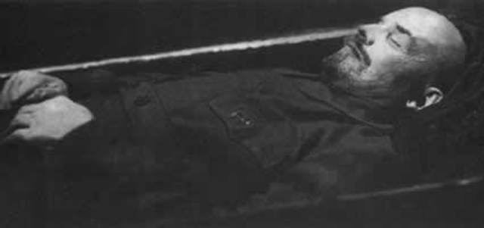
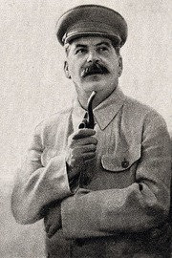
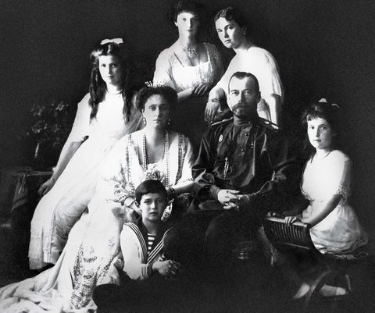
Start of the Russian Civil War (March 1918-October 1922)
The start of the Russian Civil War pitted the Bolsheviks’ Red Army, lead by Vladimir Lenin, against the remnants of the White Army, lead by loyalists and rich nobleman. The Red Army favoured socialism and wanted Russia to be ruled by socialist leaders under the banner of the USSR. They had a fierce leader and the support of the people. The White Army promoted western ideas such as capitalism and social democracy. It was their brutal aggression in warfare, which often included burning villages down and slaughtering the people, that lead to their downfall.
Vladimir Lenin dies January 21, 1924
On January 21, 1924 Vladimir Lenin passes away and a funeral was held on January 27. Over 10,000 people attended his funeral, which also included speeches by notable communist leaders.
Right before his death Lenin wrote a political testament wherein, he criticized Bolshevik leaders, particularly Stalin. Stalin had enough supporters in the government that this testament was not widely presented and allowed him to seize power of the party.
Russia leaves WW I – March 3, 1918
On March 3, 1918, the Treaty of Brest-Litovsk was signed between the Central powers and the newly formed Bolshevik government which ended Russia's involvement in the First World War. This decision was very popular with the citizens, who were suffering from a food shortages, a massive downturn in the economy, and the high death toll.
Stalin is appointed General Secretary
April 13, 1922
On April 3, 1922 Stalin is appointed to General Secretary of the Communist party. He was able to appoint men who supported him into ministry positions both in the Politburo and the party’s Central Committee.
t
October 1917
March 1918
July 1918
April 1922
June 1922
January 1924
1928
October Revolution -1917
Romanovs are executed July 16 1918
Russian civil war ends – June 1922
Stalin assumes control of the USSR
1924
On October 24 and 25 the Bolsheviks launch a coup against the Duma provisional government and take control of Petrograd and the Winter Palace. As a response, the Tsar abdicates his throne, and the Bolsheviks take control Russia and Lenin becomes the dictator of the world’s first communist state. Within weeks, the Bolsheviks start enacting communist laws, such as the ban on private property, and the Land Peace and Bread.
On March 22, 1917, the Tsar and his family were placed under house arrest by the acting provisional government. The family was moved frequently and finally ended up in the most radical communist city of Russia, Yekaterinburg. On July 17, 1918, the Romanovs were moved into a basement cellar and were executed, their bodies were dumped into a forest after being mutilated and stiped of all valuable belongings. The Romanovs were killed because they symbolized autocracy, which had no place in a Communist system
After exiling Leon Trotsky, Joseph Stalin takes full control over the Communist Party and is now the dictator of the USSR. He starts to implement a 5-year plan in an effort to improve the state of Russia, much like the Tsar tried to do decades earlier. Stalin’s rise to leader of the USSR, ends the Russian Revolution.
The Russian Civil War ends with a Bolshevik victory over the White Army. The USSR is formed after the Bolsheviks are able to take Russia nearly unopposed after years of fighting. Widespread famine, disease and drought due to the chaos of the war, kills millions on both sides.

