Slide 1
Rights of witness

Slide 2
Your rights as a witness
Any witness has the rights not to have what they say used against them in any other court case then the one that they are testifying in. And if you don’t speak the language that the court is conducting the trial in you have to right to a translator.

Slide 3
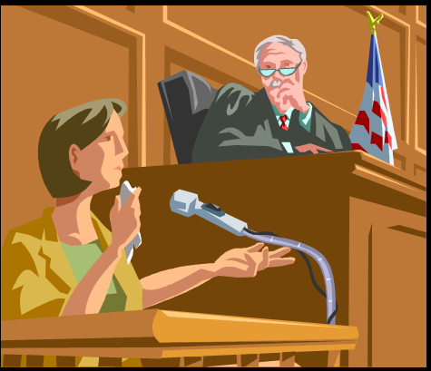
Who can be a witness
A witness can be any one the testifies or gives a statement in a court room, even the defendant or accused

Slide 4
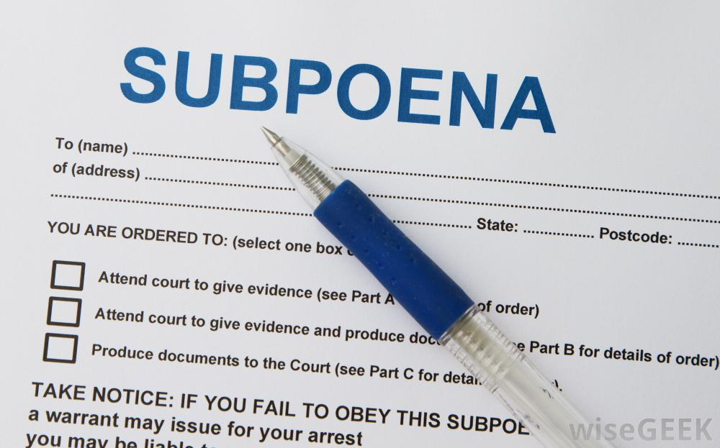
How to become a witness
You can agree to become or be ordered to become a witness by receiving a subpoena

Slide 5
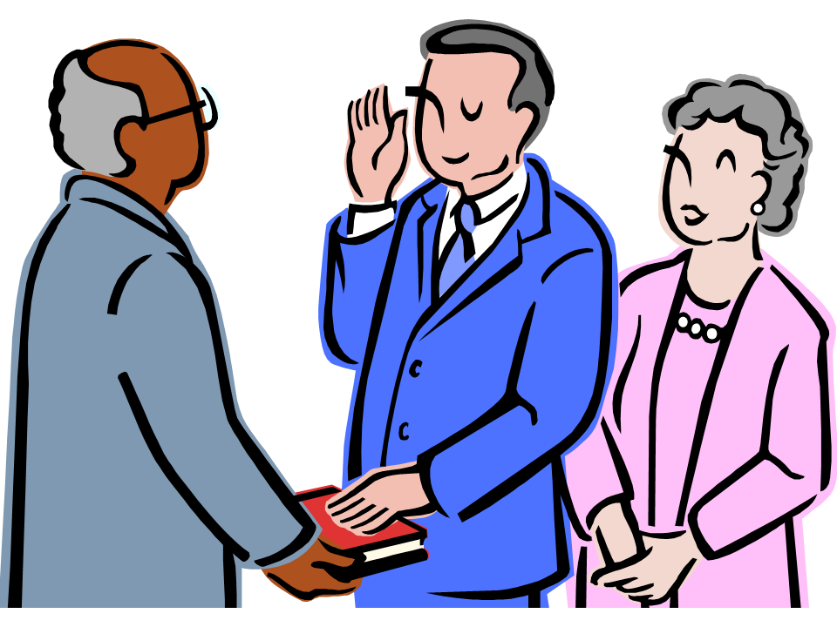
Giving a oath
You must swear the you will tell the truth and under law you are held to that, if you are found out to be lying knowingly then you can face jail time of up to 14 years

Slide 6
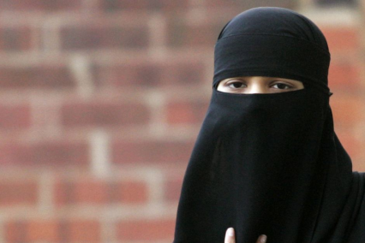
Real life
A female Muslim witness in a sexual assault case wished to wear her niqab while testifying, the court denied this request. A matter that halted the whole trial while the decision was taken to the supreme court of Canada were they ruled that wearing this religious piece would interfere with the courts ability to give a fair trial. This is breaking the religious right of this woman that is stated under the charter.

Slide 7
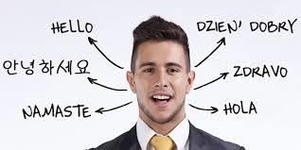
Example
A German speaking Canadian citizen is asked to be a witness in court, he agrees. This man doesn’t speak English and request a translator in court so that he can give his statement. The courts deny him this request. This is breaking his Rights as Witness.

Slide 8
Source:
https://scc-csc.lexum.com/scc-csc/scc-csc/en/item/12779/index.do
http://www.legal-info-legale.nb.ca/en/being_a_witness_court
http://www.theglobeandmail.com/news/national/witness-may-be-required-to-remove-niqab-while-testifying-top-court/article6588243/?page=all
http://laws-lois.justice.gc.ca/eng/Const/page-15.html

