Slide 1
How the Mountains of North America were formed
Definition: anything higher than a hill (Really usually around 2000 ft.)

Slide 2
How fold mountains are created

Slide 3
The Rocky Mountains (an example)

Slide 4
Mt. Everest is a fold Mountain that is getting taller and taller. Eventually it will get too tall and fall over.

Slide 5
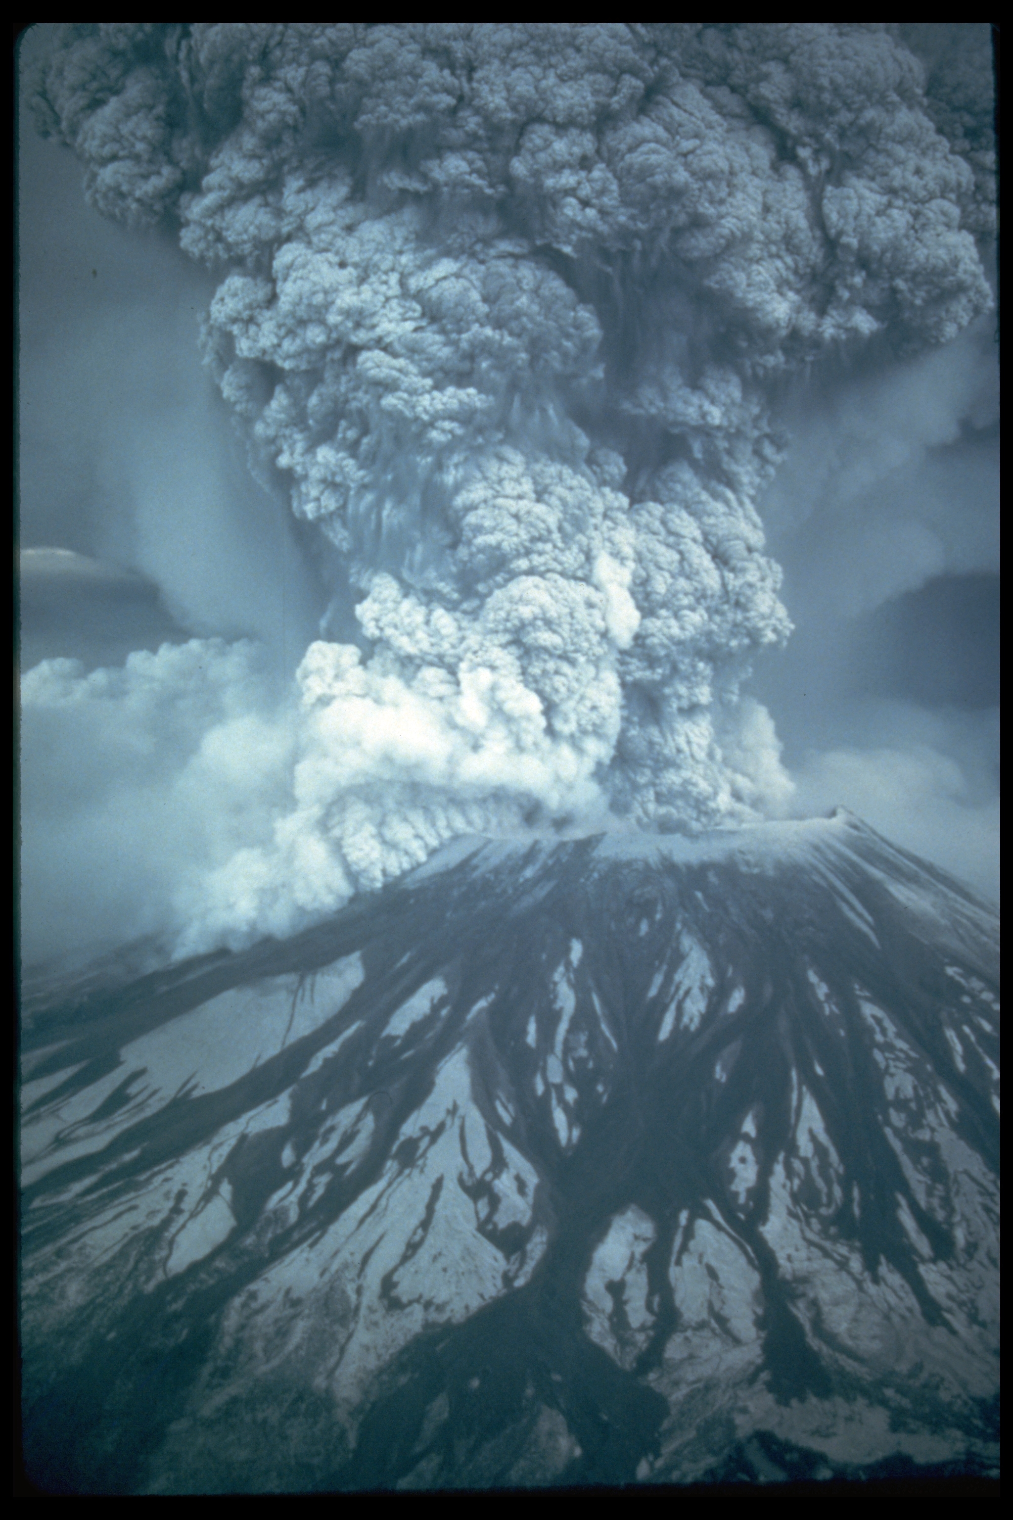
Volcanic Mountains

Slide 6
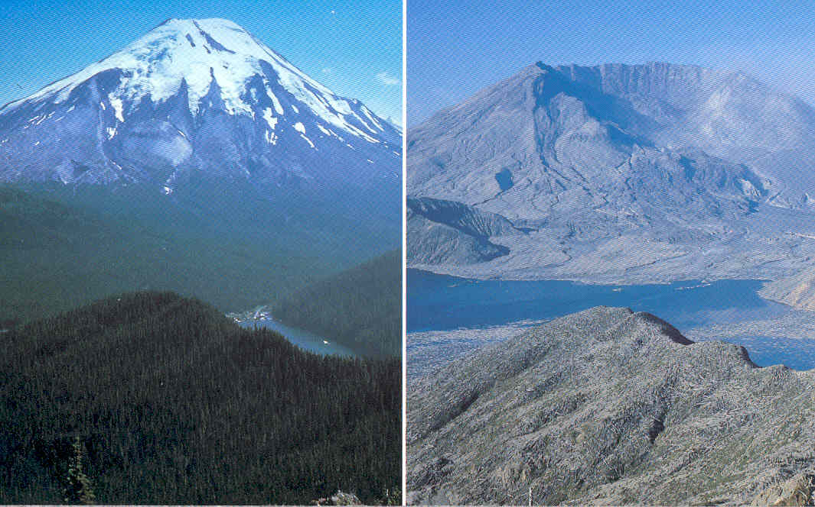
Mount St Helens. May 20, 1980 Before and After

Slide 7
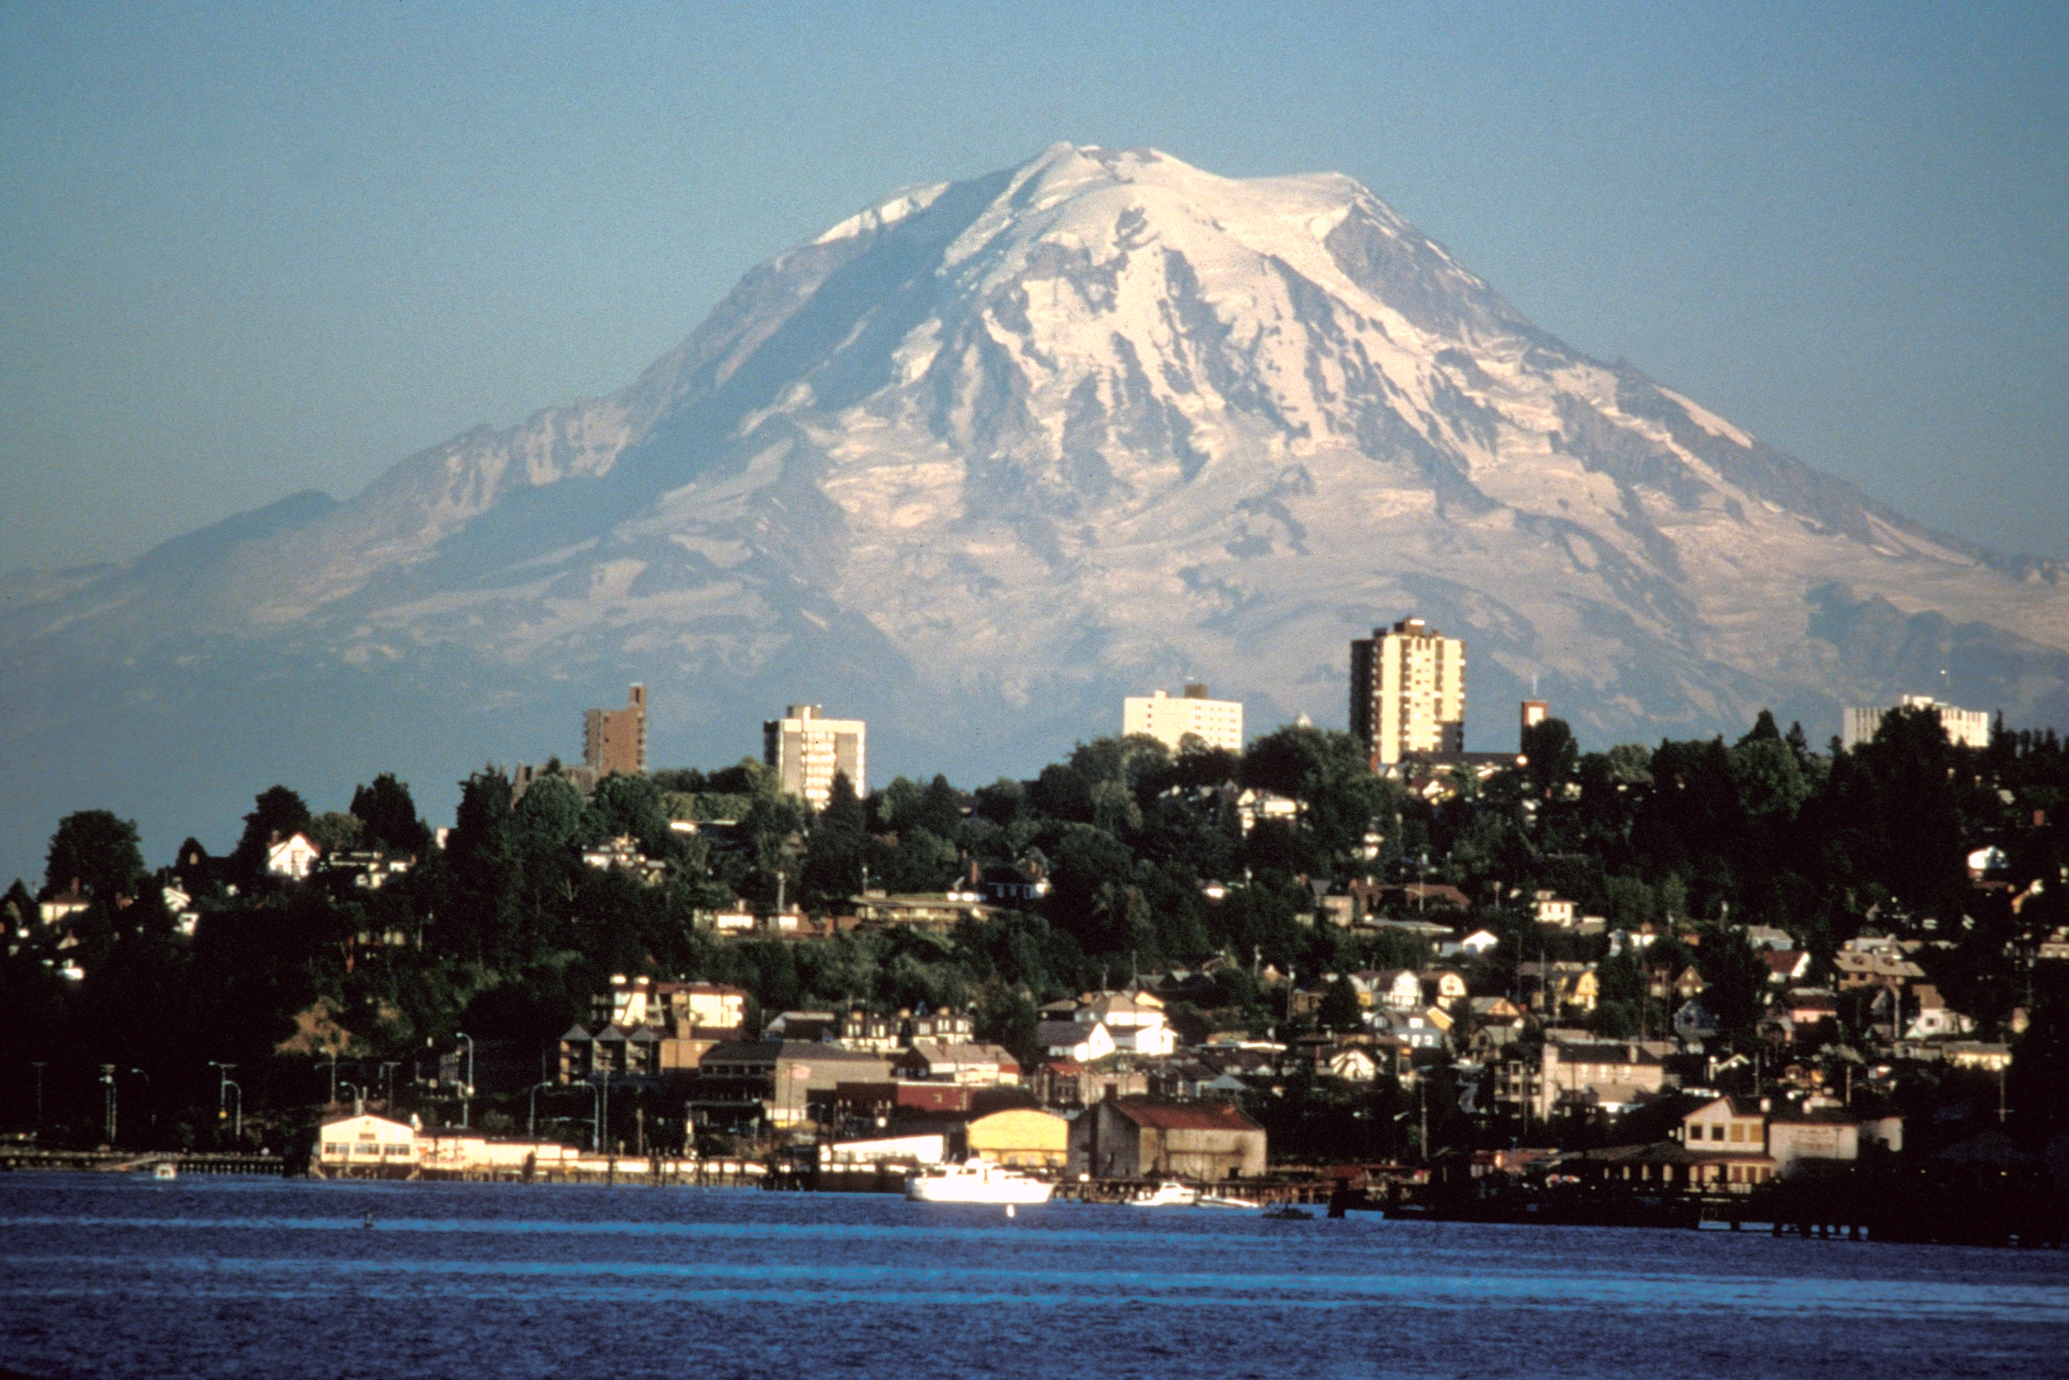
Mount Rainier Near Tacoma Washington

Slide 8
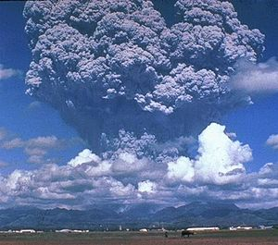
Pinatubo ash plume reaching a height of 19 km, 3 days before the climactic eruption of 15 June 1991

Slide 9
Mt. Vesuvius, Pompeii Italy

Slide 10
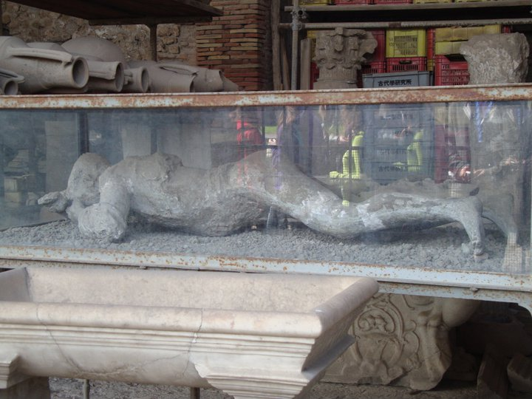
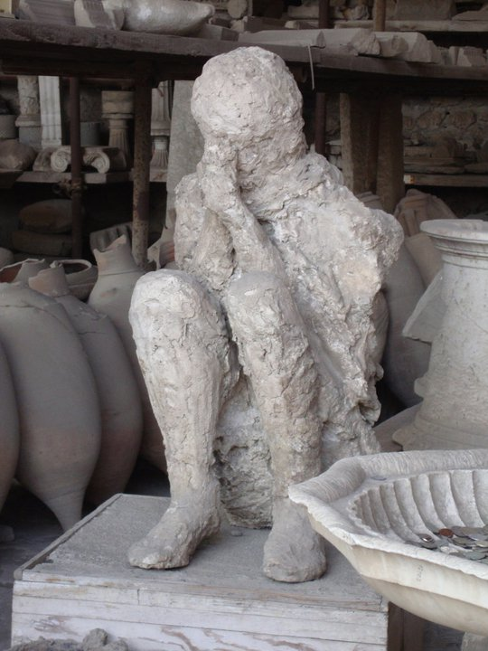
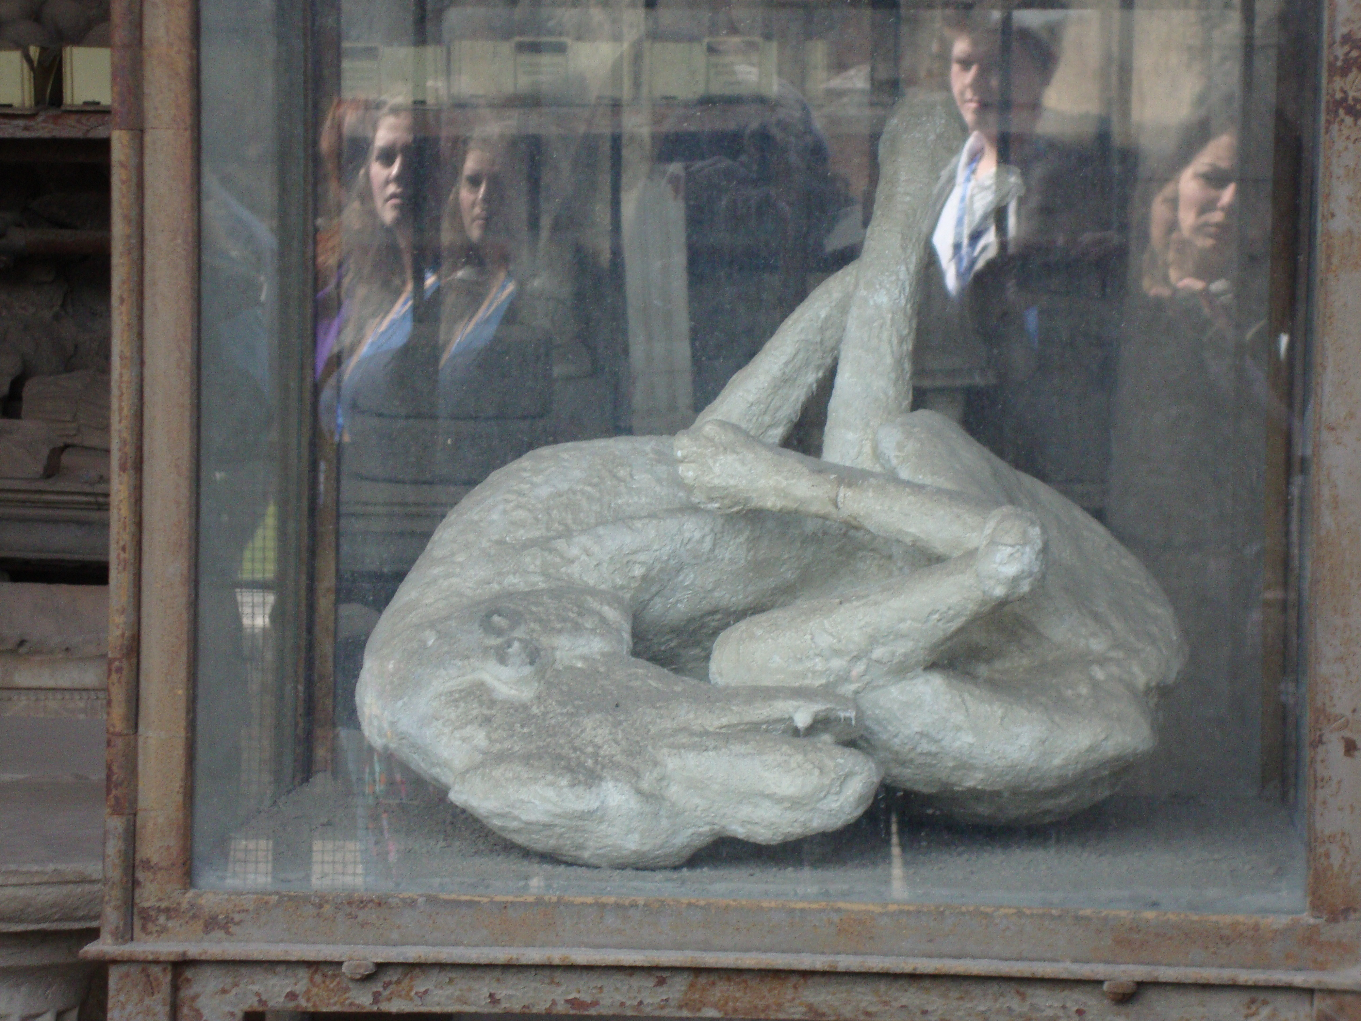

Slide 11
Volcanoes can also create islands when they erupt in the sea

Slide 15
Old Faithful. Yellowstone

Slide 16
Ice Age: Wore Down Mountains and Created the Prairies

Slide 17
Glacier Eroding Mountains

Slide 18
Prairies caused by dams of glacier silts that clogged up lakes. Eventually they dried out

Slide 19
Terms to know (please copy down)
Topography: What the land looks like
Climate: Temperature and amount (or lack of) precipitation
Vegetation: What grows there (naturally)

