Slide 1
Picture Set Activity
One partner faces the screen, the other partner faces away.
One partner describes in detail the picture on the screen for one minute.
Once complete, the other partner will look at the photo and provide one compliment to their partner. Share out a few as a class. Repeat.

Slide 2
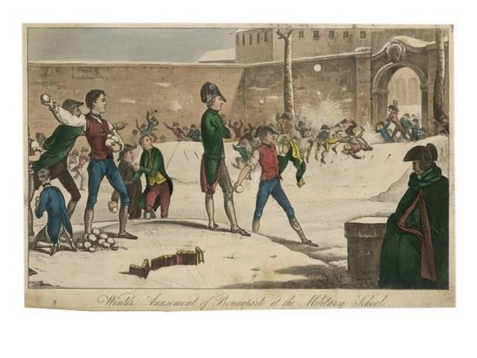

Slide 6
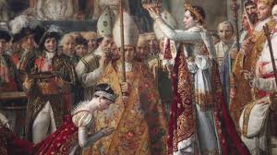

Slide 7
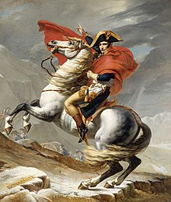

Slide 10
For Discussion
*What are some commonalities in these pictures.
*What do these pictures suggest about the material we will be studying?
* What type of person is the man in many of these photographs? (Give some evidence for your views.)

