Slide 1
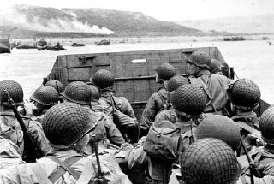
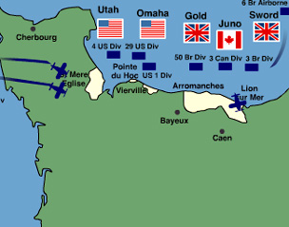
Re-Taking France
https://www.youtube.com/watch?v=Qj3X7HfezzE
(Band Of Brothers – Paratroopers – Like Blitzkrieg) - Landing on D-Day.

Slide 2
Shaping Questions
How did D-Day remain a secret?
How could an invading force so large take Nazi’s by surprise.
Watch Film:
http://www.youtube.com/watch?v=xqIACSKI4sI

Slide 3
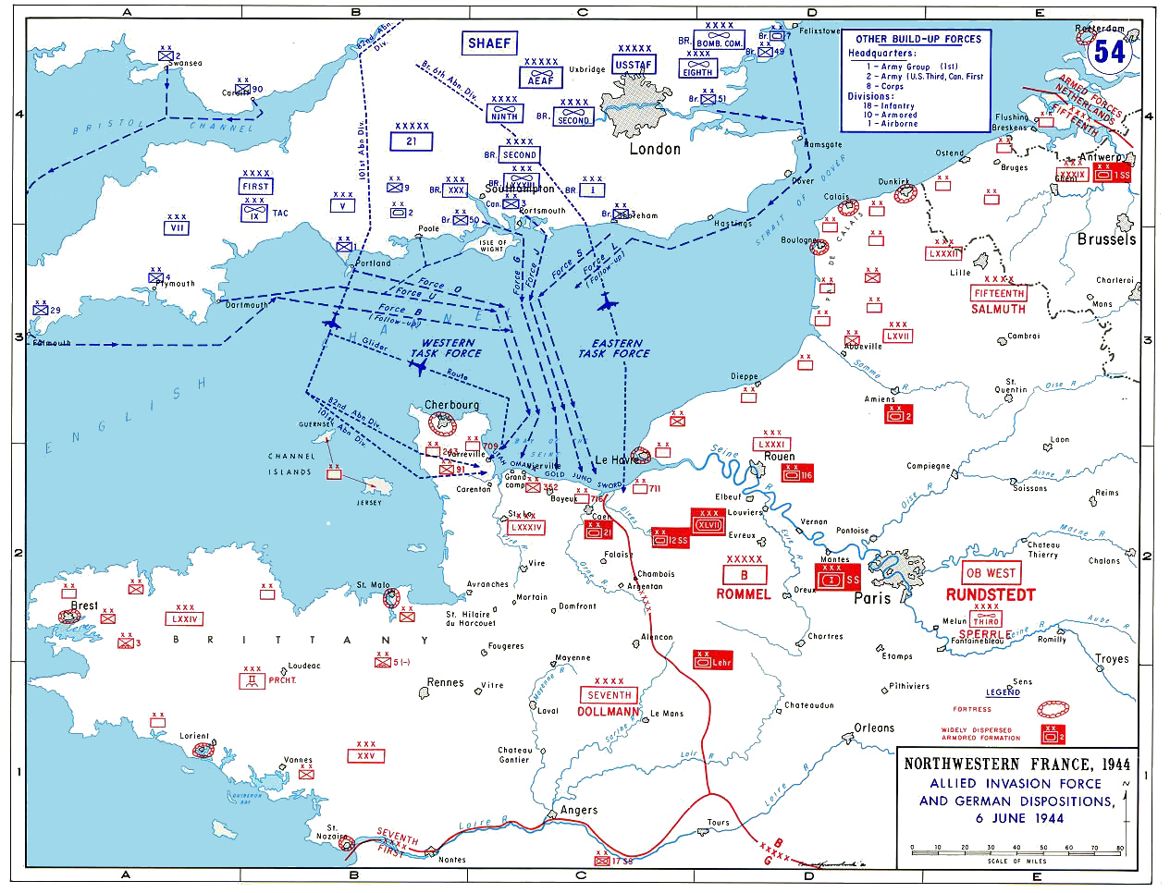

Slide 4
Opening the western front/ Germany’s defeat
6 June 1944: 3-4 names for this event:
-Operation overlord
-D-day (The D does not stand for anything)
-Battle of Normandy
-Longest day

Slide 5
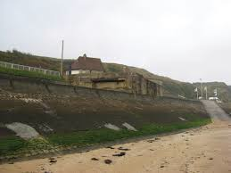
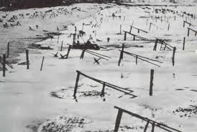
Hitler’s Preparations
By the spring of 1944, Hitler anticipated an Allied invasion on the shore of France.
He placed the task of defending “Fortress Europe” in the hands of Rommel
The Germans did a number of things to make landing on the shores very difficult:
-bunkers
-mines
-razor wire
-barriers
-sentries

Slide 6
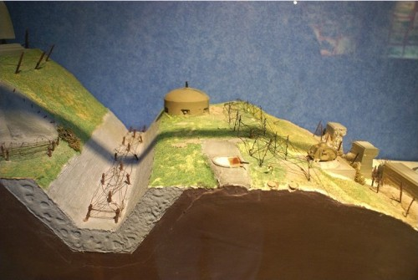

Slide 7
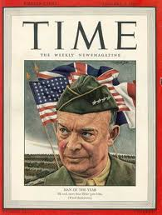
Allied commander: Dwight Eisenhower
Size of force: 3,000,000(175,000 first wave)
The Allies divided the shores of Normandy in to 5 beaches: Omaha, Utah, Gold, Juno, Sword
On the day of the attack the British ,American ,and Canadians used 3 different methods:
Gliders dropping men behind enemy
lines eg. Securing the Pegasus bridge
Amphibious assault
Extensive aerial support

Slide 8
A Quick Clip of Saving Private Ryan
https://www.youtube.com/watch?v=QHvqS2kk1rs - Saving Private Ryan
-Shows the American landing force at D-Day. They had it the hardest.

Slide 9
The End is Near!
By the end of the “longest day” the Allies had secured the beaches.
By 25 AUG.1944, the Allies and Charles de Gaulle marched into Paris.
The Allies had mixed success in Western Europe. During Operation Market Garden , the Germans slaughtered 3 airborne divisions that were dropped above their positions.
During the Battle of the Bulge, 200,000 German troops attacked a weak point in the Allied lines.
The fighting took place in DEC. of 1944, and despite some early advances, the Germans were halted on Christmas Day.

Slide 10
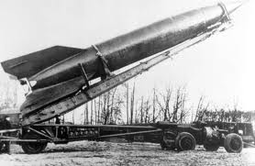
With little hope of winning the war, the Germans launched a new form of warfare against London.
V-1 (buzz-Bomb): gasoline powered bomb (Cruise Missile)
V-2: guided missile flying faster than the speed of sound-
Meant to induce TERROR. By showing that England could be hit from Germany without losing German lives.

Slide 11
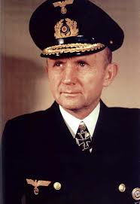
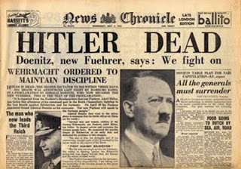
Hitler Kaput!
By late April 1945, USA and Russian forces met just south of Berlin. On 30 April, Hitler committed suicide. On May 2, Berlin fell to the Russians, and on May 7, Germany surrendered.
Admiral Karl Doenitz placed in Charge.
Policeman’s Favourite Admiral.

Slide 12
Doenitz Film Clip
http://www.youtube.com/watch?v=FHnyQXyuTGY
Admiral Doenitz Takes Over.

