Slide 1
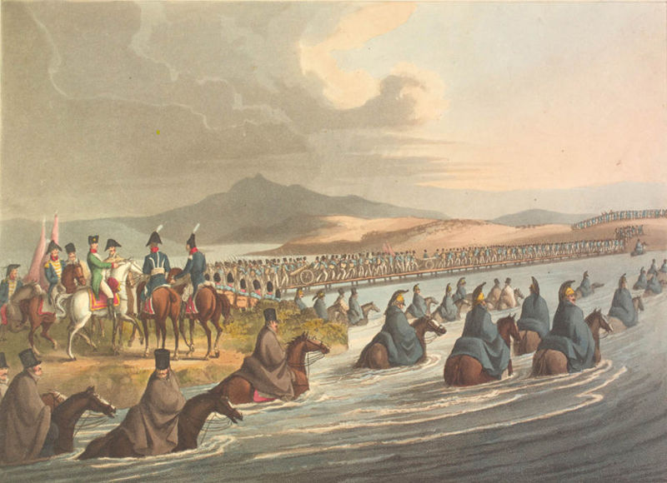
Napoleon’s Russian Campaign

Slide 2
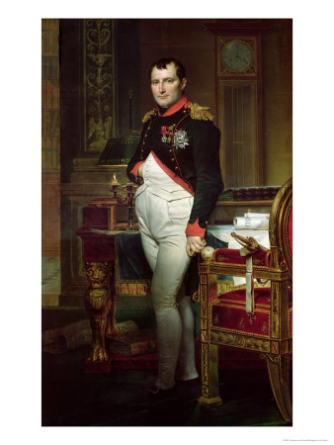
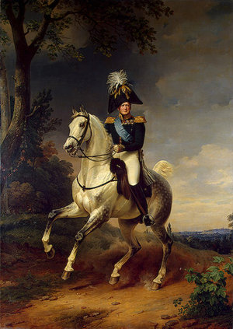
Napoleon vs Tsar Alexander

Slide 3
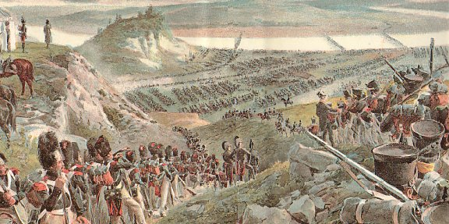
Grand Armee
Included soldiers from almost every nation of Europe
All were commanded by French Generals
The largest non-French contingent came from Poland

Slide 4
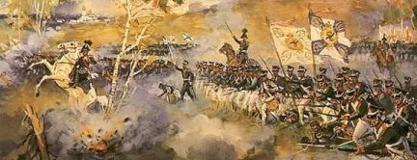
Russian Army
Soldiers were drafted for 25 years (life!)
No more than 10% survived dreadful conditions and brutal beatings
When drafted, families often treated the event as a funeral
No promotion – officers were nobles
Were immediately shot if they showed any signs of cowardice

Slide 6
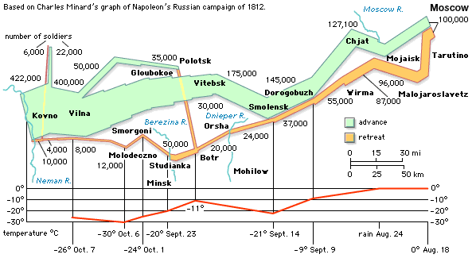
Vilna

Slide 7
Lets hear fom...
Louis and Claude

Slide 8
Vitebsk

Slide 9
Lets hear fom...
Jean, Aundre, Charles and Florian

Slide 10
Smolensk

Slide 11
Lets hear fom...
Jean- Paul and Pierre

Slide 12
Battle of Borodino

Slide 13
Lets hear fom...
Joseph, Frank and Bruno

Slide 14
Moscow

Slide 15
Lets hear fom...
Russian Man 1, Laurence, Hubert and Martin

Slide 16
Crossing the Berezina River

Slide 17
Lets hear fom...
Russian Man 2, Mattiew, Maxime and Maurice

Slide 18
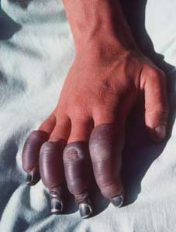
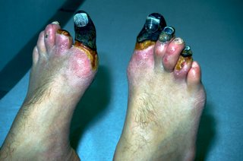
Frostbite

Slide 19
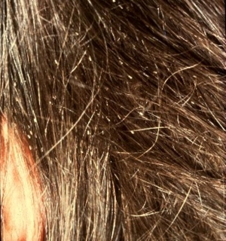
Problem Three: Lice and other diseases
Men would be covered in it – creating horrible itching
As starvation and disease took their toll the desertion rate soared. Most of the deserters were taken prisoner or promptly executed by Russian peasants

Slide 20
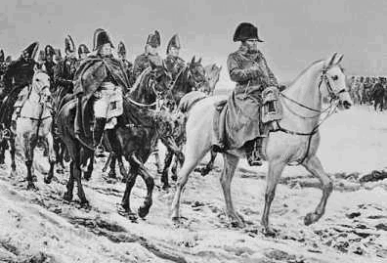
Napoleon?
Blamed many others, including the weather for this defeat
He decided to head back to Paris ahead of the army, to keep his control over Europe
Napoleon was safe from lice and starvation as he always had a regular supply of food & wine, a place to sleep with a camp bed, razors, brushes and other toiletries

Slide 21
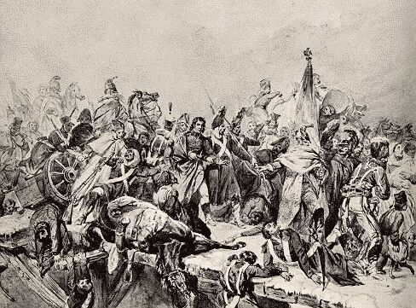
Statistics
The total number of French troops heading into Russia between June and December was around 600 000
Only about 120 000 of those made it out of Russia in December

Slide 22
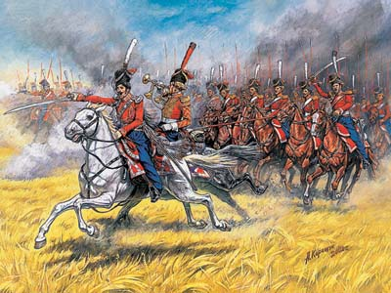
Statistics
The total number of Russian casualties was estimated at around 400 000

Slide 23
Later Napoleon said:
"I made a mistake in attacking Russia. I thought the whole world would be with me. Everybody turned against me. . . . One shudders when one thinks of such a mass as Russia that one cannot attack either from the side or from the rear. . . . She overflows on you if you lose; she retires into the middle of the ice banks if you win, and suddenly comes out again like the head of the Hydra. ... It is not in our province to attempt such a Herculean task, and I tried it stupidly. That I must admit."

Slide 24
Did Anyone Learn from Napoleon’s Mistakes?
Napoleon Bonaparte started for Moscow on June 24, 1812.
Adolf Hitler started on June 22, 1941.
Both had their units get stuck in the muddy fall
Napoleon stayed in Moscow for nearly six weeks, suffered cold and defeat in the frigid Russian winter
Adolf Hitler had to eventually order all of the skis, ski poles, snowshoes and all furs suitable for military wear in Germany to be shipped to Russia.

