Slide 1
1956
By: Tessa Freeman
History 12 June 7th, 2016

Slide 2
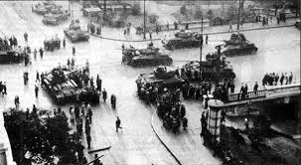
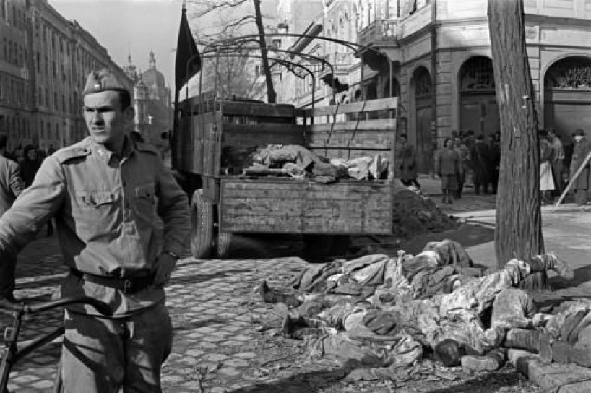
Budapest~ Political History
Students started the uprising of the Hungarian revolution.
It was against the Hungarian Peoples Republic.
The Soviet Union first threat of control since the end of WW2.
Demanded political changes.
Significance was Hungary people stood up against the Soviet rule. The people were close to winning against the Soviet Union, but it was stopped just as fast as it started.

Slide 3
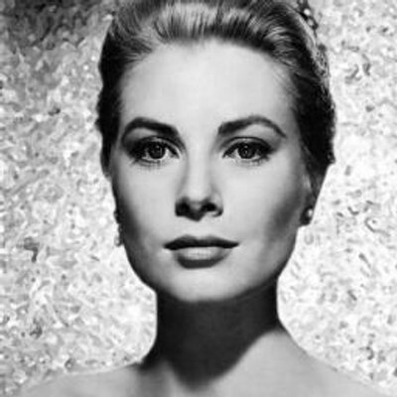
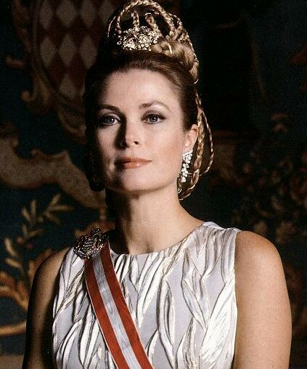
Princess Grace~ Social History
Born November 12, 1929 – September 14, 1982
American actress who married Prince Rainier III and became Princess of Monaco.
Nominated for many Academy Awards and won Golden Globes.
Princess Grace has significance because she left behind the legacy of her non-profit organization for supporting the “…well-being of children throughout the world.”

Slide 4
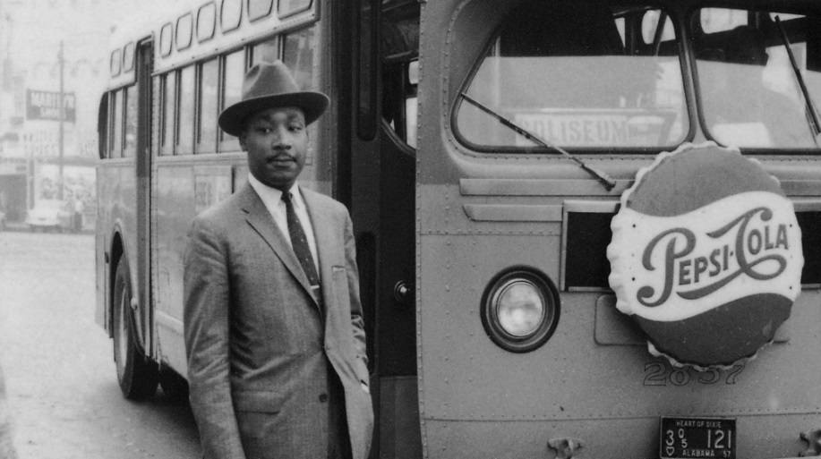
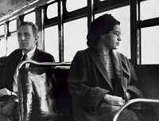
Alabama~ Political, Social History
Rosa Parks sat in a spot assigned to “whites only” causing her to be arrested.
Took Supreme Court to say segregation on public transportation is unjust.
This event was a starting point for Civil Rights movement by Martin Luther King.
Rosa Parks was one of the many to stand up against social injustice. She will always have a significance in History for standing up for her rights and against discrimination.

