Slide 1
The Happiness Advantage
Princess Margaret Secondary
The Brain Works Better at Happy!

Slide 2
The Happiness Advantage
Happiness and Optimism
FUEL
Performance and Achievement
https://youtu.be/GXy__kBVq1M - Ted Talks
https://youtu.be/TBRy3QrRGFI Ted Talk – Shawn Achor

Slide 3
The Happiness Advantage
7 Principles
#1: The Happiness Advantage
#2: The Fulcrum and the Lever
#3: The Tetris Effect
#4: Falling UP
#5: The Zorro Circle
#6: The 20-Second Rule
#7: Social Investment

Slide 4
The Happiness Advantage
Brain functions better
More thoughtful, creative and open to new ideas
Broadening Effect
Positive emotions fill our brain with dopamine and serotonin
Organize new information and retrieve it faster later
Think more creatively
More skilled at complex analysis and problem solving
Invent new ways of doing things
Undoing Effect
Positive emotion antidote to physical stress and anxiety

Slide 5
The Happiness Advantage
Prime for success: Students when asked to think of something happy before a test consistently outperform control group.
Doctors make a more accurate diagnosis when given a piece of candy
Undoing effect – burst of positivity – joke, funny activity, video
FOR CLASS DISCUSSION:
WHAT ARE SOME EXAMPLES IN SCHOOL OF STRESSORS THAT COULD BE DONE DIFFERENTLY? Ie: Exams in Gym…

Slide 6
The Fulcrum and the Lever
Changing the fulcrum of our mindset and lengthening our lever of possibility, we change what is possible.
How you interpret the world – manipulating your external reality
How you use and view your time
Seeing the value in what you do
Notes:
Reality of age – group of 75 year old men sent a retreat center– and created a world where they were 55 again (dress and act, activities, food, conversations, movies, tv) tested pre and post on a series of test – strength, memory, cognition, hearing and sight – all performed significantly better – pictures – looked an average of 3 years younger. The thought - body believed.
Cleaning the playroom -

Slide 7
The Fulcrum and the Lever
Notes:
Reality of age – group of 75 year old men sent a retreat center– and created a world where they were 55 again (dress and act, activities, food, conversations, movies, tv) tested pre and post on a series of test – strength, memory, cognition, hearing and sight – all performed significantly better – pictures – looked an average of 3 years younger. The thought - body believed.
Cleaning the playroom -

Slide 8
The Fulcrum and the Lever
Reality of age experiment – group of 75 year old men sent to a retreat center– and created a world where they were 55 again (dress and act, activities, food, conversations, movies, tv shows)
Tested pre and post on a series of test – strength, memory, cognition, hearing and sight – all performed significantly better after.
Pictures – looked an average of 3 years younger. The thought of being younger made the body believe.
Hilarious old man skateboard prank leaves punk skaters with their mouths open !! - YouTubeHumorous old man skateboard prank *turn volume down due to lyrics.
Notes:
Reality of age – group of 75 year old men sent a retreat center– and created a world where they were 55 again (dress and act, activities, food, conversations, movies, tv) tested pre and post on a series of test – strength, memory, cognition, hearing and sight – all performed significantly better – pictures – looked an average of 3 years younger. The thought - body believed.
Cleaning the playroom -

Slide 9
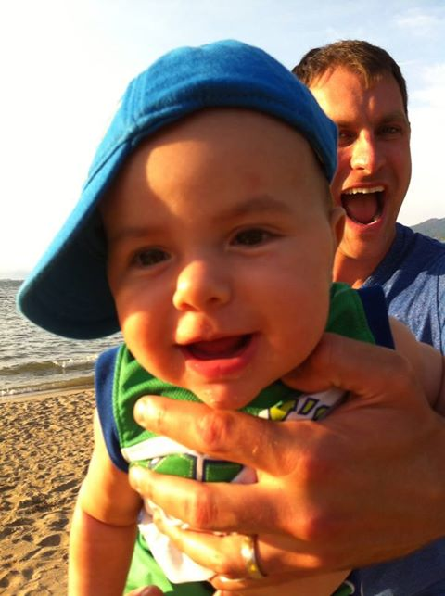
Activity:
Walk around the room and look at every single thing that you can think of that is red.
Discussion:
This relates to the lens through which you view the world. Want to scan for the positive, not the negative. We will see either one.
Notes:
Through a lens activity… get students to walk around the room and seek out everything in the room that is red. Then they have to face a partner, close their eyes (or keep open) and state everything that is blue. Discuss how this relates to the lens through which you view the world. Want to scan for the positive, not the negative. We will see either one.

Slide 10
The Tetris Effect
Repeated exposure creates new neural pathways that warps the way you view real life situations
See what we are trained or “want” to see – Lawyers will go home and argue with kids/spouses. Accountant once made a spreadsheet of all of his wife’s drawbacks.
Train your brain to see the positive
Pick up on more positive and feel better
Become more grateful
You will expect more positive outcomes
Feel Good List
http://www.youtube.com/watch?v=ae-ypgdd5-8 Shawn Anchor (0:50-5:32)
https://www.youtube.com/watch?v=9Z-eG7z6Kqw Tetris Effect –
Notes:
Played tetris for multiple hours – three days in a row – in the following days participants literally couldn’t stop seeing falling shapes
Seeing pregnant people or that new car you are looking for
English teachers always looking for gramatical errors?
Breakdancing bear video
We retain 1 out of every 100 pieces of information – what do you “Choose” to see?

Slide 11
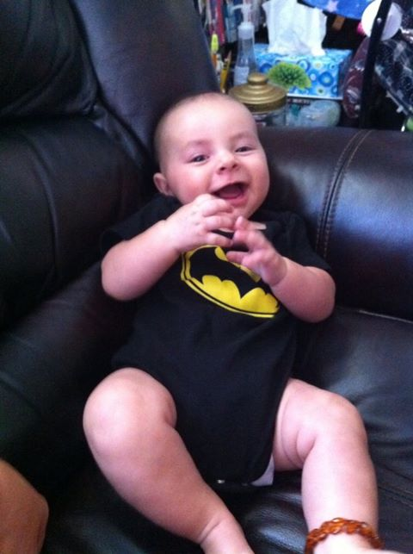

Slide 12
Falling Up
The ability to move up NOT despite the setbacks, but because of them
Overcome small challenges to develop critical skills (problem solving)
Seeing the opportunity
Notes:
Micheal Jordan, 50 people in a bank – one shot in the arm. Lucky or unlucky? I was lucky that only shot in the arm; I was lucky that no one else got hurt. Or, I was unlucky, I was only one shot out of 50 people.

Slide 13
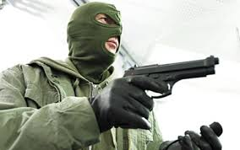
Falling Up
Michael Jordan – Very resilient
Scenario: Discussion for students – There are 50 people in a bank with you – as a robber leaves he shoots one person in the arm – YOU.
Discussion: Are you Lucky or unlucky
I was lucky that only shot in the arm; I was lucky that no one else got hurt. Or, I was unlucky, I was only one shot out of 50 people
Notes:
Micheal Jordan, 50 people in a bank – one shot in the arm. Lucky or unlucky? I was lucky that only shot in the arm; I was lucky that no one else got hurt. Or, I was unlucky, I was only one shot out of 50 people.

Slide 14
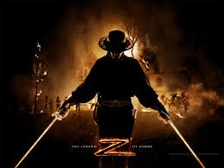
The Zorro Circle
Success in small, controlled, manageable tasks
Create an Internal locus of control
Avoid the “Jerk” response caused by stress and fight or flight
The Mask of Zorro: Sword Fight Training Scene (Antonio Banderas, Anthony Hopkins 4K HD Clip) – YouTube (Zorro Training Circle – Antonio Banderas and Anthony Hopkins - what is Zorro’s end goal… what does he do to get there?)
Class discussion: What are some things we can control?
What is something stressing you and what is ONE small thing you can do to help?
Notes:
The story of zorro,
Thinker (cognitive system) and the Jerk (emotional) – when stressed and too much – the little things put us over the edge – becoming mindful of stress levels
Classes – small projects – break it into chunks.

Slide 15
20 Second Rule
You can teach an old dog new tricks ☺
(but why is it so hard?)
Have to create new routines – that don’t fight will power
Make the desired choice the easier choice – path of least resistance (Ie: put remote control batteries in another room in a locker drawer; put your homework on the tv table).
Lower the activation energy for the habits you want to adopt and raise it for habits you want to avoid
Notes:
Common sense is not common action – we all know we should…so why don’t we? Why cant we all be positive? Have to work at it!
Groups of people were given a plate of cookies – one eat, one don’t – the don’t one gave up on complexe puzzle sooner that all other group
Take the batteries out of the remote – but leave a book or some marking on the side table. Put the alarm clock on the other side of the room
Make it visable. Take away all the time sucks – multi tasking is not effective!

Slide 16
20 Second Rule
https://www.youtube.com/watch?v=Kp-qzIvG2XI
A small video on willpower
Common sense is not common action – we all know we should…so why don’t we? Why can’t we all be positive? Have to work at it!
Willpower is a finite resource.
Take the batteries out of the remote – but leave a book or some homework on the side table. Put the alarm clock on the other side of the room. Don’t buy unhealthy food.
Want to learn to play guitar? Put it into the room where you spend most time, not somewhere that you have to get it.
Make it visable. Take away all the time sucks – multi tasking is not effective!
Notes:
Common sense is not common action – we all know we should…so why don’t we? Why cant we all be positive? Have to work at it!
Groups of people were given a plate of cookies – one eat, one don’t – the don’t one gave up on complexe puzzle sooner that all other group
Take the batteries out of the remote – but leave a book or some marking on the side table. Put the alarm clock on the other side of the room
Make it visable. Take away all the time sucks – multi tasking is not effective!

Slide 17
Social Investment
People with solid social supports are happier, more productive, engaged, energetic and resilient
Feel more valued, irreplaceable and experience more joy in working environment
Make time for valuable social interactions

Slide 18
The Ripple Effect…
Activity: Now, partner up with someone and face them. Make them smile.
Smile in the hallways, make someone’s day better. Share with a partner something you plan to do today to make someone’s day better….
Spark Positive Emotion
Notes:
Partner up – arrange your chairs facing each other – without talking – one partner raise your hand – this partner is it – make the other person smile.
Just takes one person to have an influence – the behaviors we exhibit are the ones our students mirror back.
Smile in the hallway. Say hi to students.
Get outside – take a walk with your colleagues or students
Remember when jar…

Slide 19
So – What Should We Do?
Gratitude Journal. 3 new things per day you are thankful for, 20 days in a row. Cannot duplicate any.
2. Journal for 3-5 minutes per day about something that made you happy in the previous 24 hours. Basically, you relive it.
3. Conscious Acts of kindness. Go out, intent on doing something kind for someone. *You can’t just think back and write that you did something kind. You must actively search out to do it .
Achor’s other suggestions: Exercise and Meditation

