Slide 1
Empathy Exercise
Sympathy: I feel sorry or pity for you
Empathy: Honestly trying to understand or imagine what it is like to be someone else or to be in someone else’s situation; to walk a mile in someone else’s shoes.

Slide 3
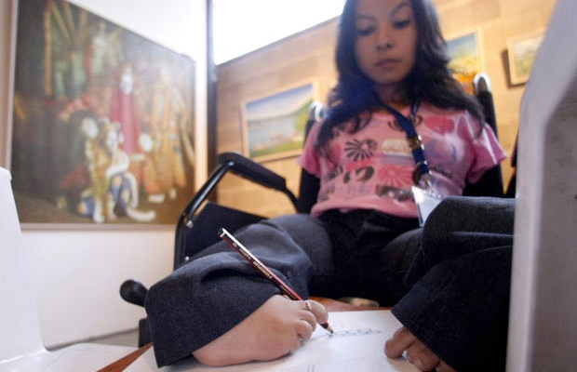

Slide 4
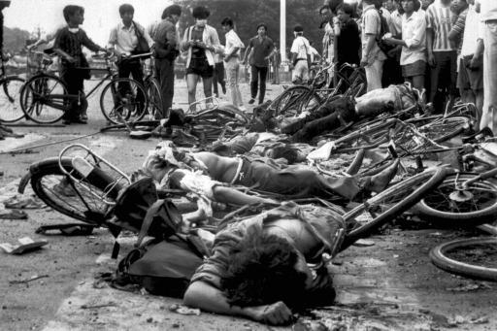

Slide 5
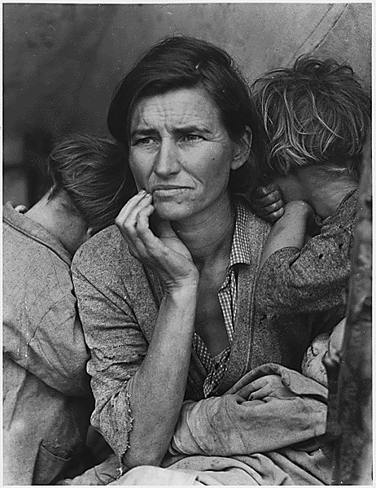

Slide 6
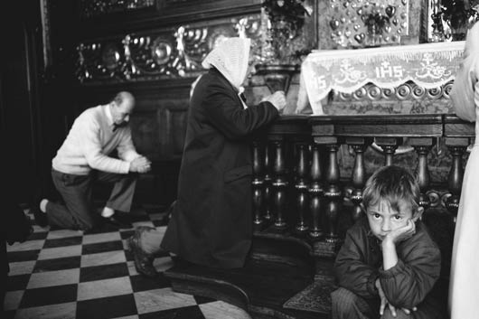

Slide 8
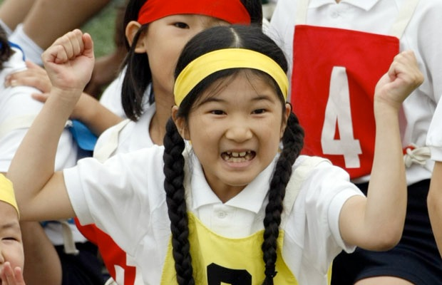

Slide 9
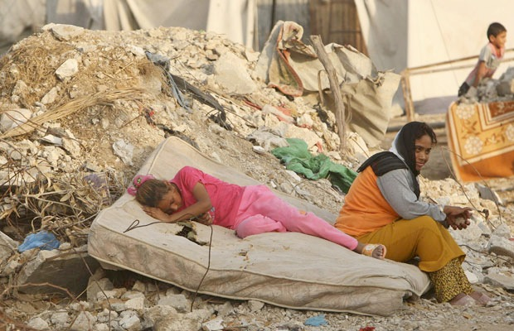

Slide 10
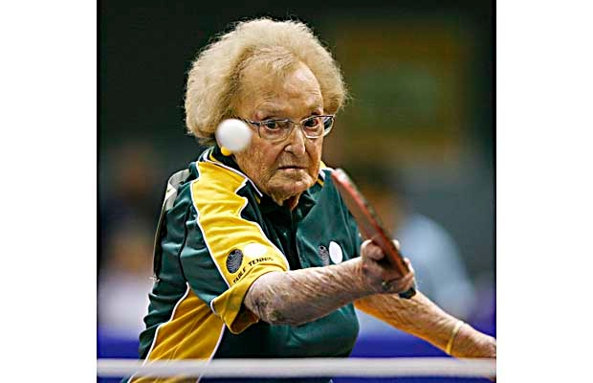

Slide 11
Instructions:
Do not get hung up on the activity. Your goal is to explain about the person and their background. Look at:
Facial Expression
Anything that is used to create “Character”
Appearance
Eyes, style, fashion, fatigue?
Emotions
Clothing
Body Language

