Slide 1
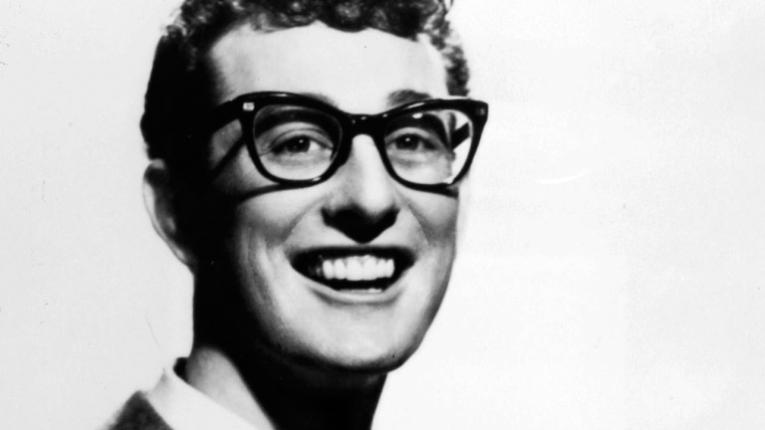
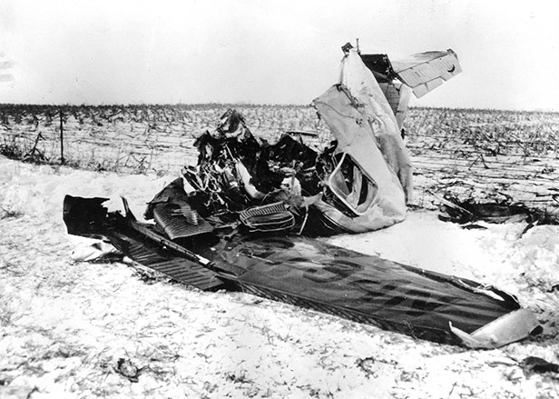
Buddy Holly
Social
Buddy Holly was a musician who’s short life was like a roller coaster. He rose to fame at the age of 16, but his life was ended at 22 when his plane crashed in 1959.
Significance
This struck sadness into the hearts of Americans, as a national treasure had just died.

Slide 2
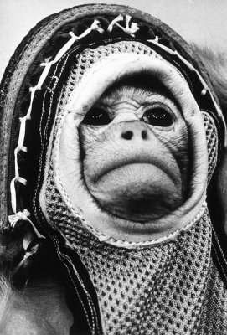
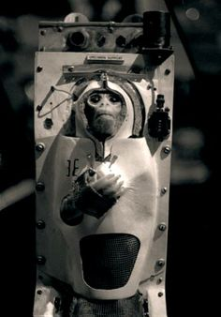
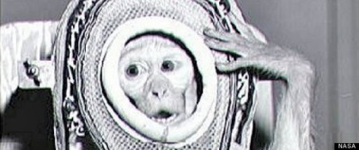
Space Monkey
Social/political
Two monkeys, Able and Baker, were sent into space on a Jupiter missile. Their heartbeats were monitored, as well as their temperature. The monkeys survived and were found in the South Atlantic Ocean.
Significance
This is significant because it struck controversy. Space experts saw it as a scientific success, while animal welfare groups criticized it as a form of abuse.

Slide 3
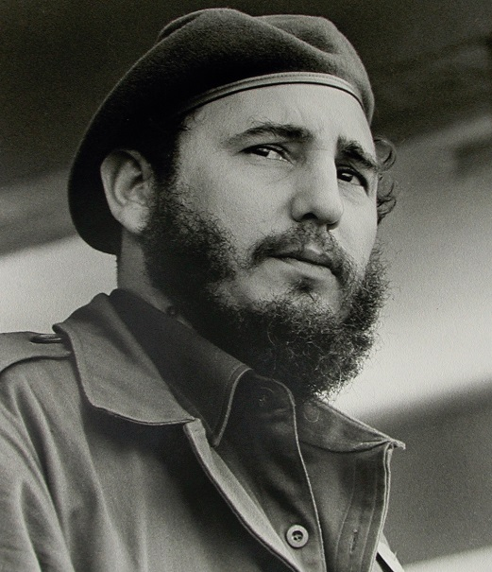
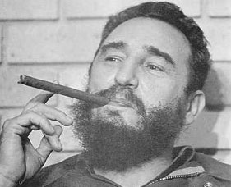
Castro
Social/ Political/ Governmental
Significance
Fidel Castro was a communist leader that influenced other countries to be communist. This scared the western democratic people because it was proof that communism was still on the rise.
Fidel Castro was a communist leader of Cuba from 1959 to 2008. He was responsible for starting communist revolutions in other countries. He launched a guerrilla warfare campaign and had taken over Cuba in one year.

