Slide 1
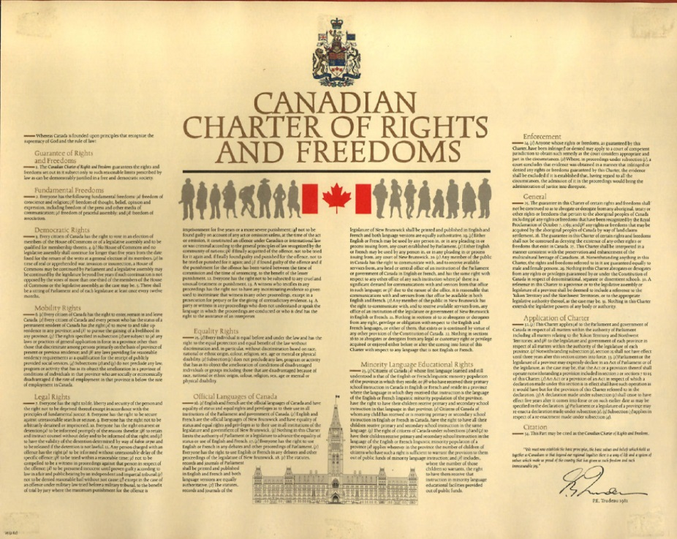
The Charter of Rights and Freedoms
By Jonah Gonzales

Slide 2
What is Equality rights? (In student friendly writing)
Equality rights is a big piece of the charter, it makes sure everyone is equal and has equal opportunity's no matter what gender, ethnicity, age, mental or physical disability or color. The charter also makes sure every individual is equal before and under the law and has the right to equal protection. which means everyone in Canada has the right to be protected by law and cant be denied safety and/or protection.
*Me in class*

Slide 3
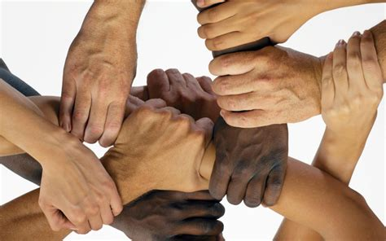
Our Equality Rights
Every individual is equal before and under the law and has the right to the equal protection and equal benefit of the law without discrimination and without discrimination based on race national or ethnic origin, color, religion, sex, age or mental or physical disability.
Subjection does not preclude any law, program or activity that has its object the amelioration of conditions of disadvantaged individuals or groups including those that are disadvantaged because of race, national or ethnic origin, color, religion, sex, age or mental or physical disability.

Slide 4
M. Andrew Vs. Law Society of British Columbia
Mark Andrews was a British subject permanently residing in Canada, he met all requirements for admission to the bar, except he wasn’t a Canadian citizen. Mark was denied access to become a Canadian lawyer, he challenged the law as discrimitory and the supreme court and ruled in Marks favor, which meant he could become a Canadian lawyer.
The Law Society of Canada breached Mark Andrews Equality rights under the Charter of Rights and Freedoms – “15 (1) Every individual has the equal benefit of the law without discrimination”

Slide 5
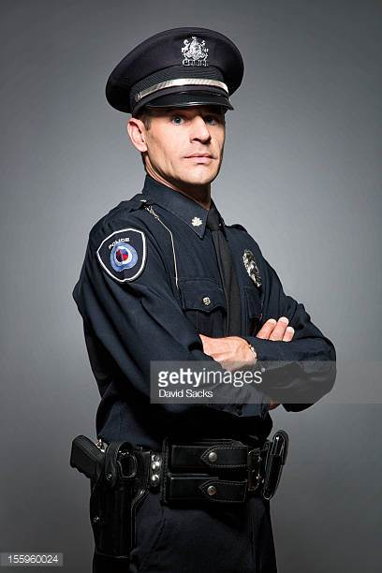
Ex. Breaching Equality Rights
Jonah was enrolled in UBCO Kelowna to get his CPA. It was May long weekend when Jonah decide to go to the mall. When Jonah got to the mall a shooting broke out, everyone ran into different stores to hide and to be safe. When the police showed up they started evacuating everyone out. On the Police officers way out he shouted “don’t save him, he's just a drunk native.” and they walked away, Jonah was now put in danger and had to make his own safe way out.
The Police officer breached Jonah's equality rights as a Canadian under the Charter of Rights and Freedoms . “15. (1) Every individual is equal before and under the law and has the right to the equal protection and equal benefit of the law without discrimination” The Police officer didn’t help Jonah because of his skin color and ethnicity which breached his rights of equal protection.

Slide 6
Bibliography
Pg 117 - Law 12 text

