Slide 1
Caged: Life Inside Canada’s Prisons
Experience OC
2018

Slide 2
The Basics
55 000 incarcerated
Youth and adults
Provincial and federal
Security levels

Slide 9
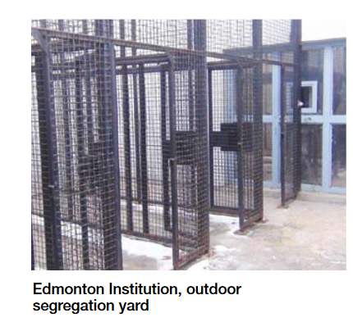

Slide 11
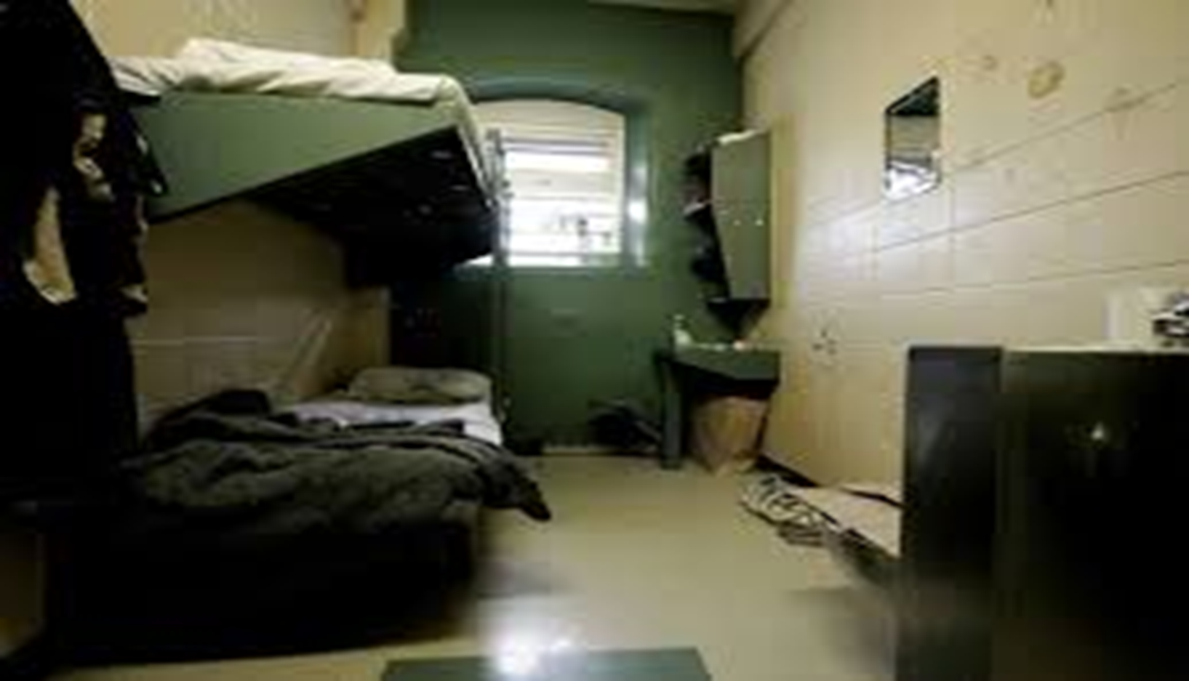

Slide 12
Solitary Confinement – The Hole

Slide 13
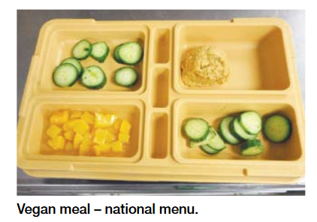

Slide 14
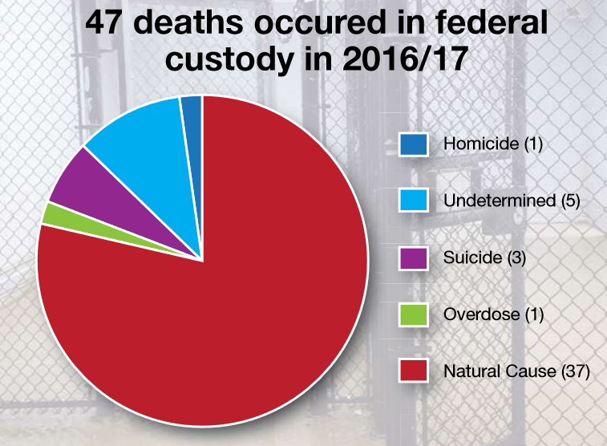

Slide 22
Audio-Visual Equipment
1 - One piece stereo system (100 W total permitted but no condenser microphones, microphones, short wave capability or detachable speakers permitted) | Yes | Yes
1 - Walkman type radio/CD player (non-recording) | Yes | Yes
40 - Audio cassettes, audio CDs or CD-ROM disks (combined) No CD-RW, CD-R-Write, MP3 Players, IPODS, DVD or “burned” permitted (exception: PBC digital recordings on CD) | Yes | Yes
10 - Video game cartridges/discs (as per CD 764) | Yes | Yes
1 - TV converter | Yes | Yes
1 - Cassette/CD cleaner (dry type) | Yes | Yes
1 - Walkman type radio/cassette player (non-recording) | Yes | Yes
2 - Headphones (no wireless and maximum 10’ long) | Yes | Yes
1 - Game system – Game Boy, PlayStation 1, Nintendo or any other game computer (console or hand-held) that does not have data or other communication capability and is available commercially on the market | Yes (CD/DC 764) | Yes (CD/DC 764)
1 - TV with remote control (maximum 16” model only, with headphone jack) | Yes | Yes

Slide 23
Miscellaneous Items
2 - Tupperware type containers (maximum 1 litre (2 X 500 ml), cooking) | Yes | Yes
1 - Footlocker (as per CD 345, or more as permitted by institution) | Yes | Yes
1 - Scissors (blunt ends only and maximum 6” long depending on security level) | No | Yes
1 - Mug (maximum 12 ounces and non-ceramic) | Yes | Yes
7 - Photo albums with pictures | Yes | Yes
1 - Stapler (non-electric) | Yes | Yes
1 - Waist pouch | No | No
Cassette tape holder and/or compact disc holder (maximum capacity of 40) | Yes | Yes
Assorted games and puzzles | Yes | Yes
Assorted books (as per CD 345) | Yes | Yes
8 - Batteries (single or rechargeable and charger) | Yes | Yes
1 - Combination lock (approved CSC type) | No | No
20 - Clothes hangers (plastic only) | No | Yes
1 - Water bottle (maximum 12 ounces) | Yes | Yes
1 - Hand held calculator with no communication capability | Yes | Yes
1 - Geometry set | No | No
1 - Toiletry bag | Yes | Yes
1 - Wallet | No | No
2 - Picture frames (no glass) for tack board or desk top | Yes | Yes
Photographs (no Polaroid) | Yes | Yes
2 - Floor mats/praying mats (18” x 30” maximum and as per CD 345) | Yes | Yes
1 - coaxial cable (10’ maximum) | Yes | Yes

Slide 24
 | Max |  | Med
Jewellery (maximum value of $300 in addition to the $1500)
Bracelet, earrings (small loops or studs), wedding band, analogue watch, neck chain (6 mm maximum and without heavy pendants), low relief decorative ring | Yes |  | Yes
Musical Instruments (one only)
Stringed instrument, wind instrument or keyboard (maximum of 1 meter in length and no amps | Yes |  | Yes
Electrical Items
1 - Electric Razor |  | Yes | Yes
1 - Hair cutting kit |  | Yes | Yes
1 - Clock radio/alarm clock |  | Yes | Yes
1 - Desk fan (plastic only) |  | 6" Max | 12" Max
1 - Power bar (as per CD-345) |  | Yes | Yes
1 - Oral irrigation appliance |  | No | No
1 - Beard/moustache/nose trimmer |  | No | Yes
1 - Hair dryer/blower (hand held, 1600-W maximum) |  | No | Yes
1 - Reading lamp (non-halogen, 60-W maximum, CSA approved, no goose necked or weighted base) |  | No | Yes
1 - Toothbrush (electric) |  | Manual | Yes
1 - Typewriter (electric/manual) |  | Yes | Yes
1 - Clothing shaver |  | No | Yes

