Slide 1
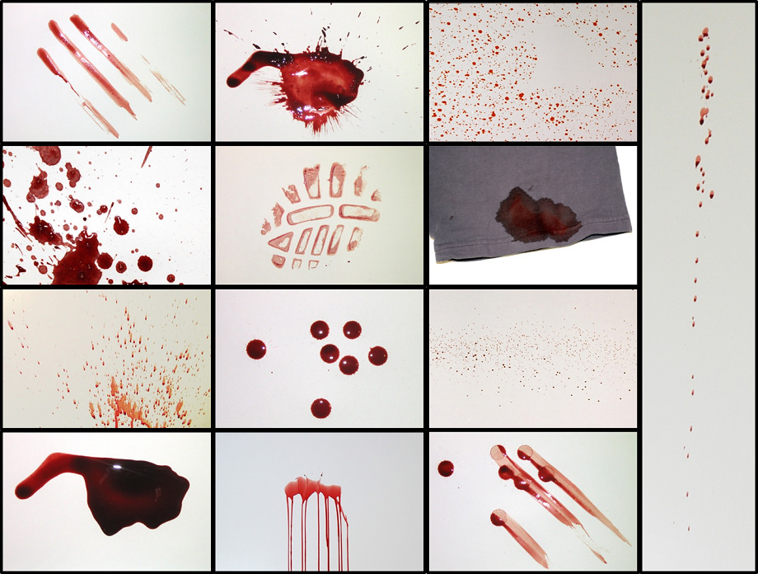

Slide 2
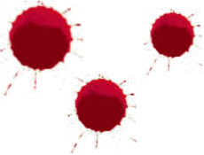
LARGE SPOTS:
Blood was traveling at a low velocity, caused by a low force and likely dropping from an angle right above where it landed

Slide 3
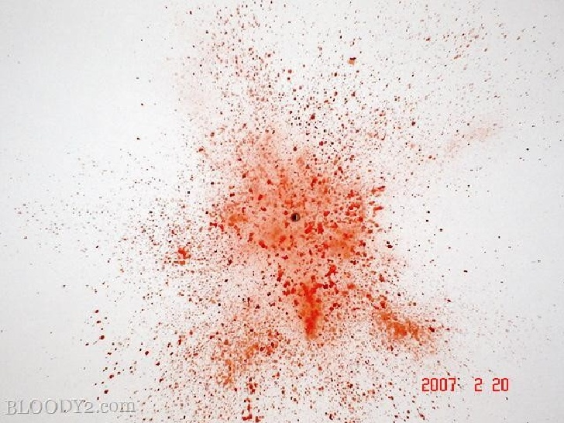
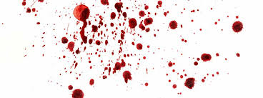
Small Spots
Blood was traveling at a high velocity, caused by a large force

Slide 4
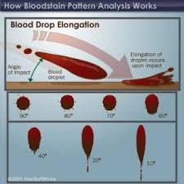
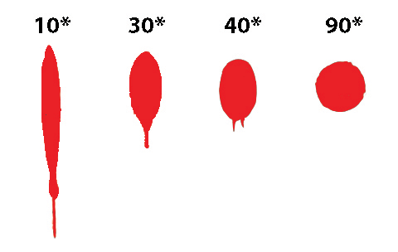
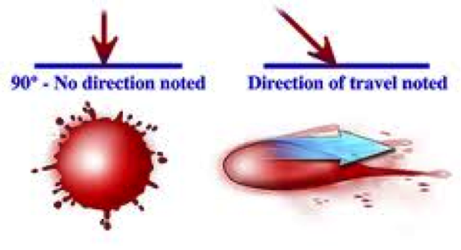
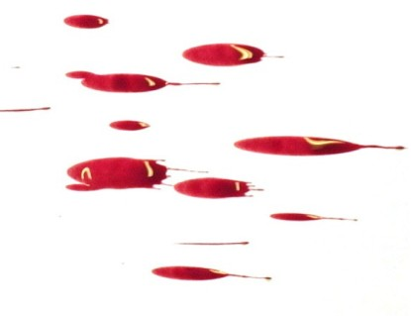
Elongated
Stretched out; can be used to determine if the victim was moving in a certain direction

Slide 5
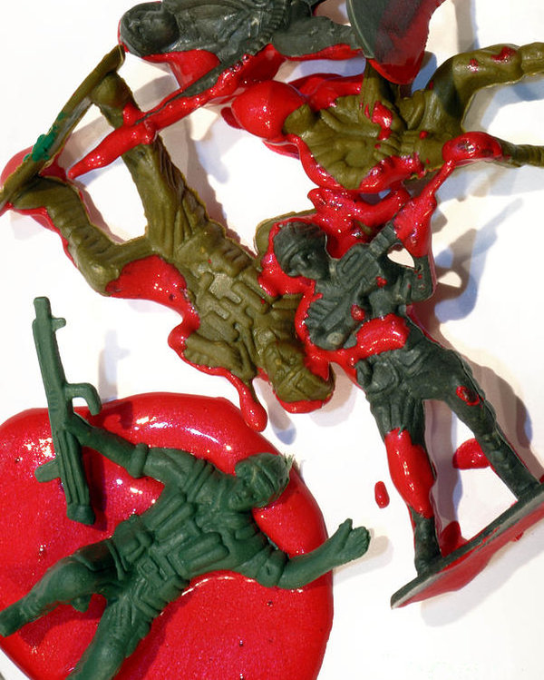
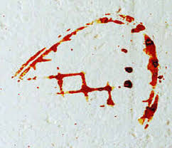
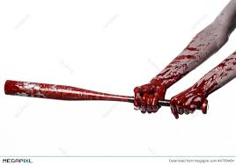
Contact Stains
Stains on a surface due to contact with blood

Slide 6
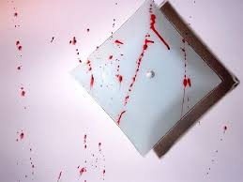
Void
An area where blood is missing because an object has been moved

Slide 7
Cast off:
Straight elongated lines of splatter indicating that blood was thrown off of a moving object. Can often be used to determine number of hits and changes in direction.

