Slide 1
World War Two

Slide 2
‘Food will win the war.’"
Ration books and the promotion of certain ‘patriotic’ foods (like apples and lobsters), victory gardens and home canning were ways the government controlled the Canadian diet
Rationing necessary because of the need to feed Canada’s overseas allies and soldiers.
Canadian food exports provided an essential lifeline to Britain. By the end of the war, it was estimated that Canadian exports accounted 77 per cent of Britain's wheat and flour – as well as 39 per cent of bacon, 15 per cent of eggs, 24 per cent of cheese, and 11 per cent of evaporated milk consumed in Britain.
had to restrict how much food people consumed in order to meet the demands overseas.
Canadian women developed cookbooks to stretch rations and to use food that may otherwise be wasted (ie. gelatin from animal bones etc.).

Slide 3
Rules
Teams of 5-7
You can only use the same player twice
3 points for eating it
2 for eating some of it
1 for licking
0 for a refusal
Most points after 7 foods wins

Slide 4
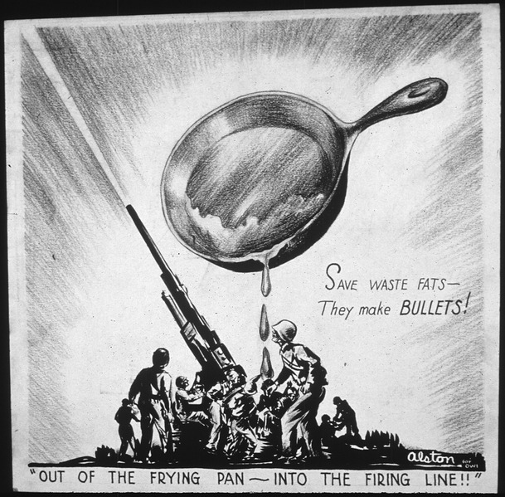
Lard
-Oil was vital in the manufacturing of glycerin.
-First removed from consumer products like gum, antifreeze, shampoo; however there was still was not enough
-Housewives were encouraged to save all meat drippings, bacon fats and water from boiling sausages in exchange for extra rations
-“One tablespoonful of kitchen grease fires five bullets.”
-“One pound of kitchen fats makes enough dynamite to blow up a bridge.”
-Glycerin is a crucial ingredient in the manufacture of explosives such as nitroglycerin,
-Oil was also a lubricant for planes, tanks, in hydraulics, and an ingredient in dyes for uniforms

Slide 5
http://www.youtube.com/watch?v=Z4497GEGOOg
Disney Propaganda video to encourage people to save oil

Slide 6
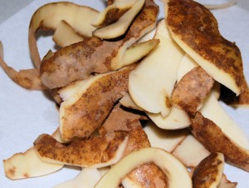
Potato Peels
-Taken from garbages by people
in Russia, Holland and Poland as
a way for starving people to survive
-Potatoes are nutrient dense and have most of the vitamins that people need to survive

Slide 7
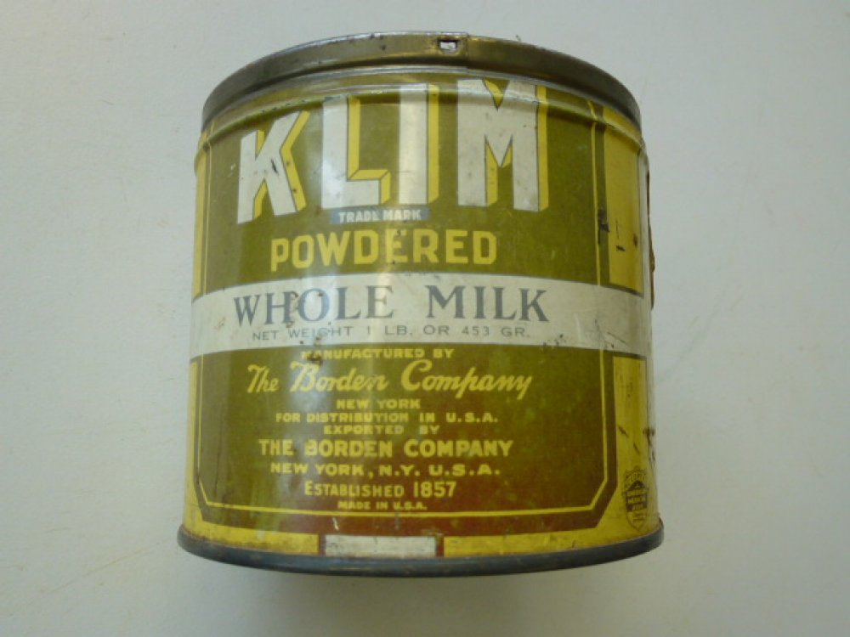
Powdered Milk
-Many dairy herds slaughtered to create more space to grow food, which led to the need for dried milk as fresh milk was rationed
-To help people cook with it, there were leaflets, books, posters and radio broadcasts.

Slide 8
MYSTERY #1

Slide 9
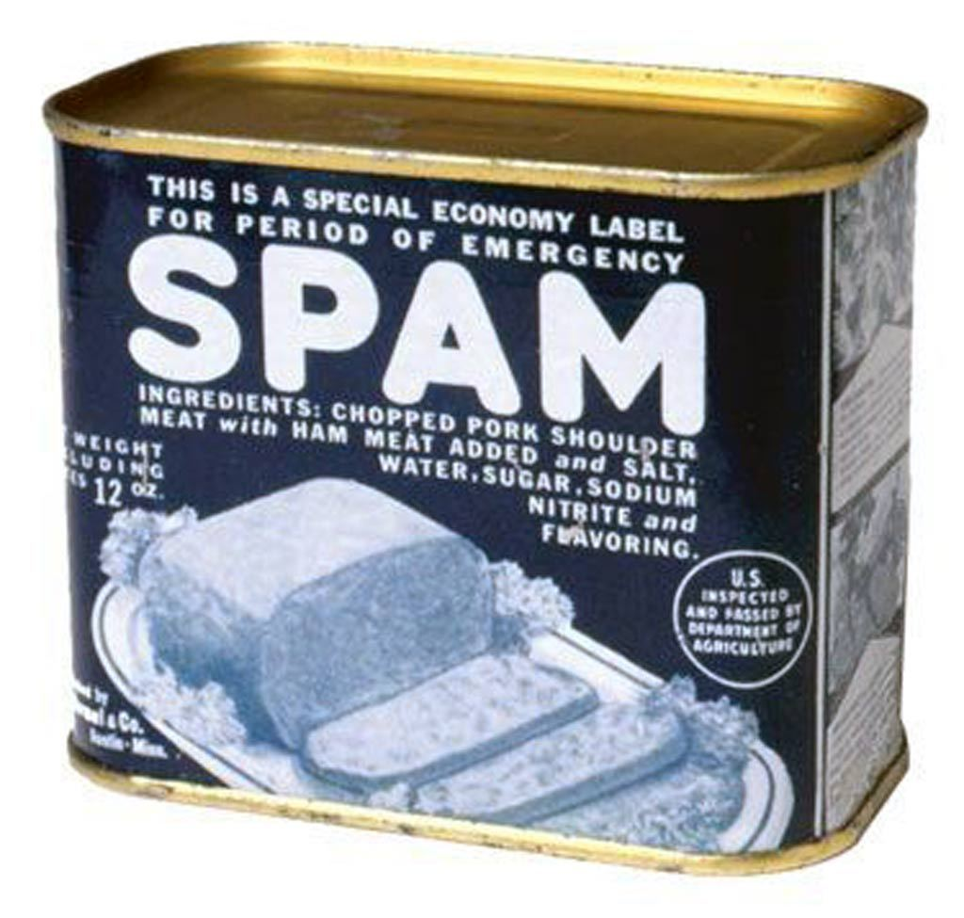
Spam
Spiced Ham, or SPAM was created in a 1937 as an inexpensive luncheon meat to help housewives stretch their budget dollars
100 million pounds exported to allied troops during the war. Staple ration for the army.
“Without Spam, we wouldn’t have been able to feed our army.”
7 billion cans sold by 2007

Slide 10
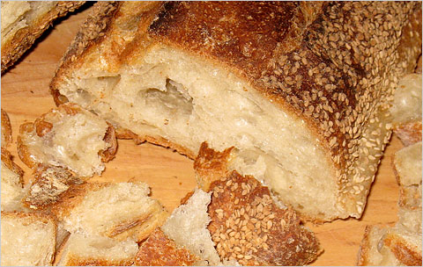
Stale Bread
Encouraged to use everything
“Waste not, want not”
Entire recipe books developed to use stale bread (bread pudding, casseroles etc.)

Slide 11
MYSTERY #2

Slide 12
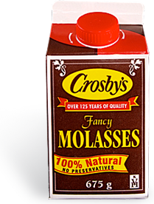
Molasses
Sugar was the first food to be rationed; molasses became a substitute
Sugar was used in the manufacturing of shells and bombs making it vital to the war effort.
Later Molasses was rationed because it was used in the production of synthetic rubber
Lunch for many schoolchildren would consist of a molasses sandwich and molasses cookies

Slide 13
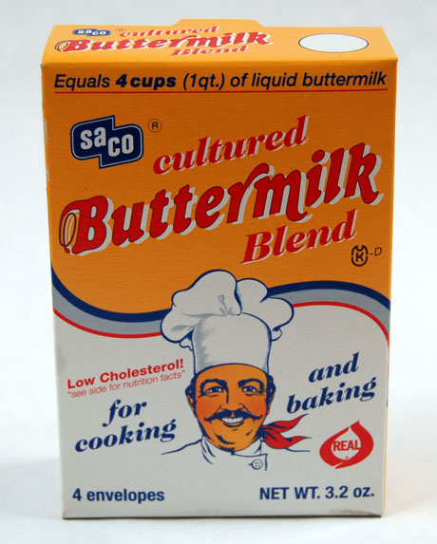
Buttermilk
Buttermilk is the low-fat milk left over after butter is churned from cream.
lasts longer than regular milk.
Added flavor to recipes

