Slide 1
CIVIL LAW

Slide 2
Why Sue?
Money (Damages)
Justice
Injunction (Court Order)

Slide 3
Who are the parties?
Litigants
Plaintiff (Person suing)
Defendant (People being sued)
Third Parties (People being sued by the defendant)

Slide 4
How do you sue?
Writ of Summons
Statement of Claim with remedy (relief sought by plaintiff)
Served on Defendant

Slide 5
Balance of Probabilities
The weighing of evidence to decide whether the plaintiff’s or the defendant’s version of events is more convincing or likely to be correct.
different from criminal law where the state must convince the judge beyond a reasonable doubt.

Slide 6
How do you defend?
Statement of Defence
Counterclaim
Third Party Claim

Slide 7
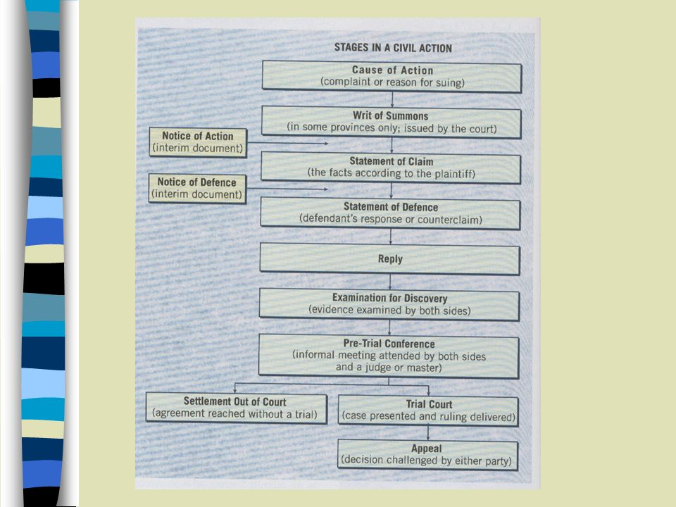

Slide 8
Why can you sue?
Breach of Contract
Tort - harm caused to a person or property for which the law provides a civil remedy
Equitable Remedy (forced action instead of fine)
Statutory Standing (e.g. Family Law)

Slide 9
Torts
Tort: Harm caused to a person or property for which the law provides a civil remedy
you can be deemed liable - legally responsible for a wrongful action

Slide 10
Torts
Two Types:
Unintentional Torts - injuries caused by accident or an action not intended to cause harm (negligence)
Intentional Torts - actions intended to cause injury with others

Slide 11
Intentional Torts (pp. 441-466)
Assault
Battery
False Imprisonment
Malicious Prosecution
Intentional Infliction of Nervous Shock
Invasion of Privacy

Slide 12
Intentional Torts
Trespass to Land
Nuisance
Trespass to Chattels
Conversion

Slide 13
Defamation of Character
Inuring a person’s reputation or good name
Slander - verbal
Libel - Written

Slide 14
Alternative Dispute Resolution
Settling out of Court:
Negotiation: between the 2 parties, no third party is required
Mediation: a third party is there to bring the opposing parties to an agreement. This isnt always voluntary. This is often quicker, cheaper and more private than the courts.
Arbitration: a neutral third party hears both sides of the dispute and makes a binding decision. Usually is quicker and cheaper than court and is a compromise rather than a win-lose as in court.

