Slide 1
1961
Sophie Biollo

Slide 2
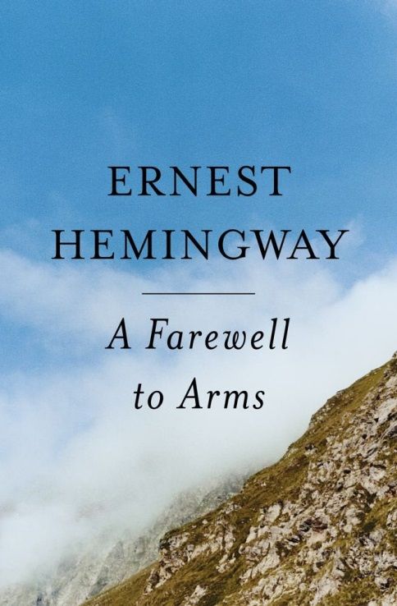
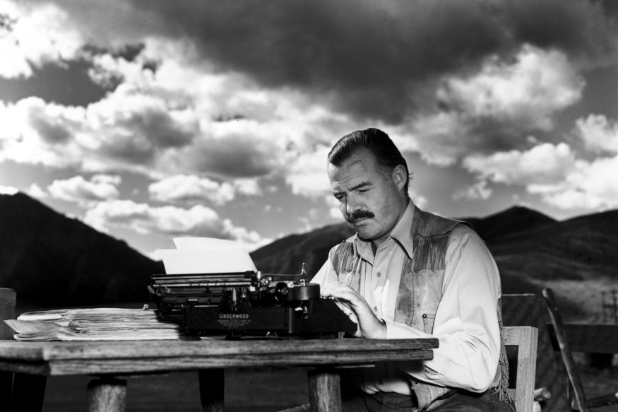
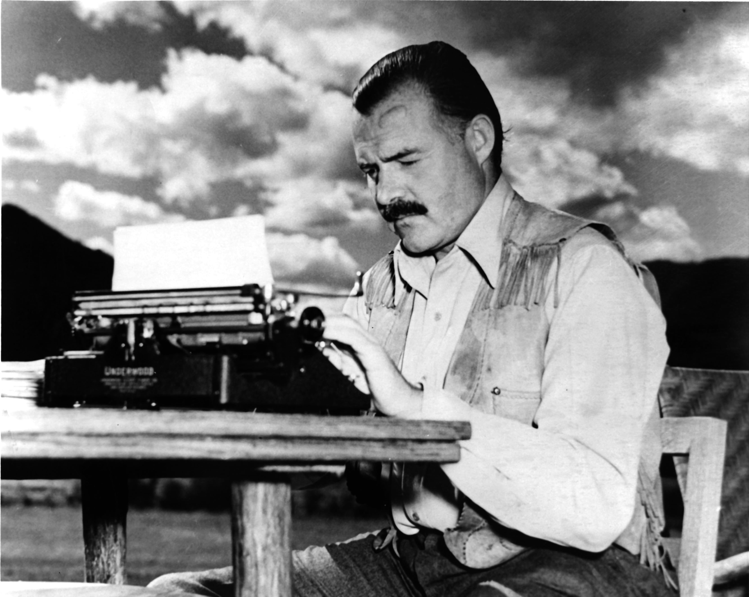
Ernest Hemingway
Ernest Hemingway committed suicide on July 2, 1961. He was an author from America and is known for his classic literature. Hemingway was awarded a Nobel prize for literature in 1954.
The style in which he wrote his book provided inspiration towards fiction novels of the twentieth century. His image to the public and adventurous decisions impacted future generations.
This is Social history.

Slide 3
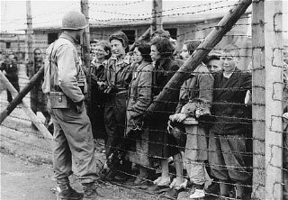
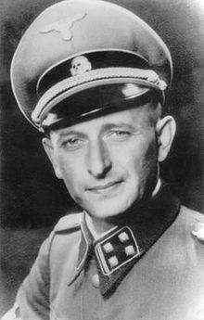
Eichmann
Eichmann was captured by the Israeli intelligence agency and put on trial in 1961. He was lieutenant colonel in the German army and made an outline of a Jewish reservation farther east or in another country but it never happened.
Eichmann was a important person in military history with coordinating of the holocaust, as well as implementing the movement of Jewish people to extermination camps in WW2.

Slide 4
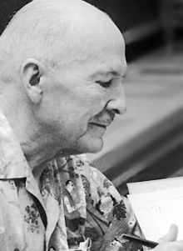
Stranger in a Strange Land
This is a book published in 1961 by Robert A. Heinlein is about a Martian adjusting to the different kind of life on earth. The main character realizes the power of religion and autonomy.
It is important to the social history because it is a benchmark in the history science fiction and is credited with being “The most famous science fiction novel ever written”.

Slide 5
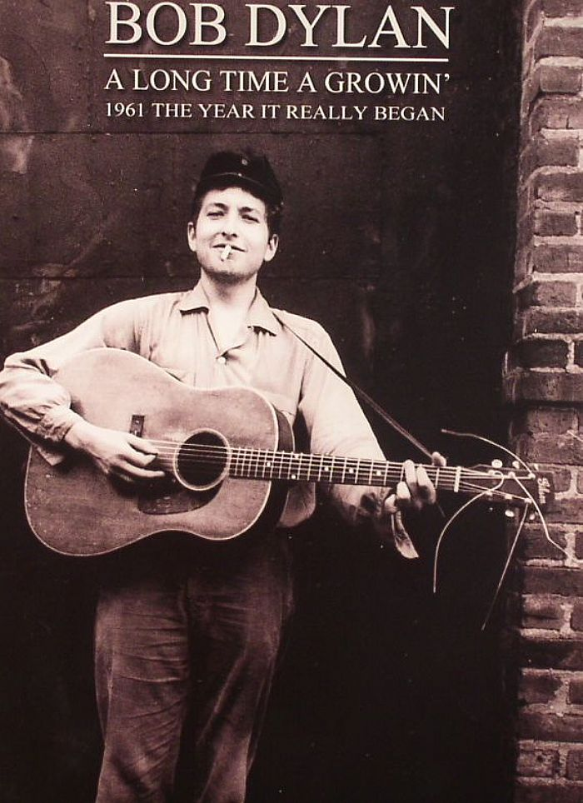
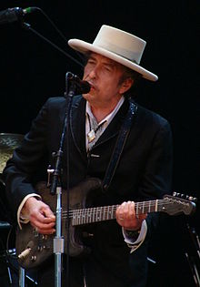
Bob Dylan
Bob Dylan is a famous popular singer from America. The songs he wrote expressed his beliefs about freedom and peace. He started to receive credit for his music in 1961 while performing in clubs and making friends with folk singers.
He is a part of social history because of his expressive beliefs of American culture through music. His songs spoke for many people in his generation and can be looked at to see the feelings of people during the 60’s.

Slide 6
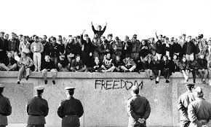
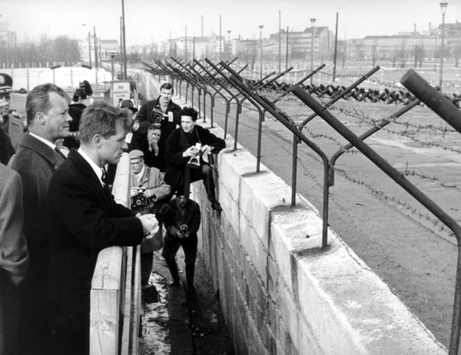
Berlin
In 1961 the crisis of Berlin caused the wall to be built separating east Berlin from the west. This was a very controversial time as people were no longer able to move over the border.
This is political, social, governmental, economic and military history. It upset the people and caused an uproar because the government would not allow you to go over or you could be shot ,it cost lot to build/ guard.

